Slide 1
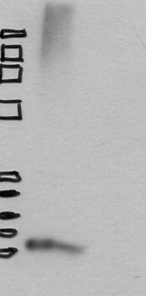
-- SDF-1
FBS -
0% FBS -
10% FBS -
Supplemental 5 - DeCastro 2014
Notes:
Supplemental Figure 5| SDF-1 protein expression in FBS:
Western immunoblot against stromal derived factor 1 (SDF1) of protein lysates harvested from fetal bovine serum, DMEM supplemented with 10% FBS and DMEM media without FBS.

