Slide 1
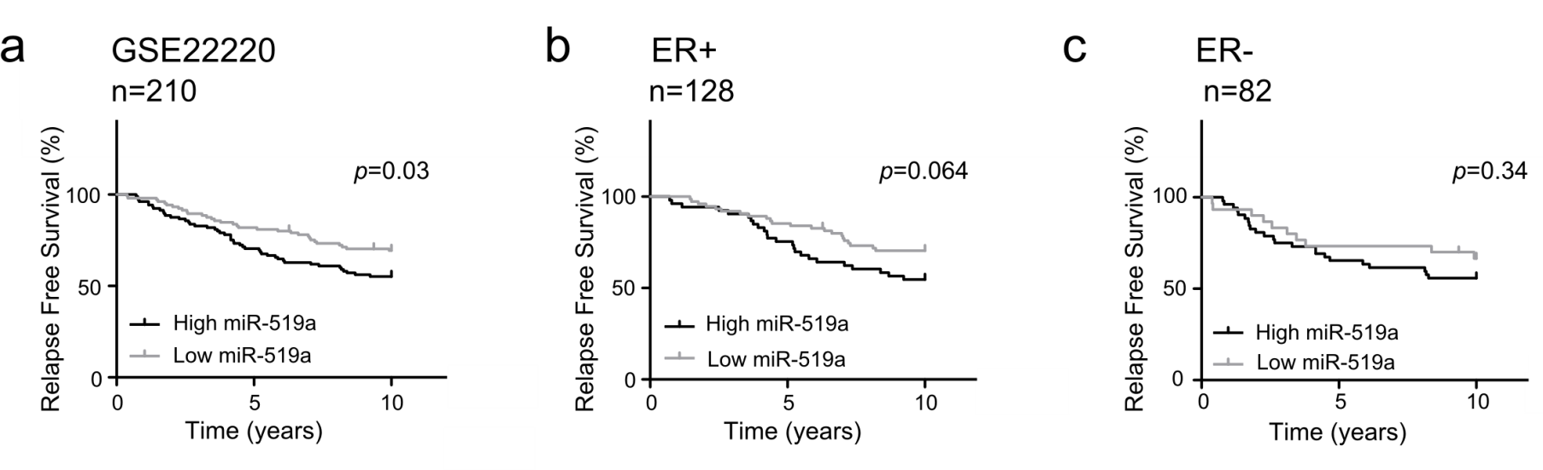
Figure S7: Increased expression of miRNA-519a is significantly correlated with higher risk of relapse in breast cancer patients. Patients were separated according to miRNA-519a expression (median cut off) in a cohort of breast cancer patients [22] and miRNA-519a expression significantly correlated with survival

