Slide 1
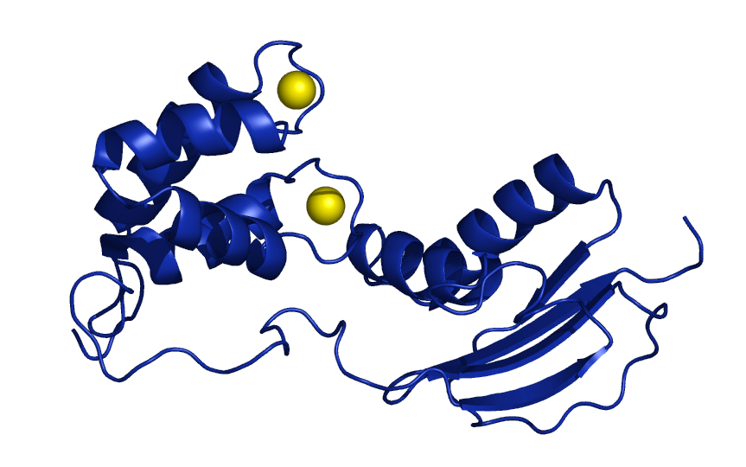
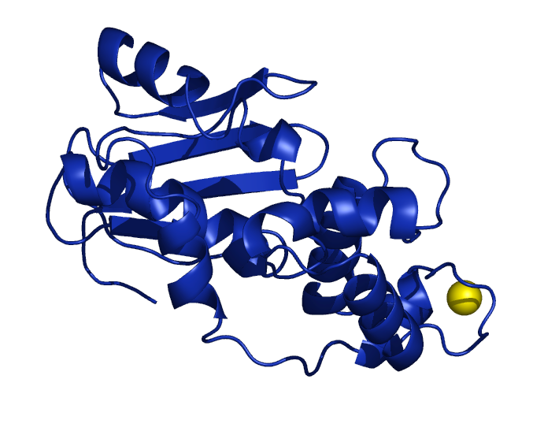
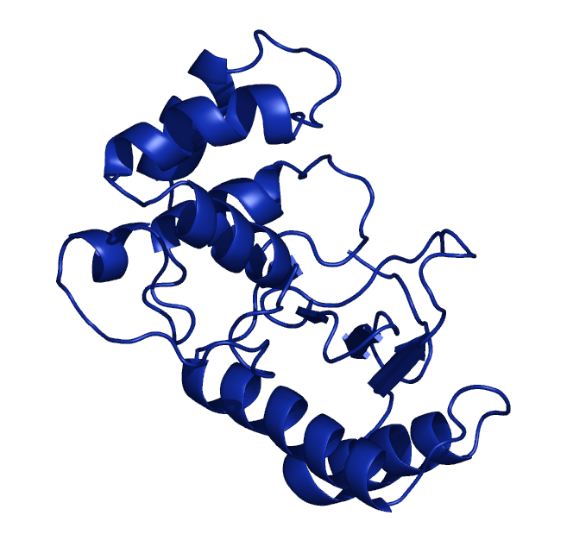
C
SmTAL1
N
SmTAL2
C
N
C
N
SmTAL3
Supplementary Figure S1: Molecular models of the SmTAL proteins. SmTAL2 and SmTAL3 were aligned to the EF-hand domain of SmTAL1 (residues 1-72). The yellow spheres represent calcium ions. Note, the linker regions are likely to be unstructured and flexible meaning that the orientation of the domains may vary.

