Slide 1
Supplementary Figure 1
Title : Synergistic interactions between CFZ and ACY1215 lead to induction of apoptosis in a time-dependent manner
A
SUDHL16
B
Granta 519
C
OCI-LY18
*
*
*
*
*
*
*
D
E
F
SUDHL4
U2932
OCI-LY7
*
*
*
*
*
*
Legend : (A) SUDHL16 cells were treated with CFZ 2.5 nM ± ACY1215-1.5µM (B) Granta 519 cells were treated with CFZ 3.5 nM ± ACY-2.0µM (C) OCI-LY18 cells were treated with CFZ 3.0 nM ± ACY1215-1.5µM (D) SUDHL4 cells were treated with CFZ 3.5 nM ± ACY1215-2.0µM (E) U2932 cells were treated with CFZ 3.5 nM ± ACY1215-2.0µM (F) OCI-LY7 cells were treated with CFZ 3.5 nM ± ACY1215-2.0µM for varying intervals, after which cell death was monitored by flow cytometry and 7-AAD staining. * = significantly greater than values obtained for CFZ plus ACY1215 treatment vs single drug ; P < 0.02.

Slide 2
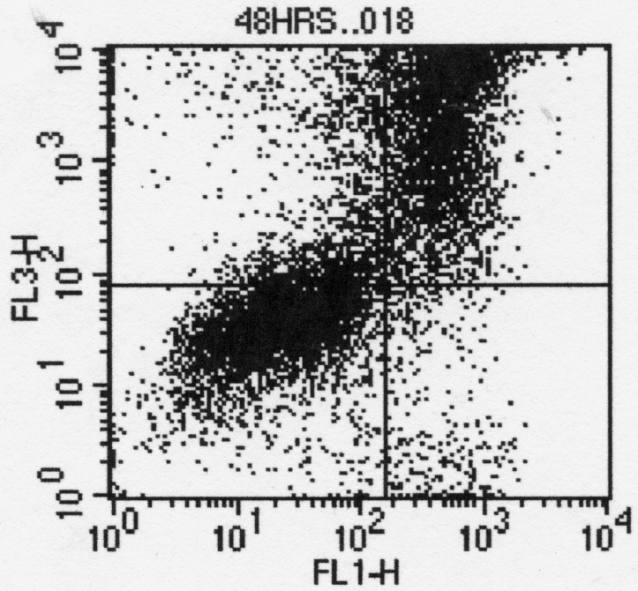
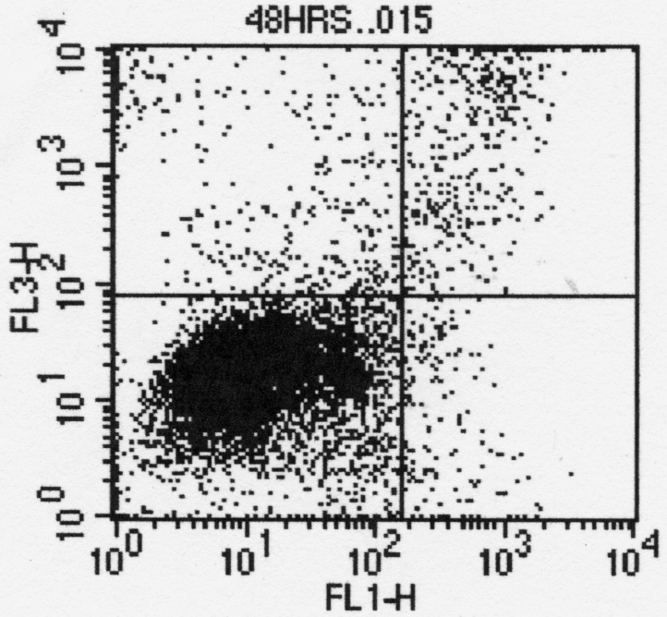
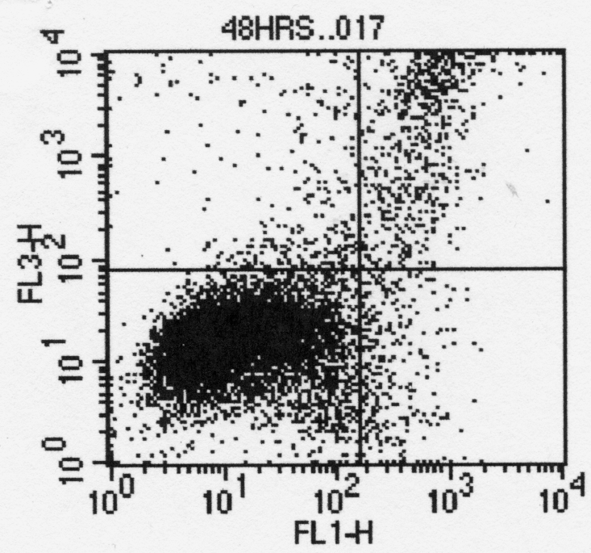

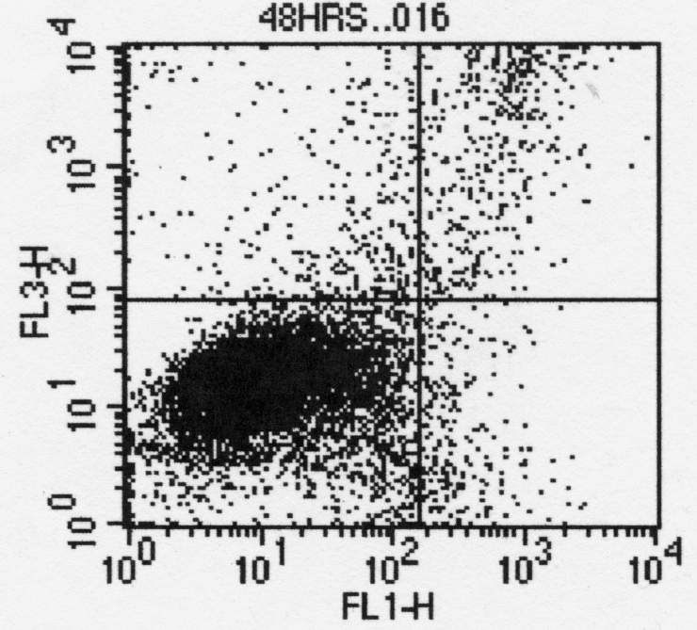
Supplementary Figure 2
Title : Knocking down HDAC6 expression by shRNA or pharmacologic inhibition by ACY1215 or Tubastatin A potentiates proteasome inhibitor lethality.
SUDHL4
SUDHL4
Cont
MG132
A
scramble
shHDAC 6
B
C
4.0
5.0
5.0
4.3
HDAC6
*
*
*
2.2
2.6
*
*
*
*
3.3
6.7
14.9
50.5
3.0
4.5
ACY1215
MG132+ACY1215
7AAD staining
ANN/PI staining
Legend : (A) SUDHL4 cells were transiently transfected with shHDAC6 or scrambled sequence construct as described in Methods and exposed to 2.5 nM CFZ for 36h. after which cell death was monitored by flow cytometry with 7AAD staining. (B) Cells were exposed to CFZ (SUDHL16-2.5 nM, SUDHL4-3.0nM and OCI-LY7-3.5nM) or MG132 (SUDHL16-100nM, SUDHL4-250nM and OCI-LY7-300nM) ± Tubastatin-A (SUDHL16-4.0 µM, SUDHL4-6.0 µM and OCI-LY7-7.5 µM) for 48h, after which cell death was monitored by 7AAD staining. (C ) SUDHL4 cells were treated with MG132 (250 nM) ± ACY1215(2.0 µM) for 48h, after which apoptotic cells were monitored by flow cytometry with annexin V/PI staining. A, * = significantly greater than values obtained for CFZ treatment vs controls; P < 0.04., B, * = significantly greater than values obtained for single drug treatment; P < 0.02.

Slide 3





Supplementary Figure 3
Title : Combined CFZ/ACY1215 exposure activates stress pathways and increases DNA damage in SUDHL16 cell.
SUDHL16
CFZ+ ACY1215
Cont
ACY 1215
CFZ
PARP
CF Caspase 3
p-JNK
p-p38
AC-Tub
γH2A.X
Tubulin
Legend : SUDHL16 cells were treated (14h) with CFZ (2.5 nM) ± ACY (1.5 µM). Protein expression was determined by Western blotting using indicated antibodies. Results are representative of three independent experiments. CF- cleaved fragment

Slide 4











Supplementary Figure 4
Title : Pre-treatment of cells with pan-caspase inhibitor BOC does not protect JNK activation, induction of DNA damage and inactivation of ERK
SUDHL4
U2932
C
SUDHL16
A
B
CFZ+ ACY1215
BOC+CFZ +ACY1215
CFZ+ ACY1215
CFZ+ ACY1215
BOC+CFZ +ACY1215
BOC
BOC+CFZ +ACY1215
BOC
Cont
Cont
BOC
Cont
CF caspase 3
p-JNK
p-p44/42
γH2A.X
Tubulin
Legend : (A-B) SUDHL4 and U2932 cells were pre-treated with 10µM BOC-fmk for 3h followed by combined exposure of ACY1215 (2.0µM)/CFZ (3.0nM) for 24h. (C) SUDHL16 cells were pre-treated with 5µM BOC-fmk for 3h followed by combined exposure of ACY1215 (1.5µM)/CFZ (2.5nM) for 14h. Protein expression was determined by Western blotting using indicated antibodies. Results are representative of three independent experiments.

Slide 5





Supplementary Figure 5
Title : Knocking down HDAC6 expression by shRNA recapitulate signaling events when treated with ACY1215 alone similar to combined treatment of CFZ+ ACY1215 to untransfected cells
scramble
shHDAC6
CFZ
Cont
CFZ
Cont
p-JNK
JNK
p-p38
p38
p-p44/42
p44/42
Tubulin
Legend : SUDHL4 cells were transiently transfected with shHDAC6 or scrambled sequence construct as described in Methods and exposed to 3.0 nM CFZ for 20h. Protein expression was determined by Western blotting using indicated antibodies. Results are representative of three independent experiments.

Slide 6




Supplementary Figure 6
Title : CFZ and ACY1215 interact synergistically in bortezomib-resistant DLBCL and MCL cells
A
SUDHL16-10BR
B
*
*
CFZ + ACY1215
*
Cont
ACY1215
CFZ
PARP
CF caspase3
p-JNK
p-p38
γH2A.X
Tubulin
Legend : (A) Bortezomib-resistant SUDHL16-10BR, OCI-LY7-40BR, or Granta-25BR cells were treated with minimally toxic concentrations of CFZ and ACY1215 alone or in combination. Concentrations were as follows: SUDHL16-10BR - CFZ (5 nM) ± ACY1215(1.5 µM), OCI-LY7-40BR - CFZ (15 nM) ± ACY1215 (2.0 µM), Granta – 25BR - CFZ (12 nM) ± ACY1215 (2.0µM). Cell death was monitored after 48h drug exposure by flow cytometry with 7AAD staining. (B) SUDHL16-10BR cells were exposed (24h) to CFZ and ACY1215 as in (A), after which Western blot analysis was performed with the indicated antibodies. * = significantly greater than values obtained for CFZ or ACY1215 treatment alone; P < 0.02.

Slide 7
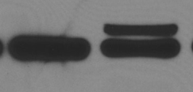
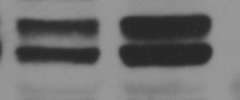



Supplementary Figure 7
Title : Constitutive MEK/ERK phosphorylation does not protect SUDHL4 cells from the ACY1215+CFZ regimen
SUDHL4 - MEK1 - CA
SUDHL4-NC
MEK1
SUDHL4–MEK1-CA
SUDHL4-NC
A
p-ERK
B
CFZ + ACY1215
CFZ + ACY1215
Cont
Cont
p-p44/42
Tubulin
Legend : (A) SUDHL4 cells were transiently transfected with MEK1-CA or empty vector constructs for 24h and then exposed (48h) to CFZ (3.0 nM) + ACY1215 (2.0 µM). Cell death determined by flow cytometry with 7AAD staining. Inset: Expression of MEK1/p-ERK cells transfected with NC (scramble) to MEK1-CA cDNA construct. (B) SUDHL4 cells were transfected and treated as described in (A) above for 24h and expression of the indicated proteins was monitored by Western blotting.

Slide 8



Supplementary Figure 8
Title : Knocking down of Histone1.2 circumvent the lethality of ACY1215+CFZ drug regimen in U2932 cells.
U2932-scram
U2932 - shH1.2
A
Histone 1.2
U2932-scram
U2932-shH1.2
Tubulin
B
CFZ + ACY1215
CFZ + ACY1215
Cont
Cont
*
PARP
CF caspase3
Tubulin
Legend : (A) U2932 cells were transiently transfected with Histone 1.2 cDNA construct or empty vector (scramble) constructs for 24h and then exposed (48h) to CFZ (3.0nM) + ACY1215 (2.0 µM). Cell death determined by flow cytometry with 7AAD staining. Inset: Expression of Histone1.2 cells transfected with NC (scramble) and shH1.2 cDNA construct. (B) U2932 cells were transfected and treated as described in (A) above for 24h and expression of the indicated proteins was monitored by Western blotting.

Slide 9
Supplementary Table 1
Title : Addition of ACY1215 to CFZ does not enhance inhibition of chymotryptic activity in DLBCL cells.
Treatment | Chymotryptic-like proteasome activity
 | SUDHL16 | % inhibition | OCI-LY7 | % inhibition
control | 301 ±1.9 | - | 235 ± 2.2 | -
CFZ | 60 ± 1.6 | 80 | 38 ± 0.6 | 84
ACY1215 | 283 ± 1.7 | 6 | 226 ± 1.2 | 4
CFZ + ACY1215 | 57 ± 1.1 | 81 | 37 ± 1.7 | 84
Legend : SUDHL16 and OCI-LY7 cells were exposed to CFZ (SUDHL16-2.5 nM, OCI-LY7-3.5 nM) ± ACY1215 (SUDHL16-1.5 µM, OCI-LY7- 2.0 µM) for 4h and chymotryptic activity was monitored as described in Methods.

Slide 10
Supplementary Table 2
Title : Combined ACY1215t/CFZ exposure leads to G2M arrest of DLBCL cells.
Cell cycle (phase) | Control | CFZ | ACY1215 | CFZ + ACY1215 | TBAP | TBAP+CFZ+ACY1215
SUDHL4
G₀G₁ | 45.9 ± 3.8 | 30.9 ± 0.9 | 65.8 ± 1.6 | 16.2 ± 3.0 | 43.8 ± 1.9 | 40.2 ± 1.3
G₂M | 15.1± 1.6 | 28.2 ± 1.4 | 15.4 ± 1.2 | 68.2 ± 4.9 ** | 18.2± 2.1 | 21.2 ± 3.1
S | 35.4± 2.8 | 40.4 ± 1.6 | 16.7 ± 1.3 | 15.6 ± 1.2 | 37.1 ± 3.7 | 36.2 ± 2.8
OCI-LY7
G₀G₁ | 30.7 ± 1.7 | 23.4 ± 1.6 | 38.4 ± 3.1 | 14.9 ± 1.5 | 33.1 ± 2.4 | 29.5 ± 3.6
G₂M | 12.5 ± 1.5 | 21.8 ± 2.2 | 15.1 ± 1.7 | 50.2 ± 1.4 ** | 16.1 ± 2.1 | 23.7 ± 3.9
S | 53.5 ± 4.5 | 54.7 ± 0.7 | 46.4 ± 3.5 | 34.4 ± 1.1 | 50.1 ± 1.7 | 46.6 ± 3.8
Legend : SUDHL4 and OCI-LY7 cells were treated with CFZ (3.5 nM) and/or ACY1215 (2.0 µM) for 24h. After treatment, cells were collected, fixed in ice cold methanol at a ratio of 1 mL PBS to 3 mL methanol, and the cell cycle distribution was analyzed by flow cytometry as described in Methods. ** = significantly greater than values obtained for CFZ or ACY1215- treatment alone P < 0.05.

