Slide 1
HE
EVG
100 μm
Mφ
SMC
100 μm
100 μm
Fig.10B

Slide 2
HE
EVG
100 μm
Mφ
SMC
100 μm
100 μm
Fig.10C

Slide 3
HE
EVG
100 μm
Mφ
SMC
100 μm
100 μm
Fig.10D

Slide 4
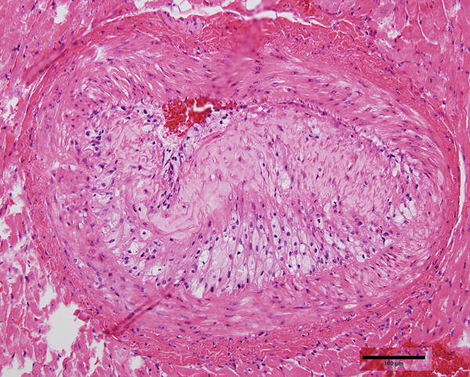
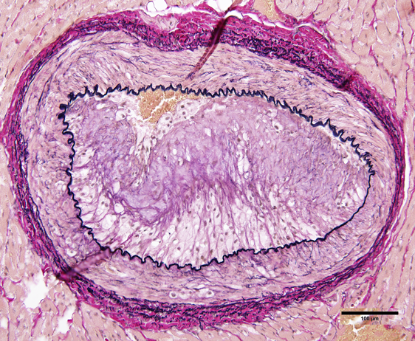
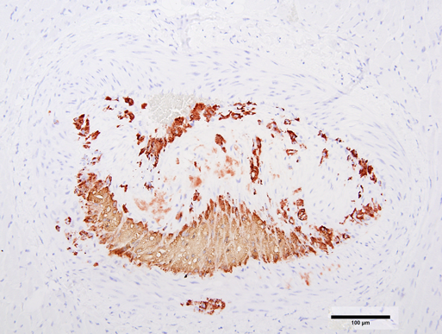
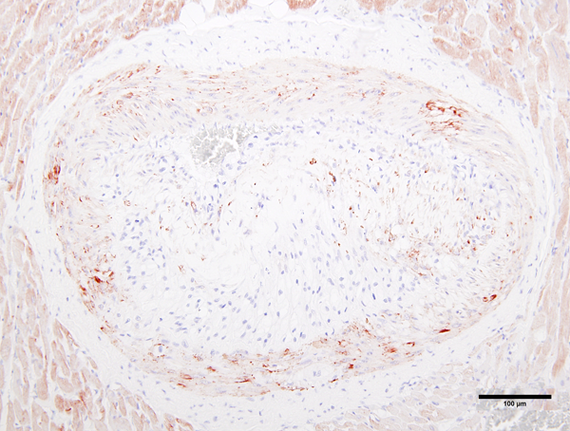
HE
EVG
Mφ
SMC
Fig.11A

Slide 5
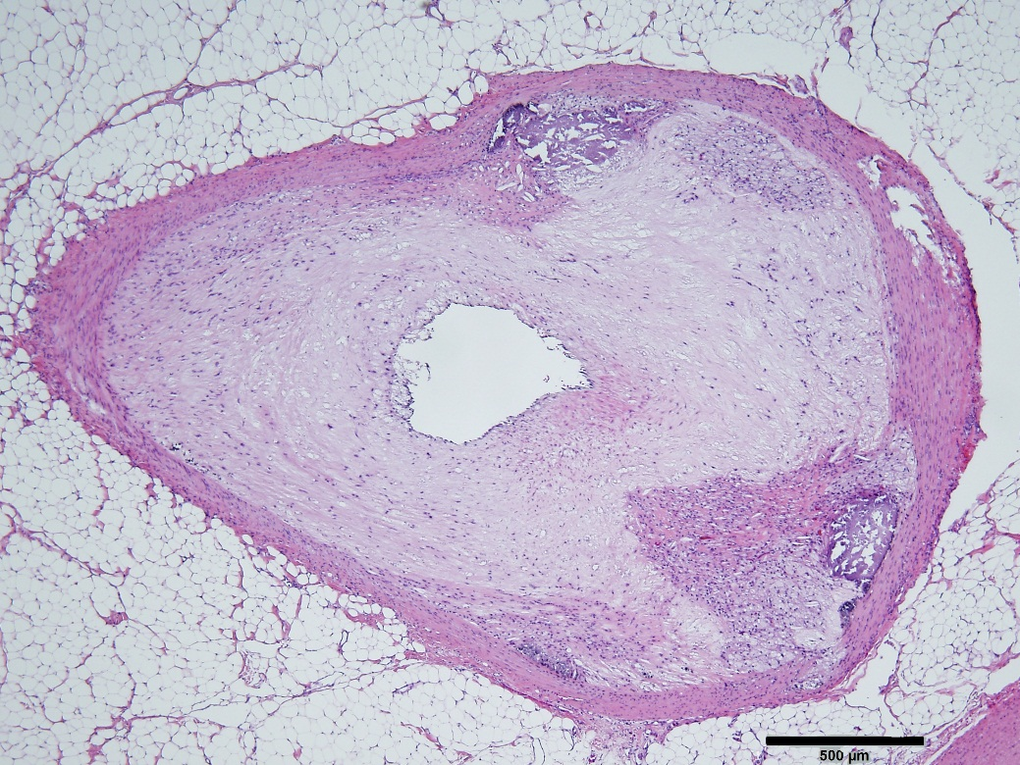
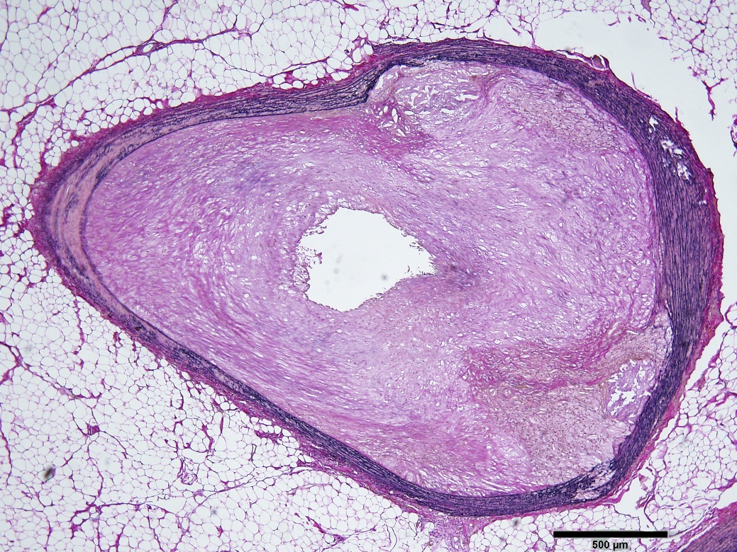
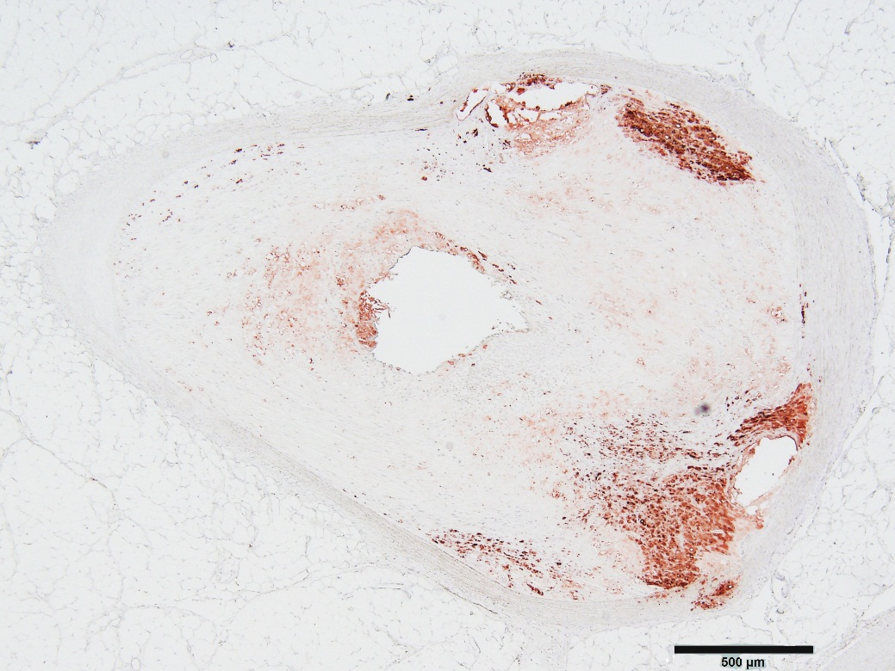
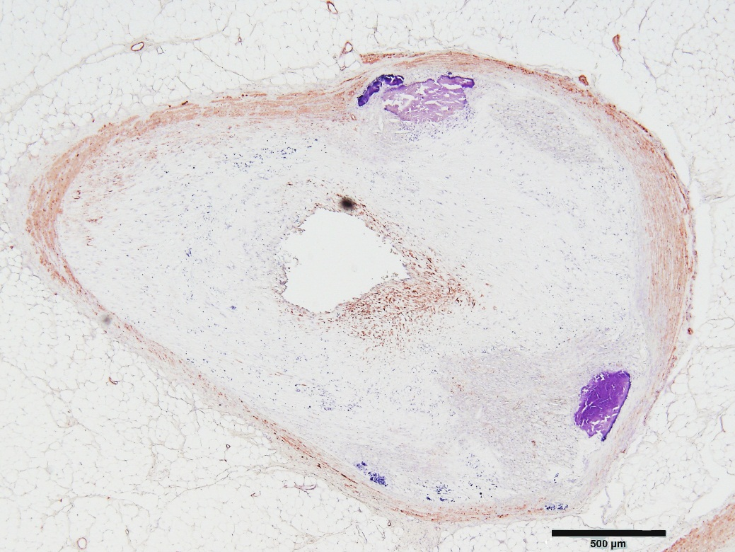
HE
EVG
Mφ
SMC
Fig.11B

Slide 6
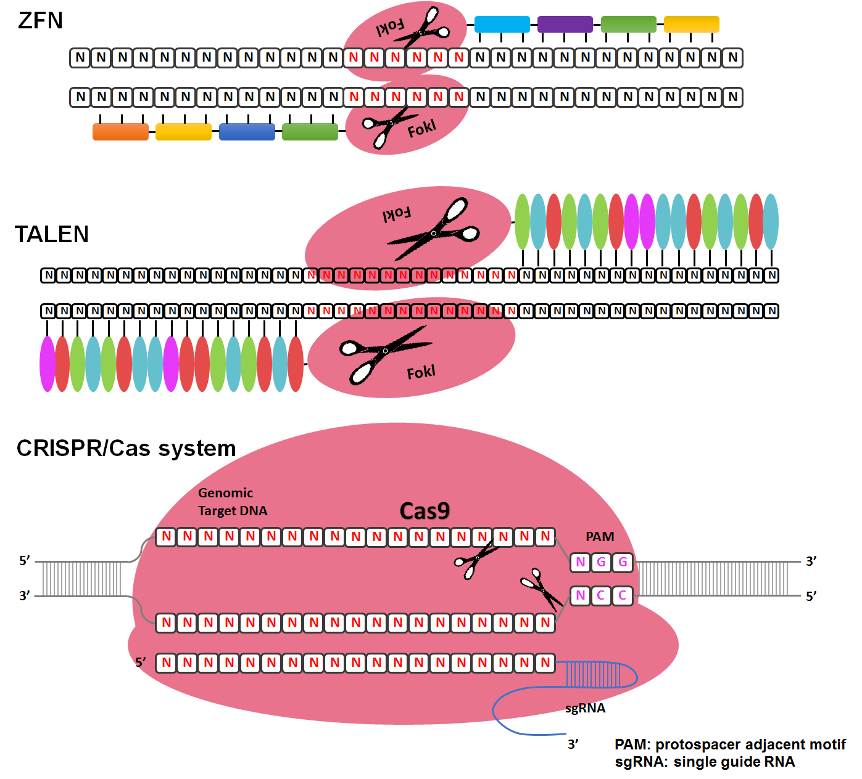
Fig. 12

