Slide 1
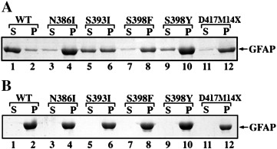
Fig. 1 Expression, purification and electrophoretic analysis of WT and mutant GFAPs. (A) Purified recombinant GFAP was analyzed by 12% (w/v) SDS-PAGE and visualized by silver staining. Lane 1, WT GFAP; lane 2, N386I GFAP; lane 3, S393I GFAP; lane 4, S398F ...
Yi-Song Chen , Suh-Ciuan Lim , Mei-Hsuan Chen , Roy A. Quinlan , Ming-Der Perng
Alexander disease causing mutations in the C-terminal domain of GFAP are deleterious both to assembly and network formation with the potential to both activate caspase 3 and decrease cell viability
Experimental Cell Research, Volume 317, Issue 16, 2011, 2252 - 2266
http://dx.doi.org/10.1016/j.yexcr.2011.06.017

