Slide 1
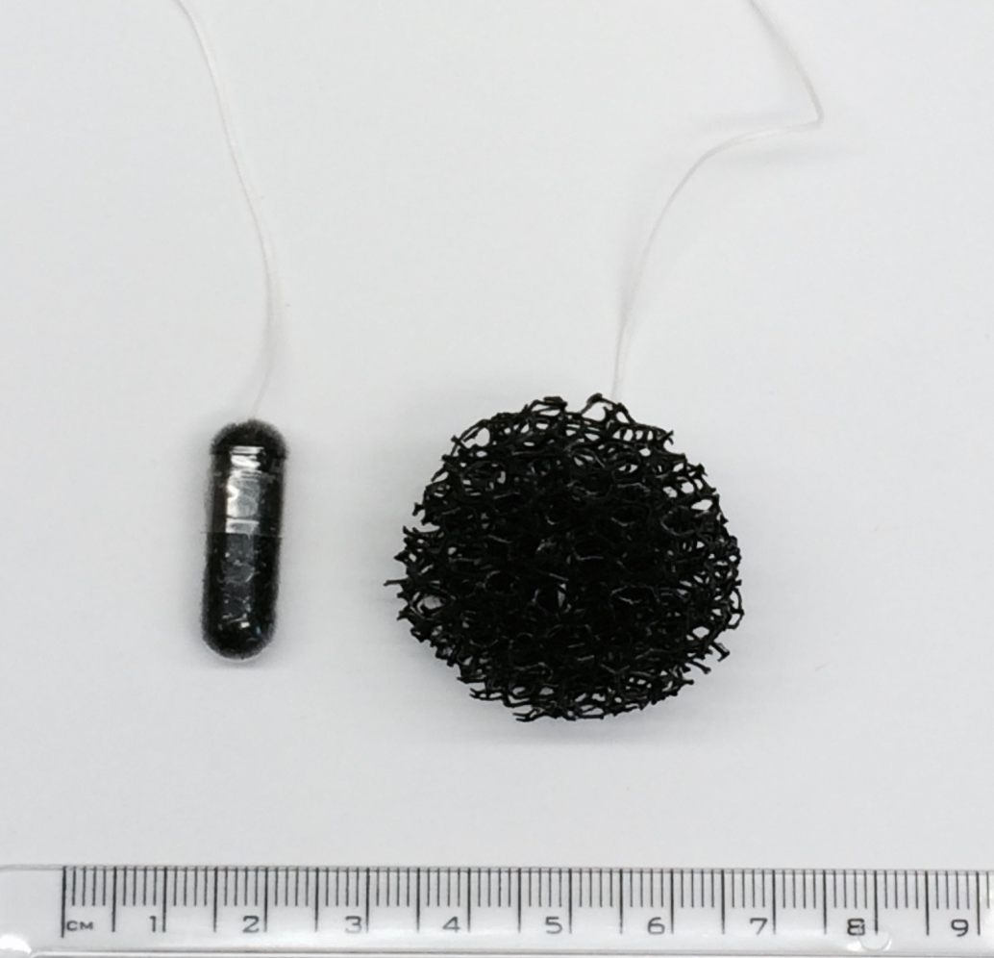
Figure S1: Cytosponge in the capsule before ingestion, as well as after the capsule has dissolved and the Cytosponge has been released.

