Slide 1
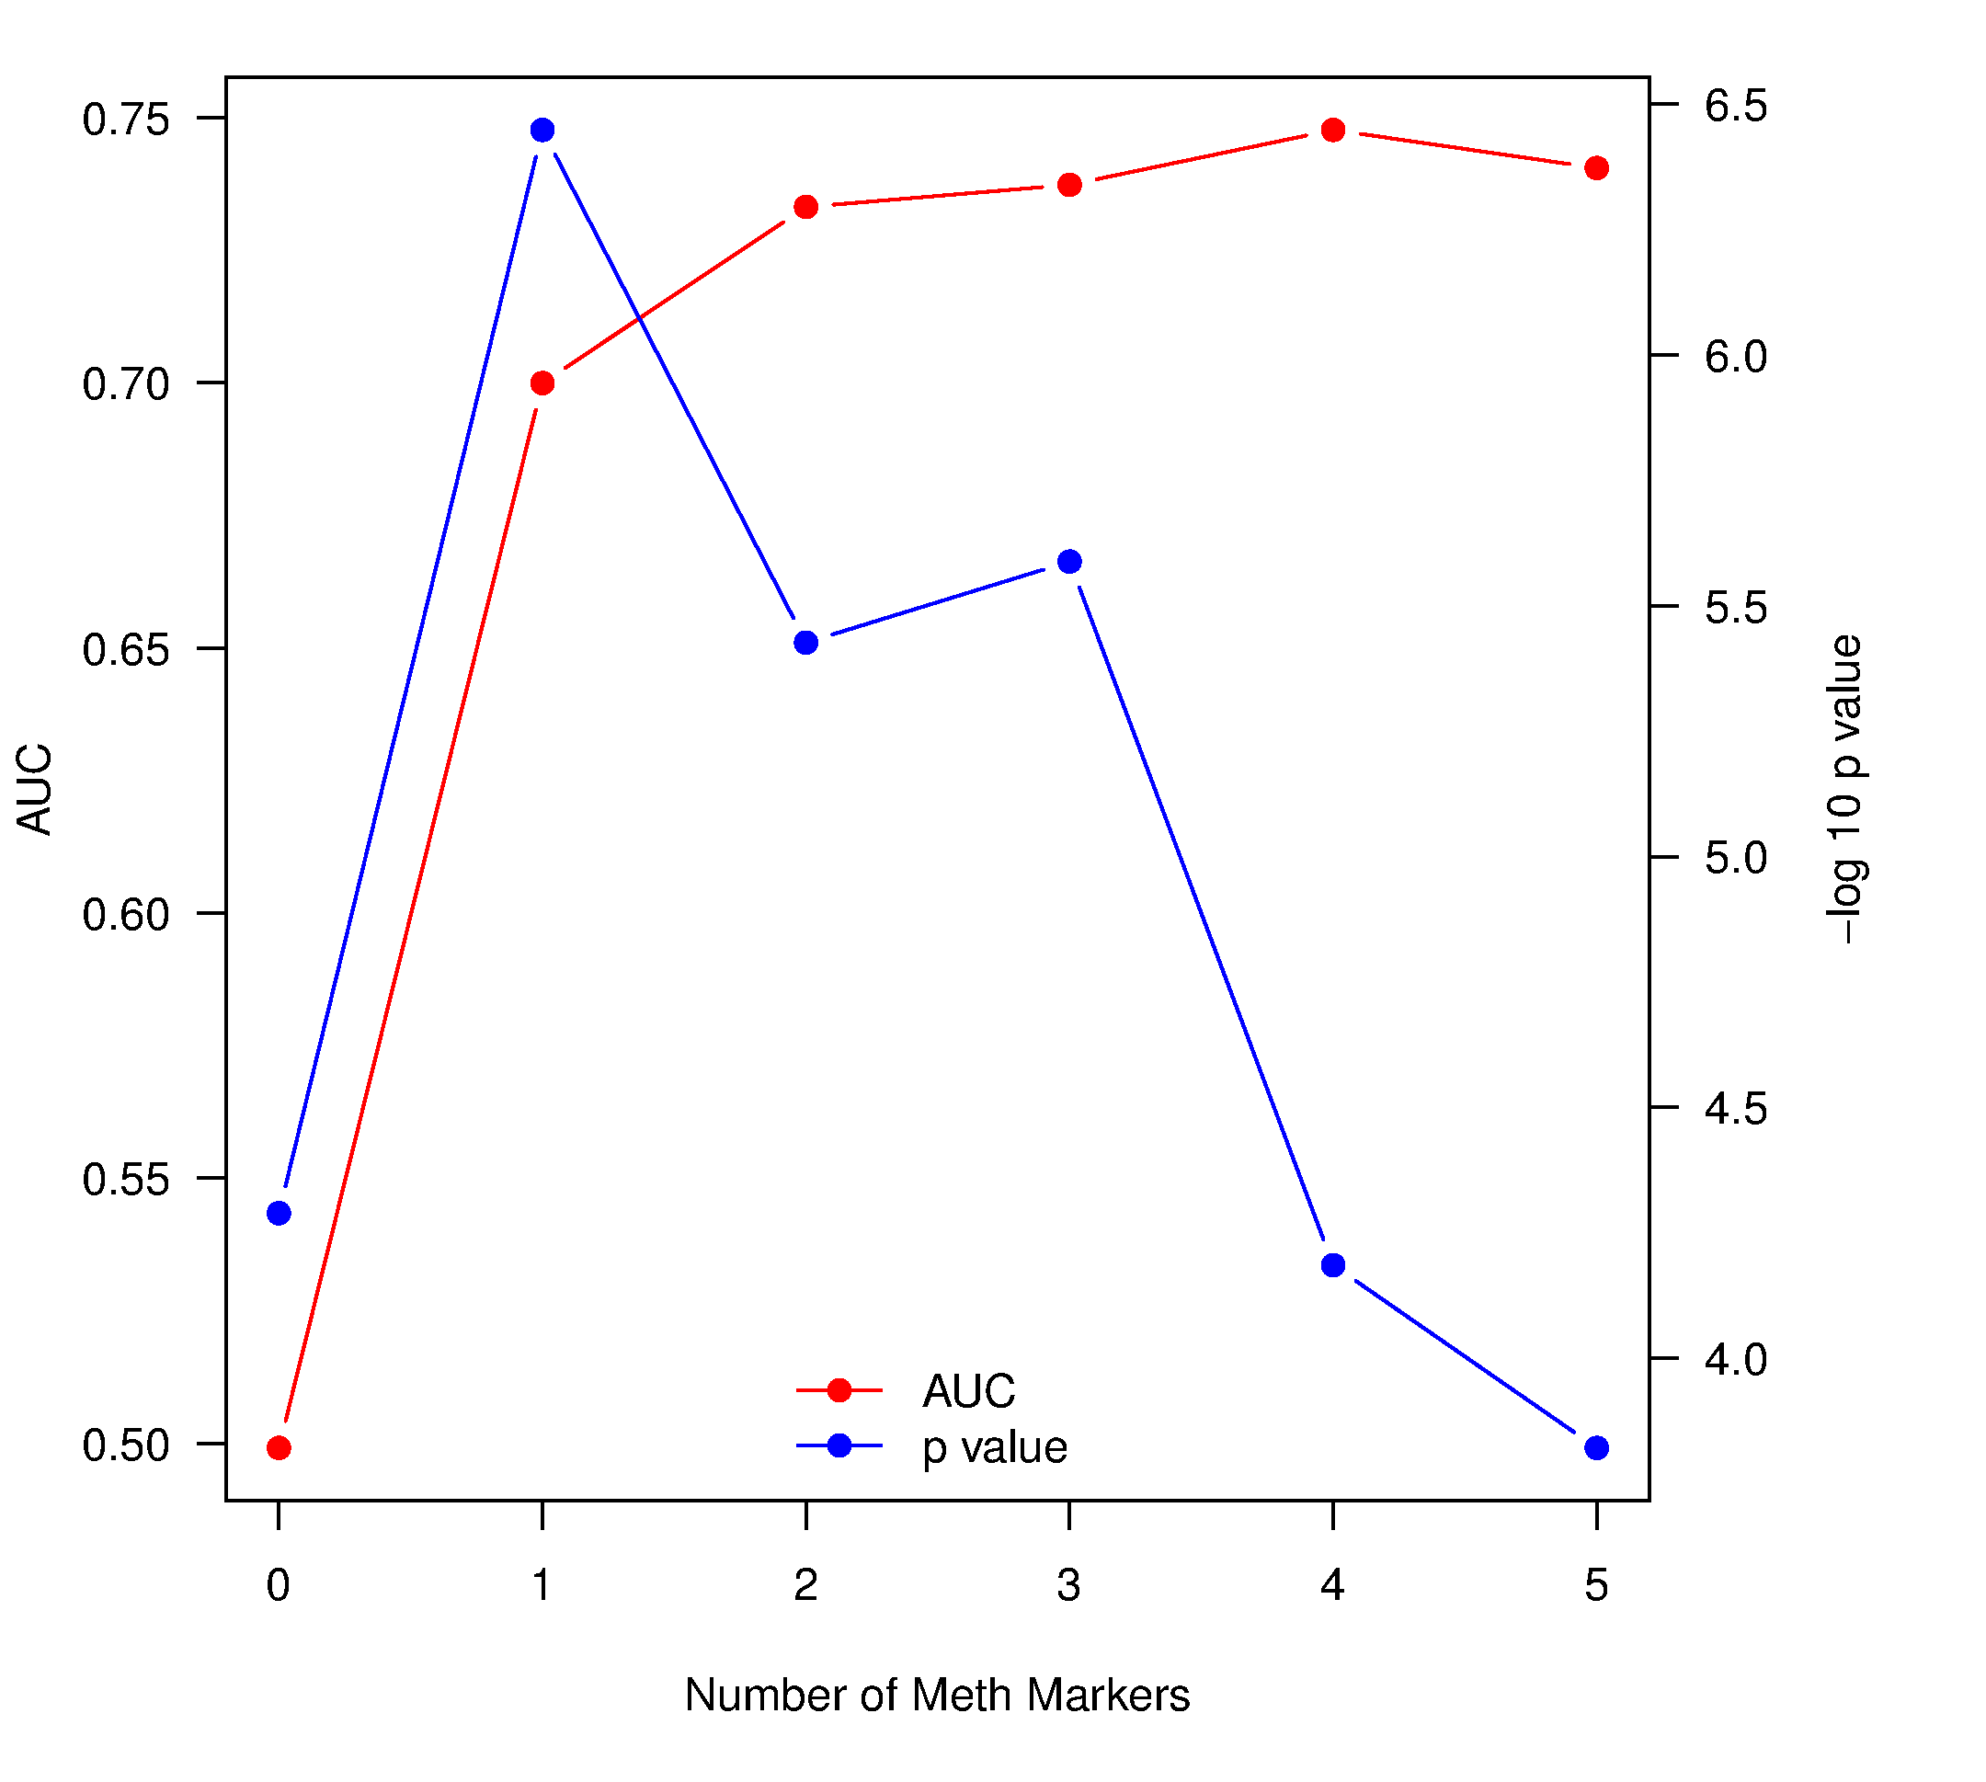
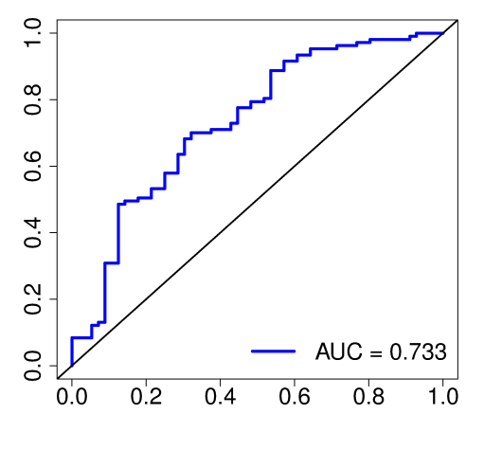
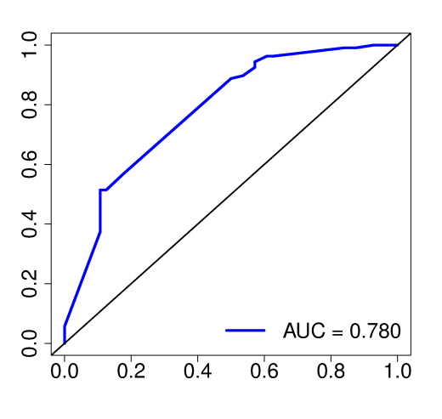
a
b
ASCL2 (P360)
ZIM2 (E110)
Frequency
Frequency
β value
β value
NTRK1 (E74)
MEG3 (E91)
Frequency
Frequency
c
d
β value
β value
MET (E333)
ALPL (P433)
Frequency
Frequency
β value
β value

