Slide 1
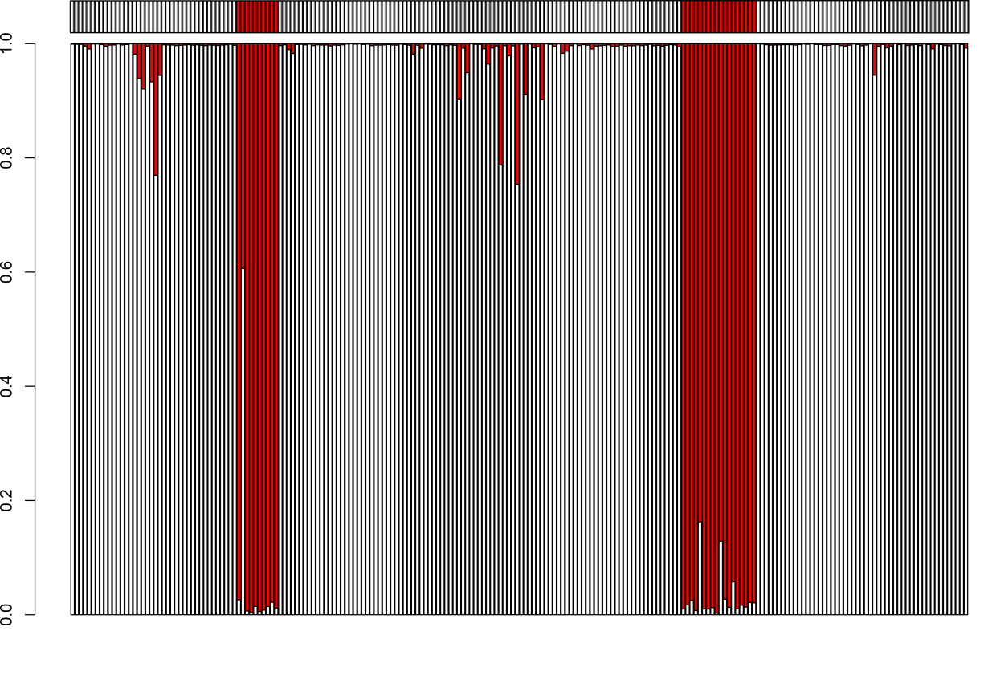
a
b
Classified samples
NC samples
c
Probability
Probability
Training
Test
WNT
WNT
Array classification
 |  | Cluster Assignment
 |  | Other | WNT
SVM Prediction | Other | 188 | 0
 | WNT | 1 | 27
d
5-probeclassifier
Probability

