Slide 1
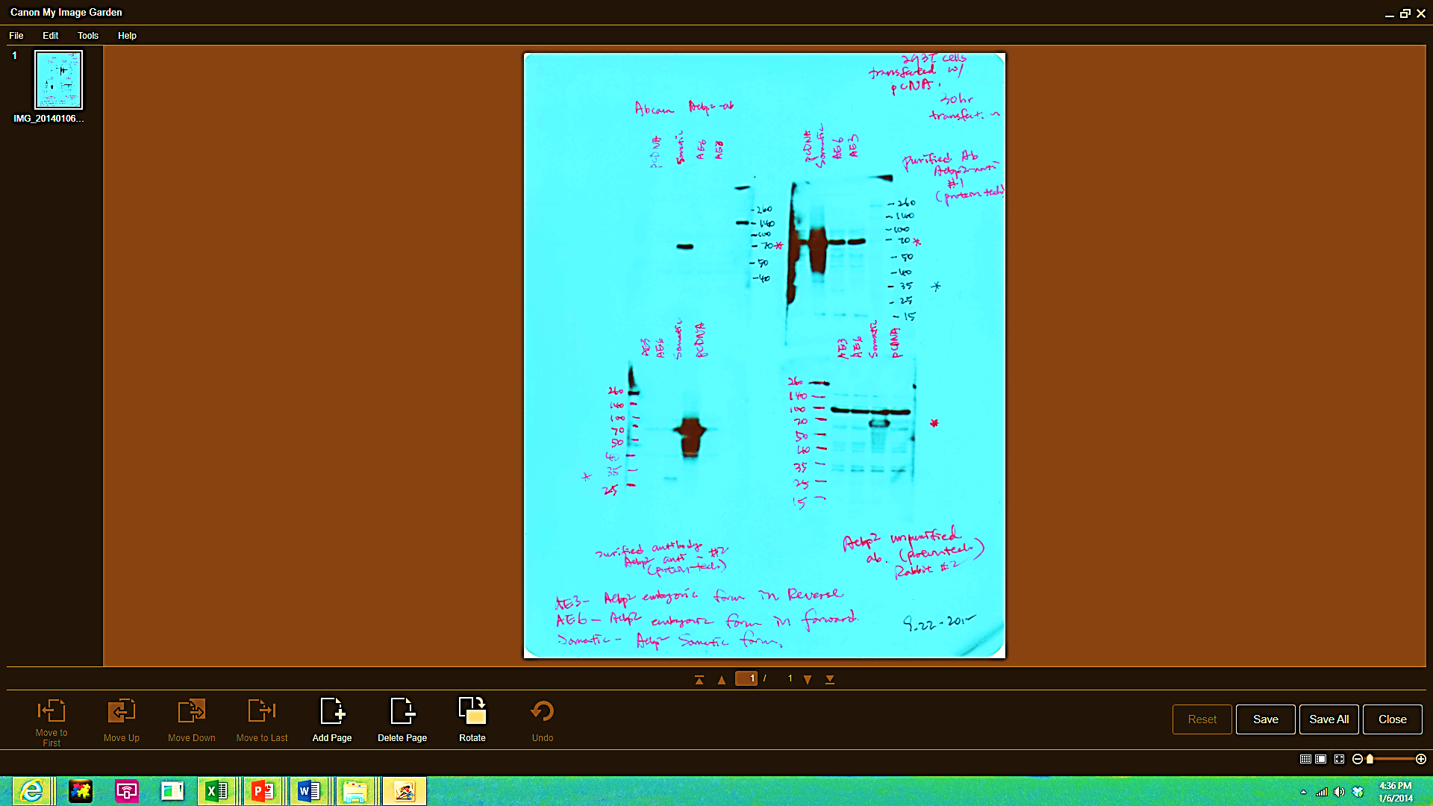
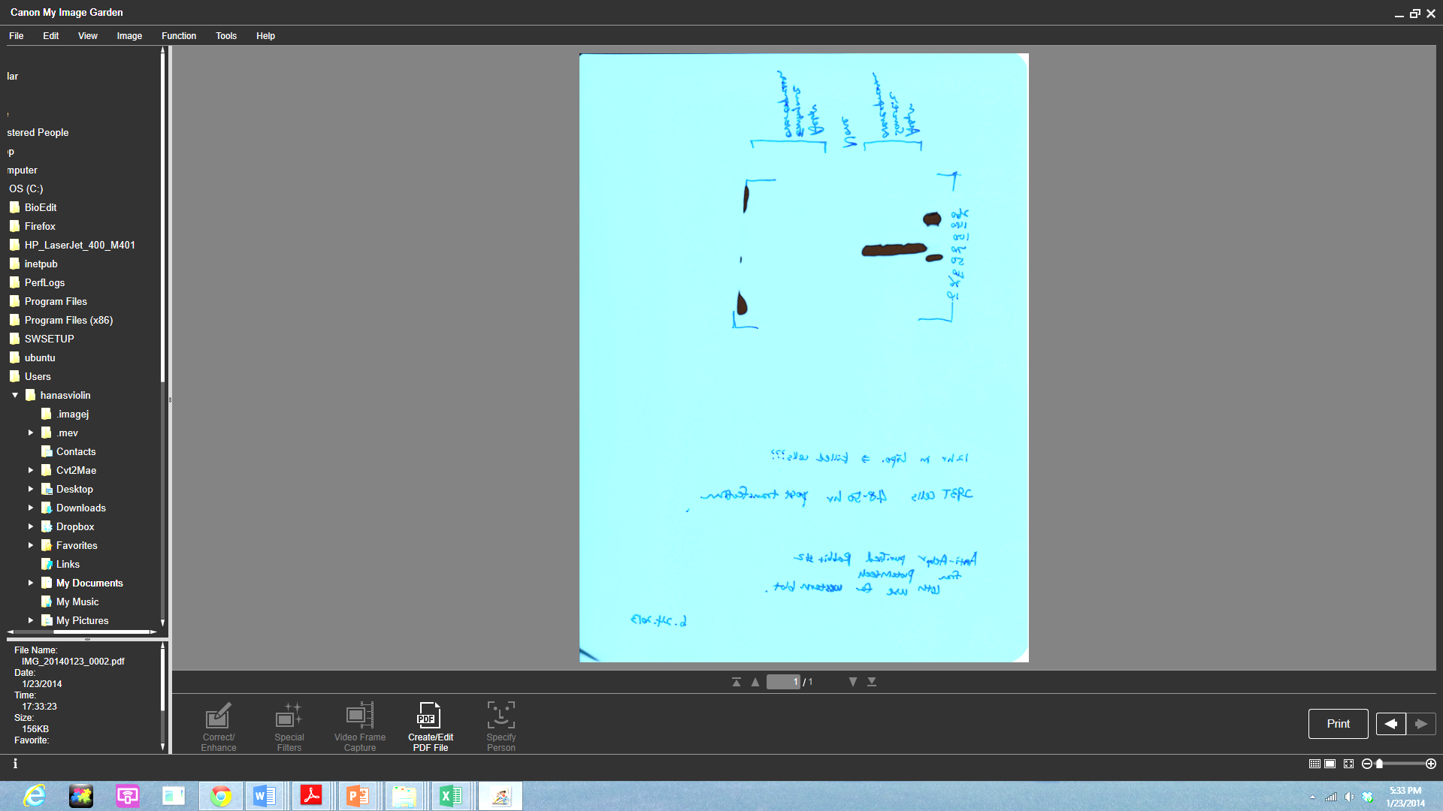
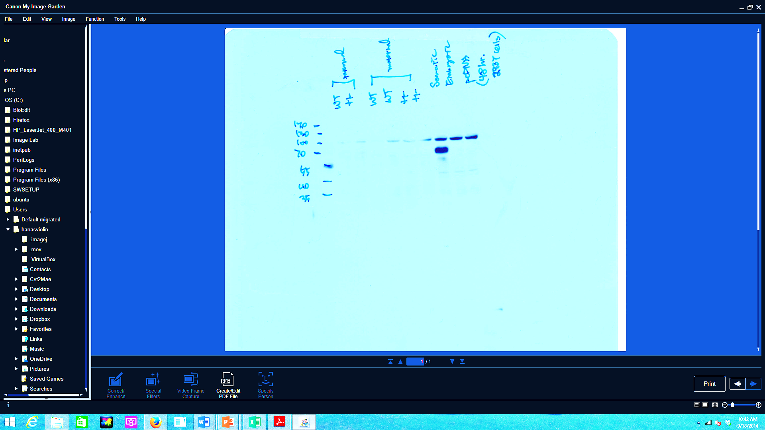
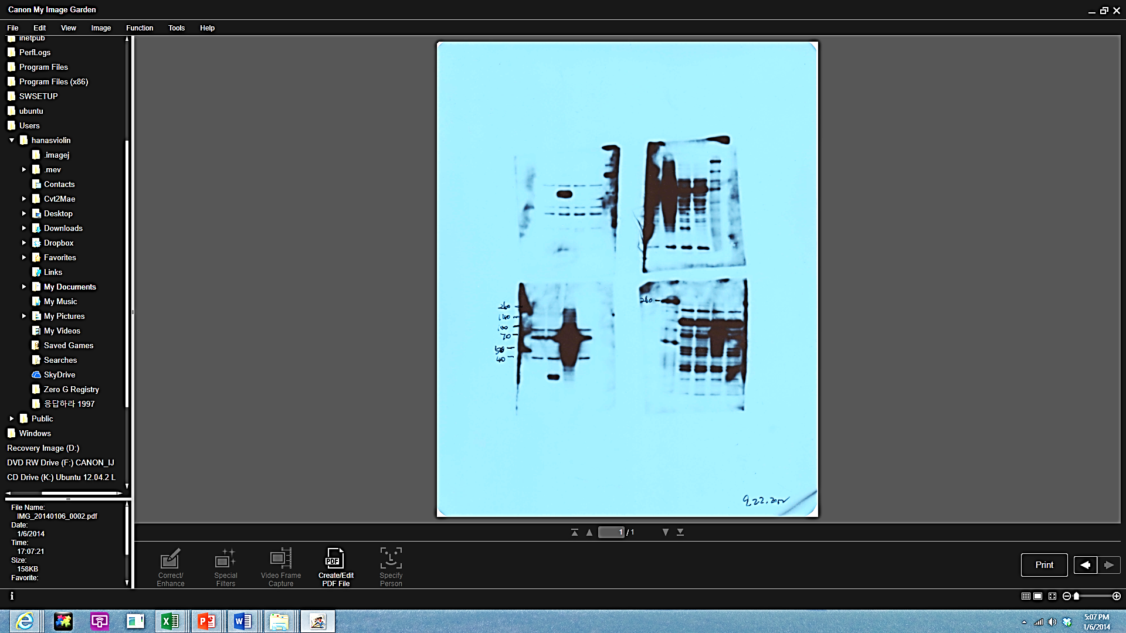
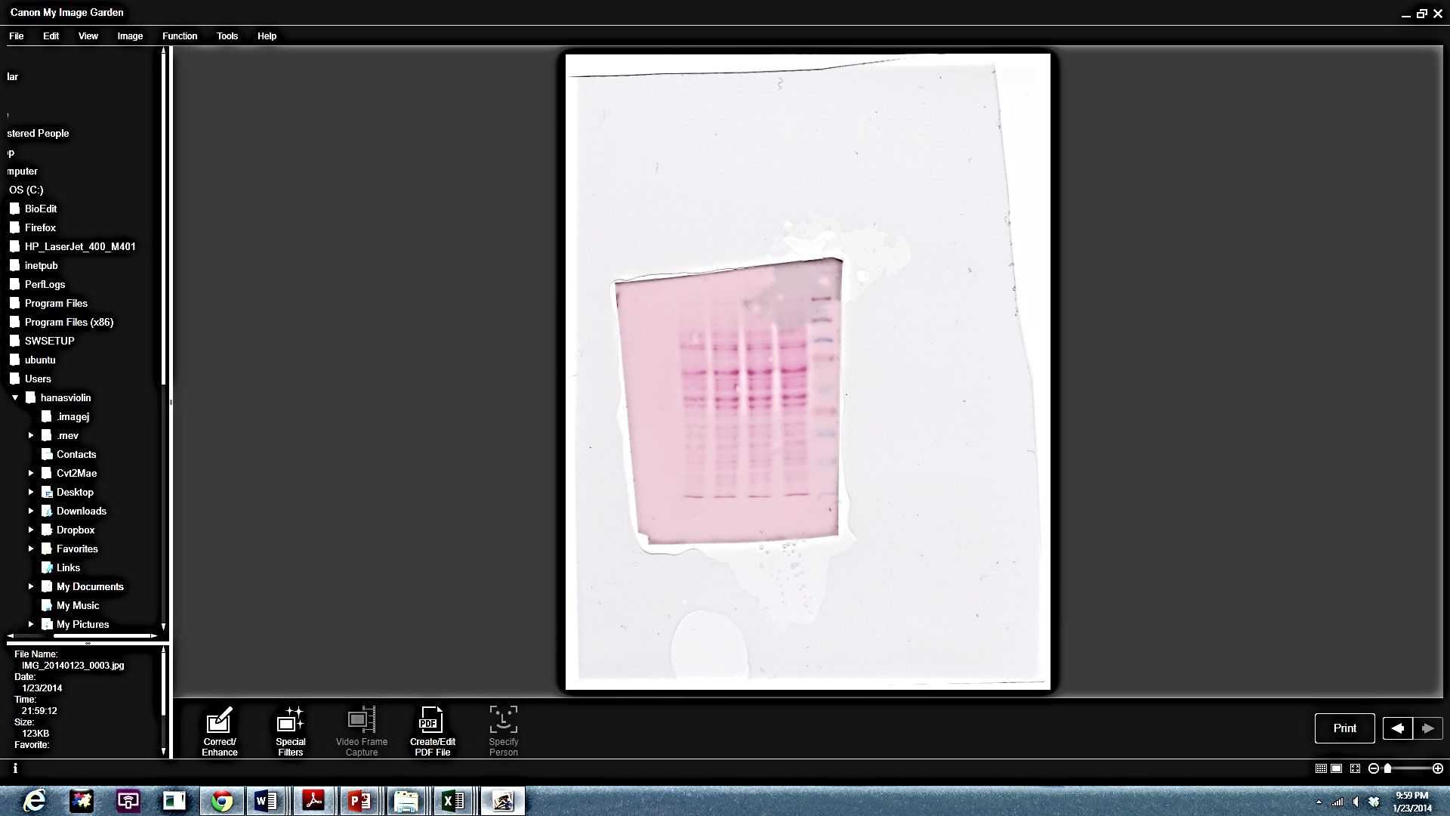
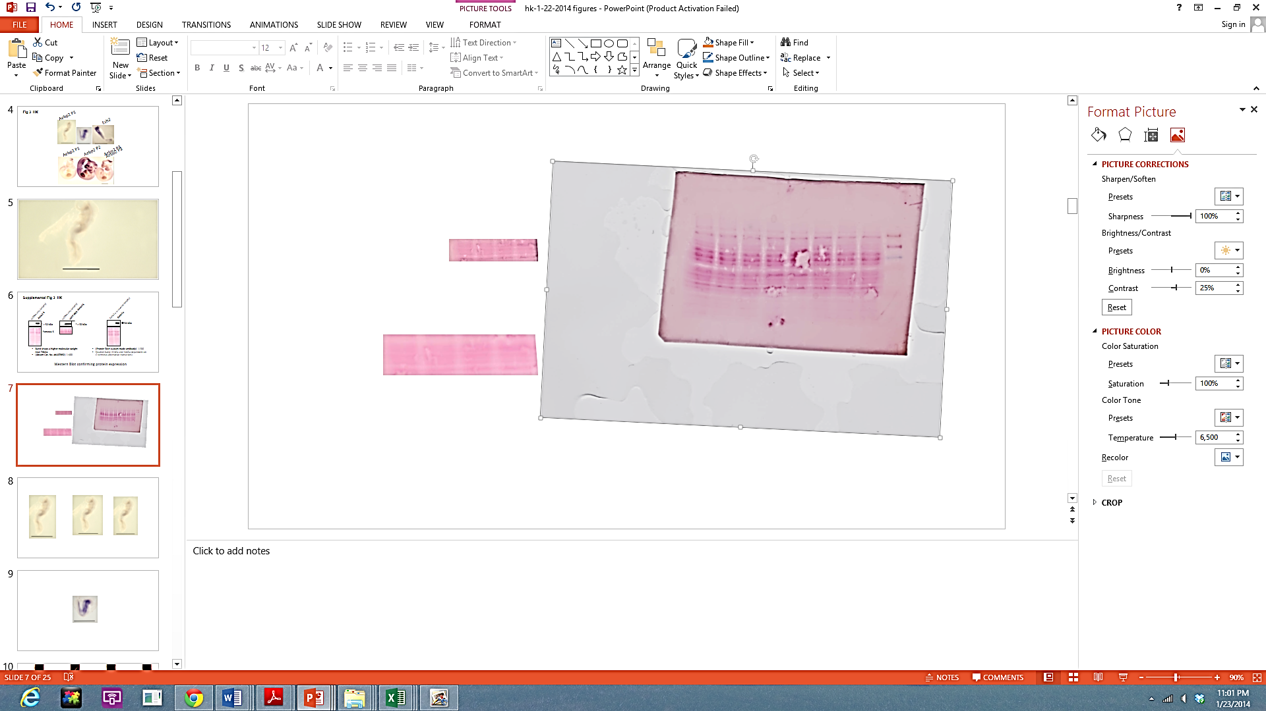
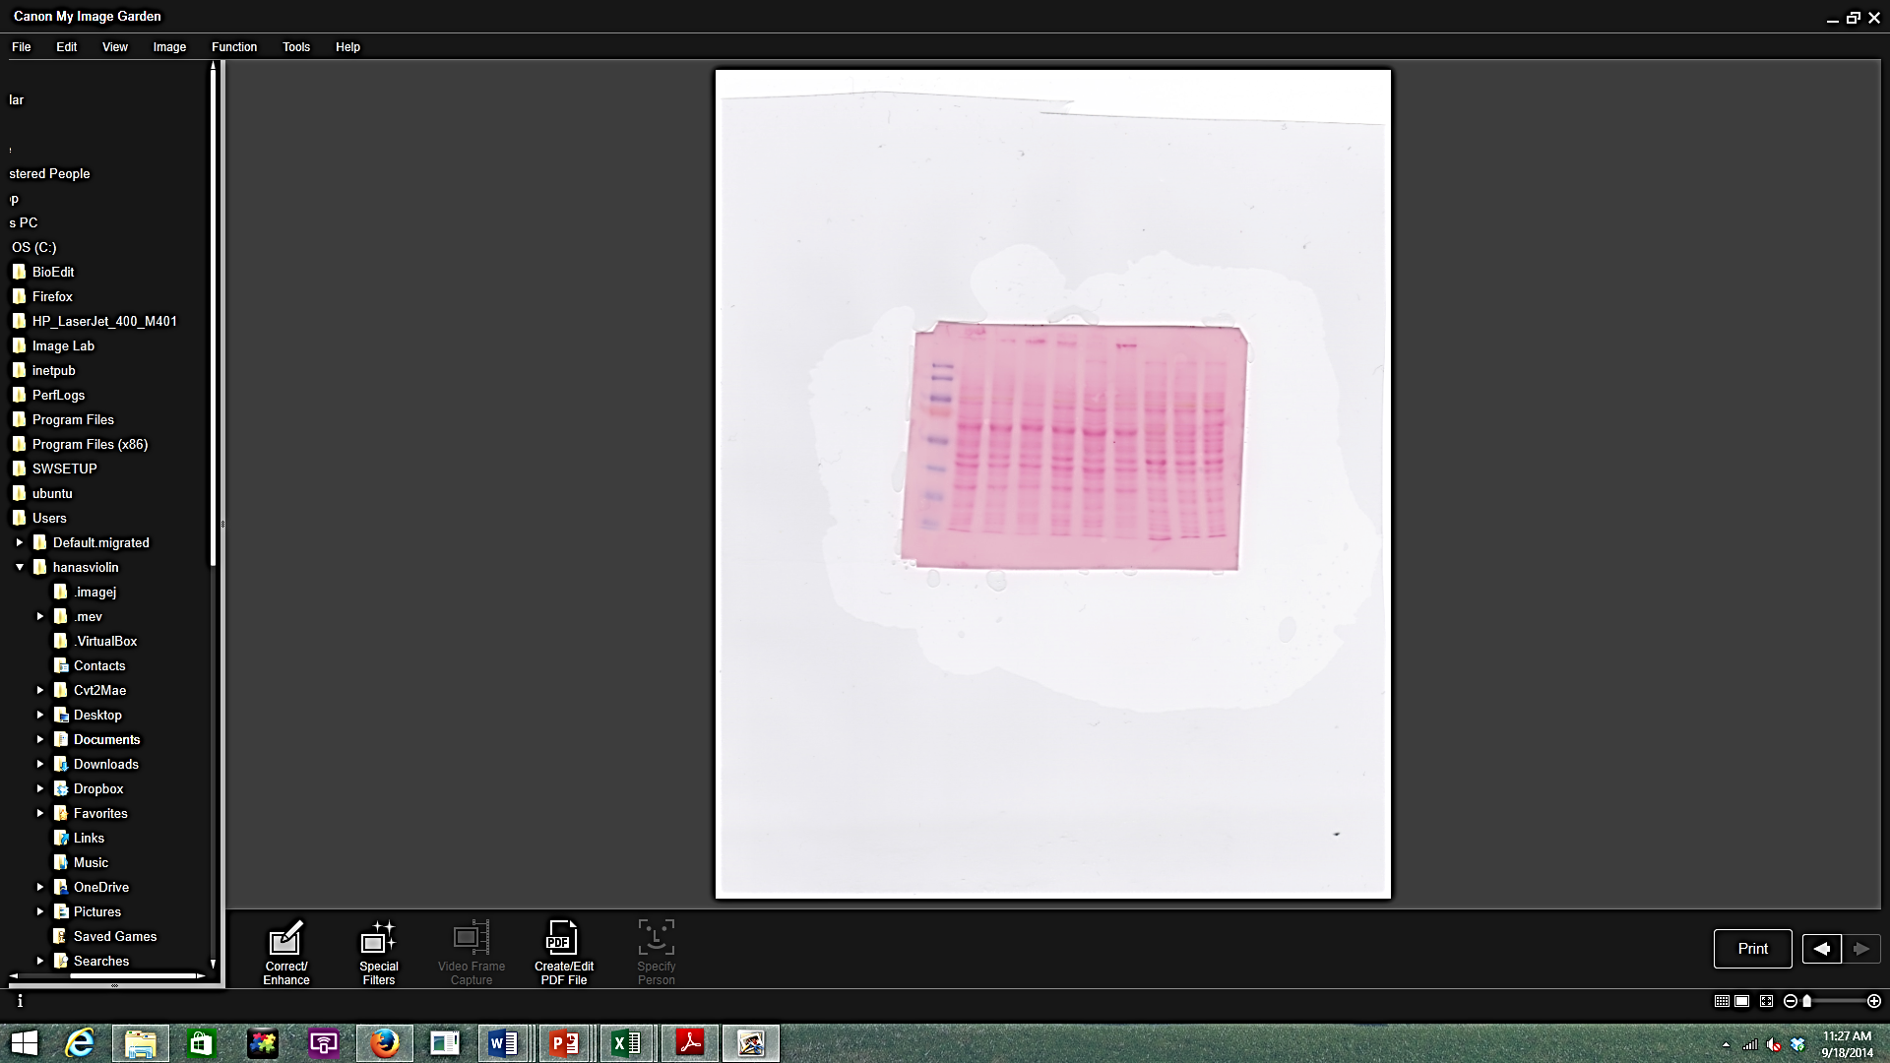
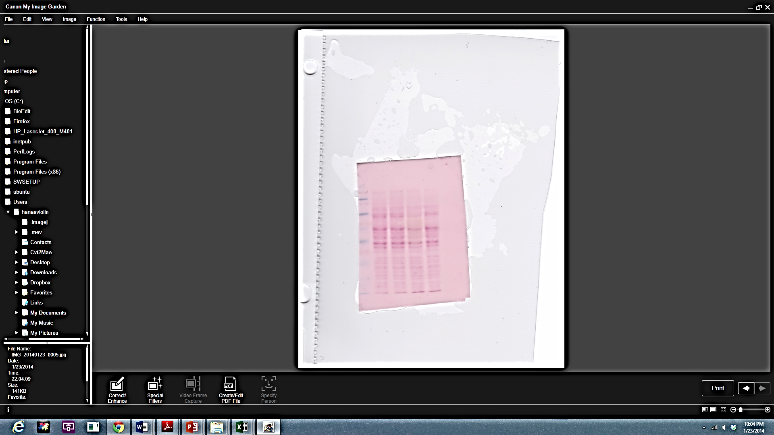
Supplemental Material 2_HK
Aebp2-e in reverse (empty)
Aebp2-e in reverse (empty)
Aebp2-S
eGFP-IRES-Aebp2-S
Aebp2-S
Aebp2-e
pcDNA only (empty)
pcDNA only (empty)
pcDNA only (empty)
> 52 kDa
> 52 kDa
> 52 kDa
← 32 kDa
Ponceau S
Band shows a higher molecular weight near 70kDa
(Abcam Cat. No. ab107892) 1:400
(Protein Tech custom made antibody) 1:200
Doublet band (32kDa and 34kDa dependent on C-terminus alternative transcripts)

Slide 2
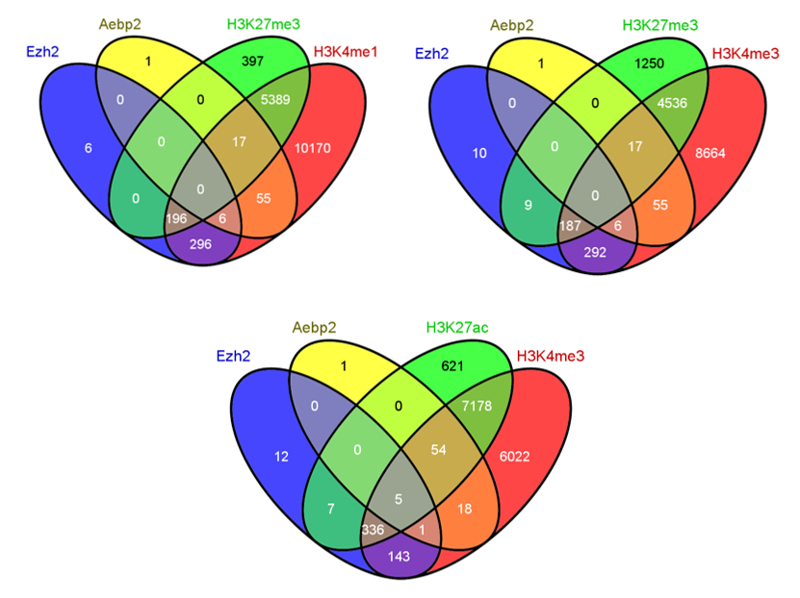
Supplemental Material 3_HK

Slide 3
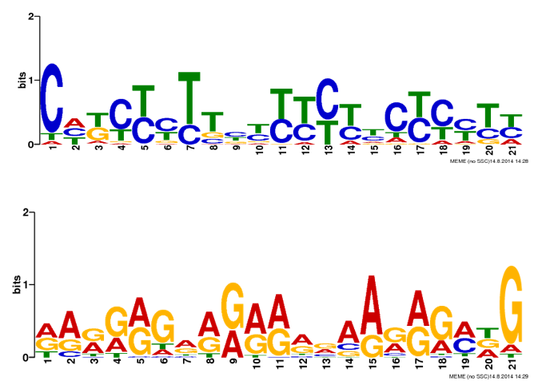
Supplemental Material 4_HK
Reverse complement

Slide 4
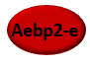
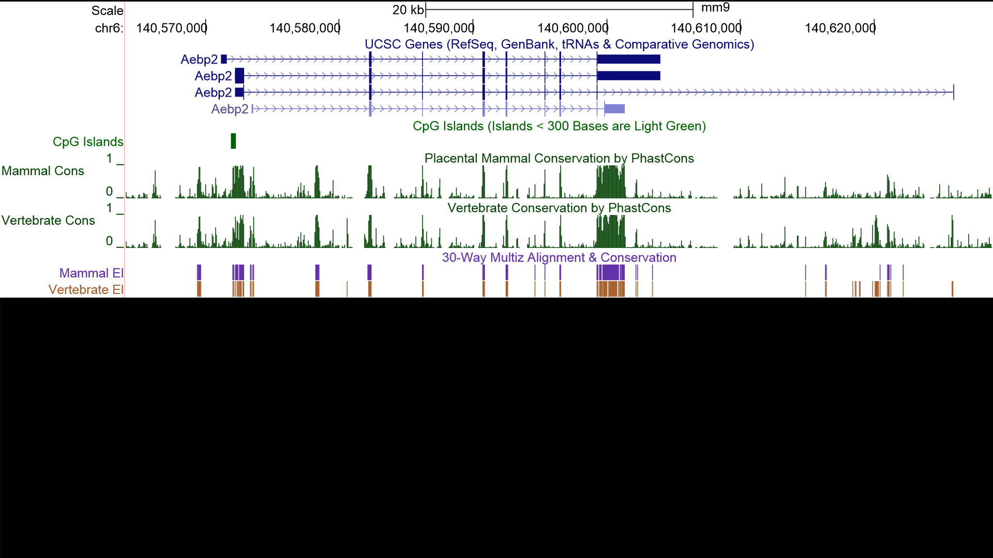
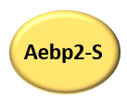
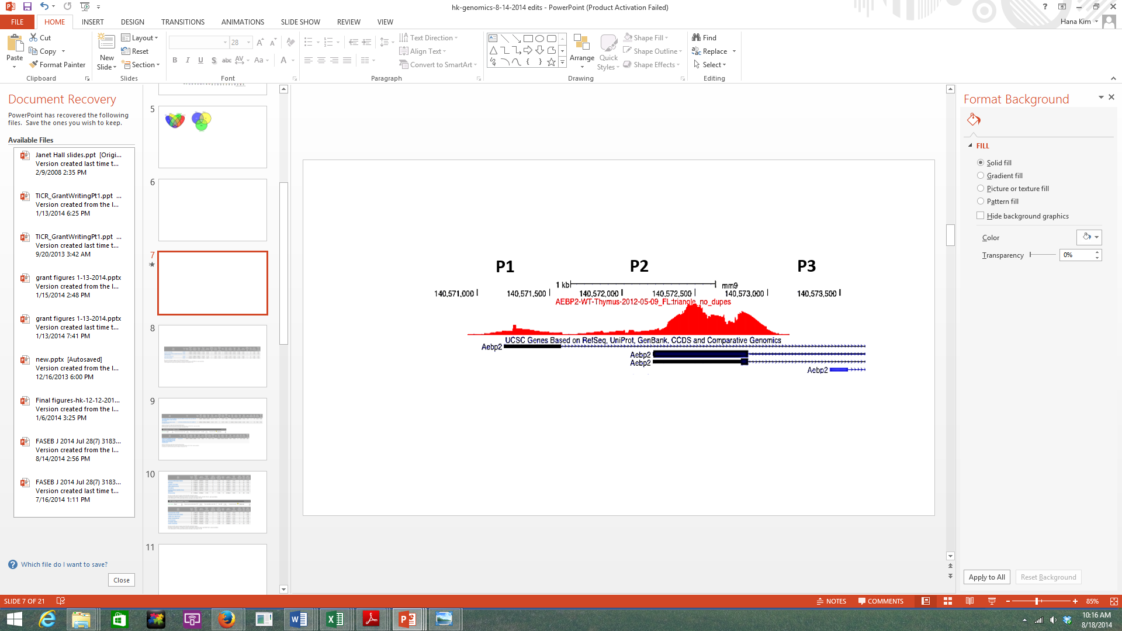
Supplemental Material 5_HK
Acidic & Neutral
Zn finger
Basic
or

Slide 5
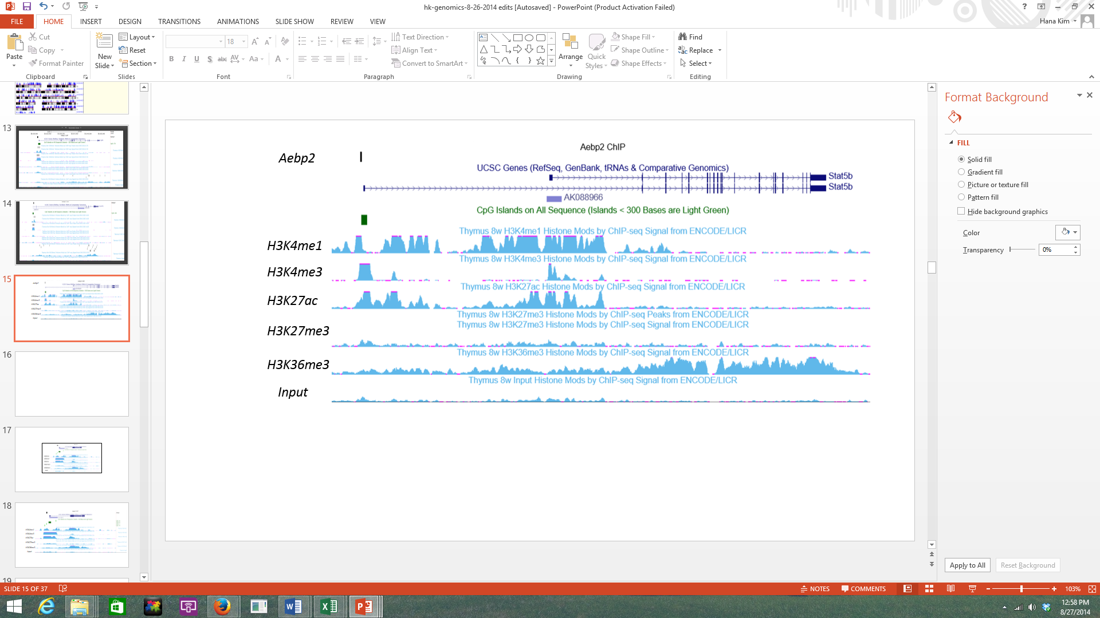
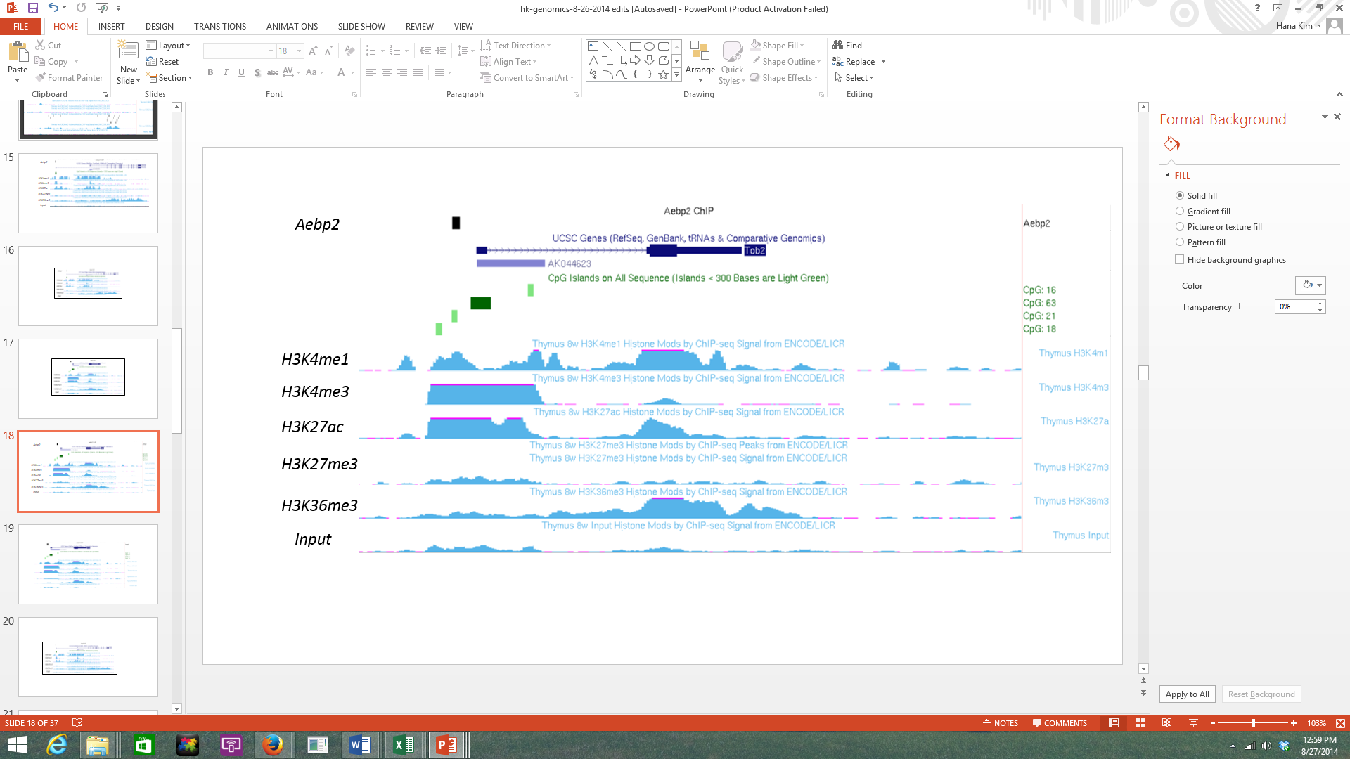
Supplemental Material 6_HK

Slide 6
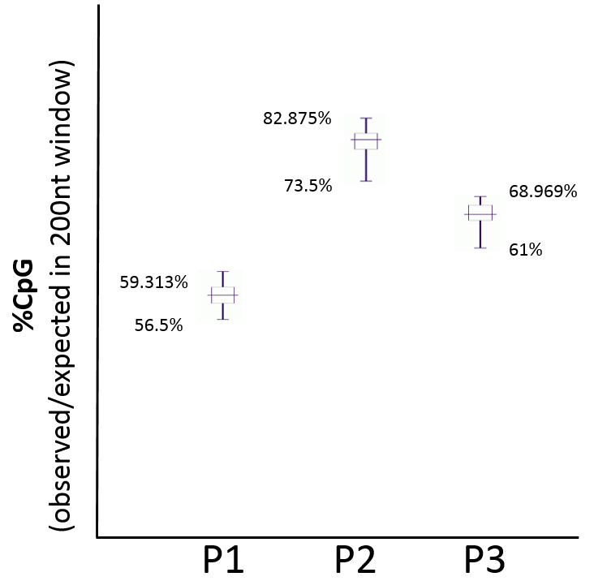
Supplemental Material 7_HK

Slide 7
Supplemental Material 8_HK

