Slide 1
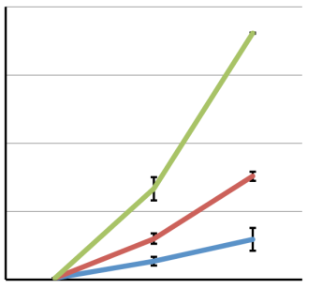
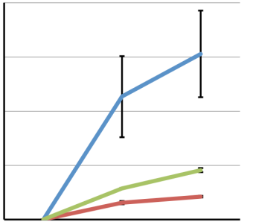
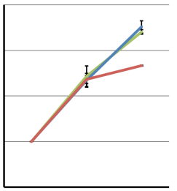
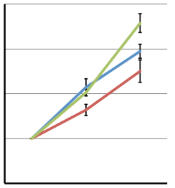
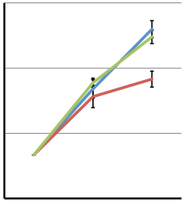
lncRNA-Cox2
Cox2
200
4000
10 ng/ml
150
3000
100 ng/ml
1 ug/ml
Fold induction (RNA)
100
2000
50
1000
0
0
0 hr
3 hr
6 hr
0 hr
3 hr
6 hr
lncRNA-Lyn
lncRNA-Lyn-Intron1
Lyn
lncRNA-Lyn-Intron1
(NR_028126)
lncRNA-Lyn
(ENSMUSG00000091559)
Lyn
4
4
4.5
3
3
3.0
2
2
Fold induction
1
1
1.5
0
0 hr
3 hr
6 hr
0
0 hr
3 hr
6 hr
0.0
0 hr
3 hr
6 hr

