Slide 1
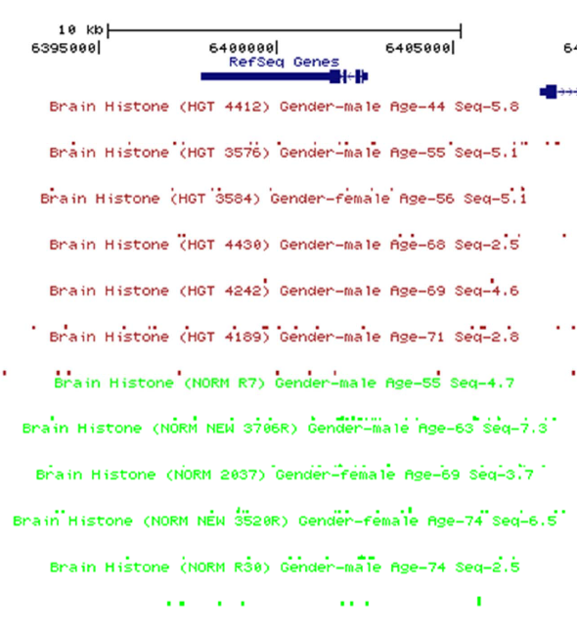
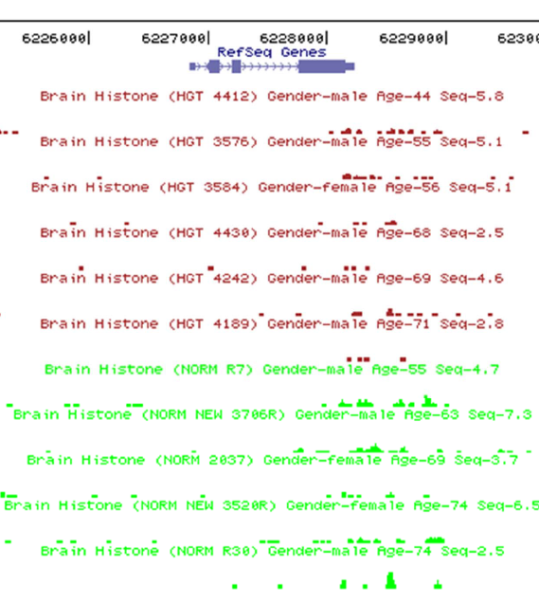
Supplemental Figure 1: H3K4me3 peaks for HES family genes
in HD and control cortex
HES2
HES3

Slide 2
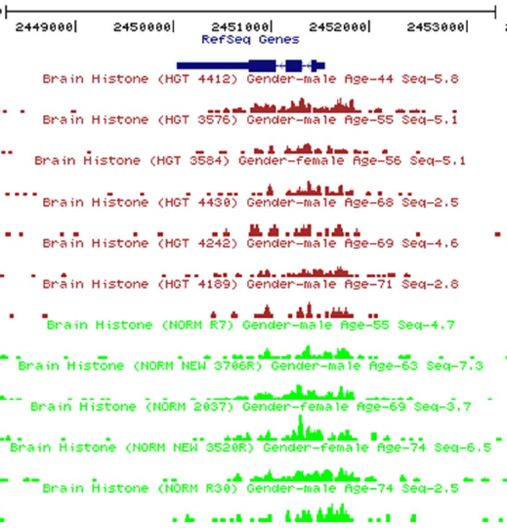
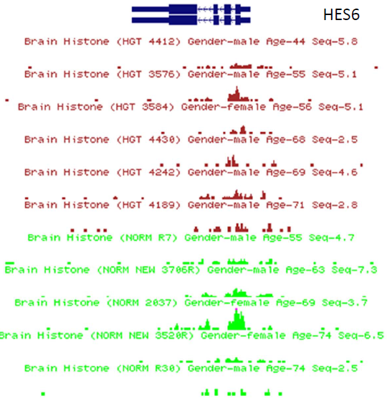
HES5
HES6

Slide 3
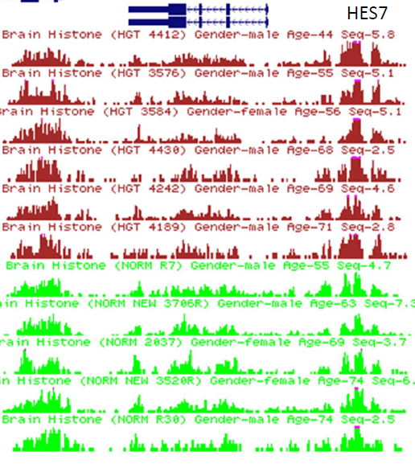
HES7

Slide 4
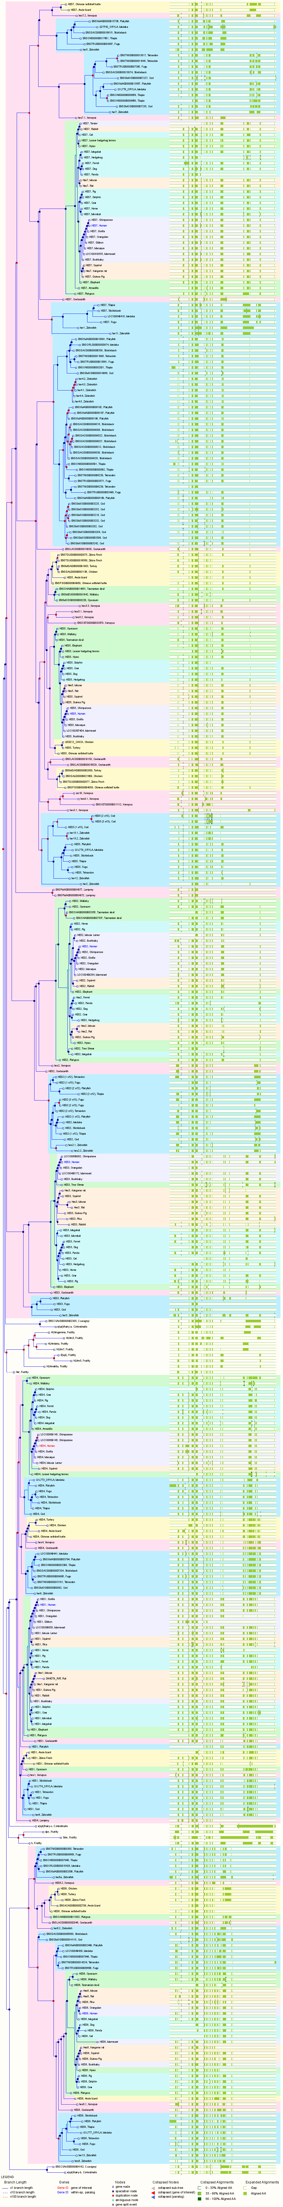
Supplemental Figure 2A: Phylogenetic analysis of HES4 gene (extended)

Slide 5
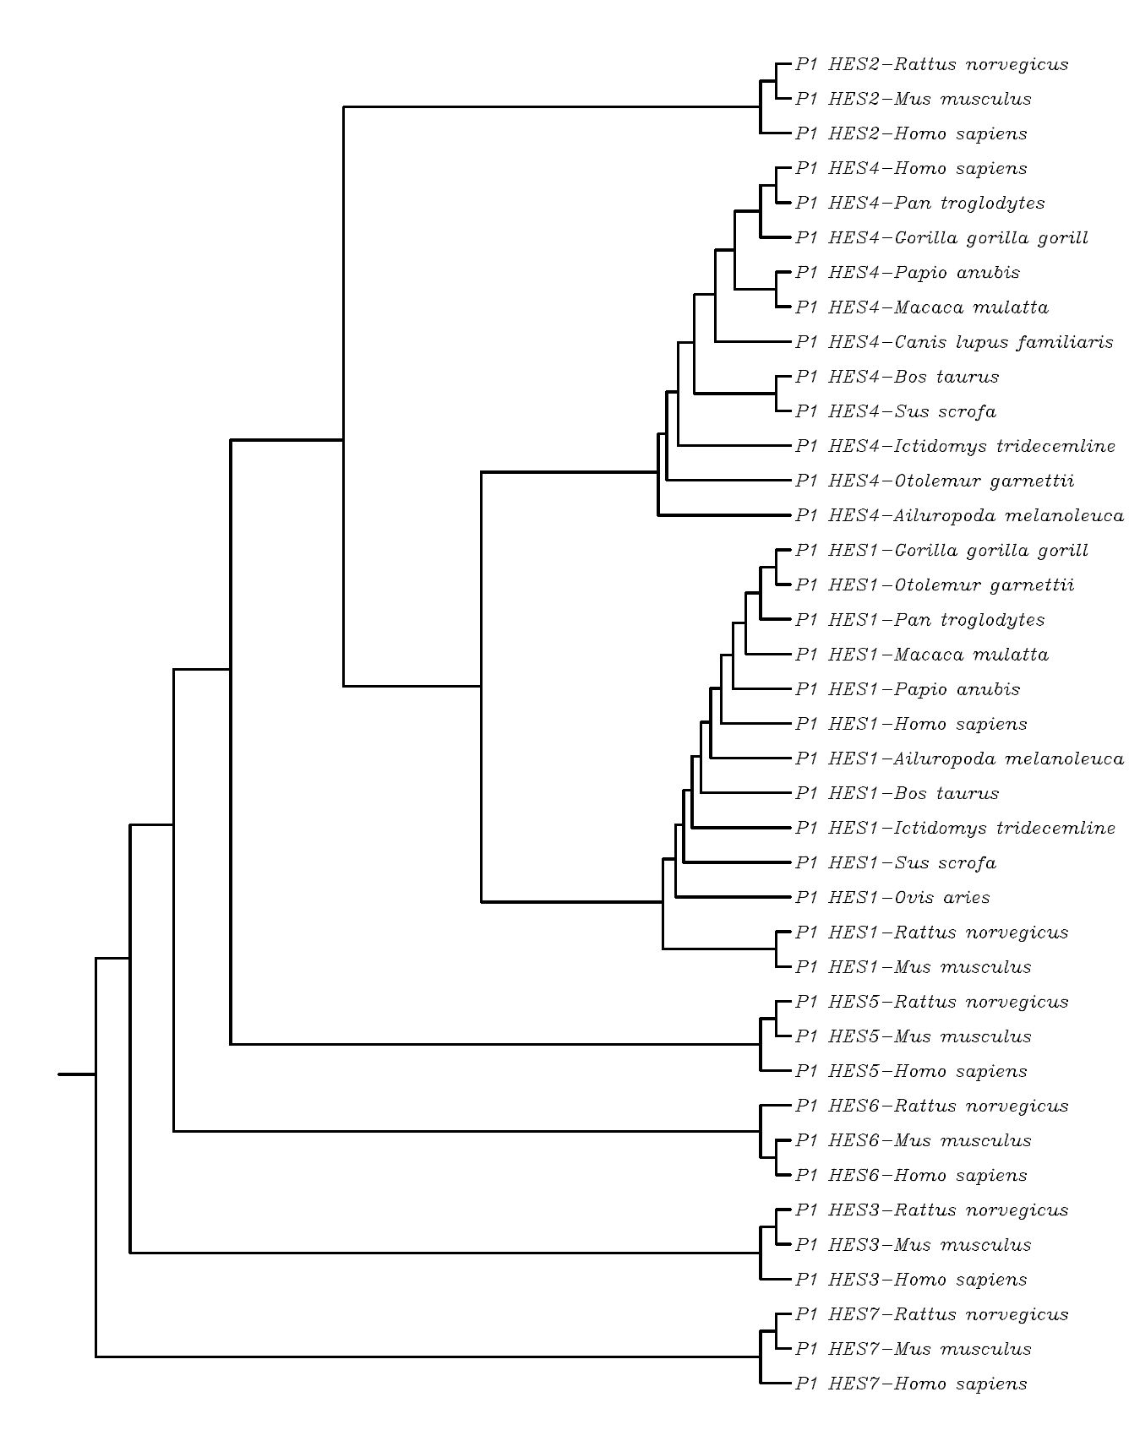
Supplemental Figure 2B: Phylogenetic analysis of HES gene family

Slide 6
Supplemental figure 2. Phylogenetic analysis of HES4 gene family
Amino acids of 100%, 80% and 60% homology are marked by black, dark grey, light grey letters, respectively. HES report file contains on the grey field the number of identical (in bold) or similar amino acids between HES4, HES1 proteins from different species. Similarly, on the white field we present percentage of identical (in bold) or similar amino acids between HES4, HES1 proteins from different species. Rooted phylogenetic tree (Unweighted Pair Group Method with Arithmetic Mean) was also constructed (HEStree files).

