Slide 1
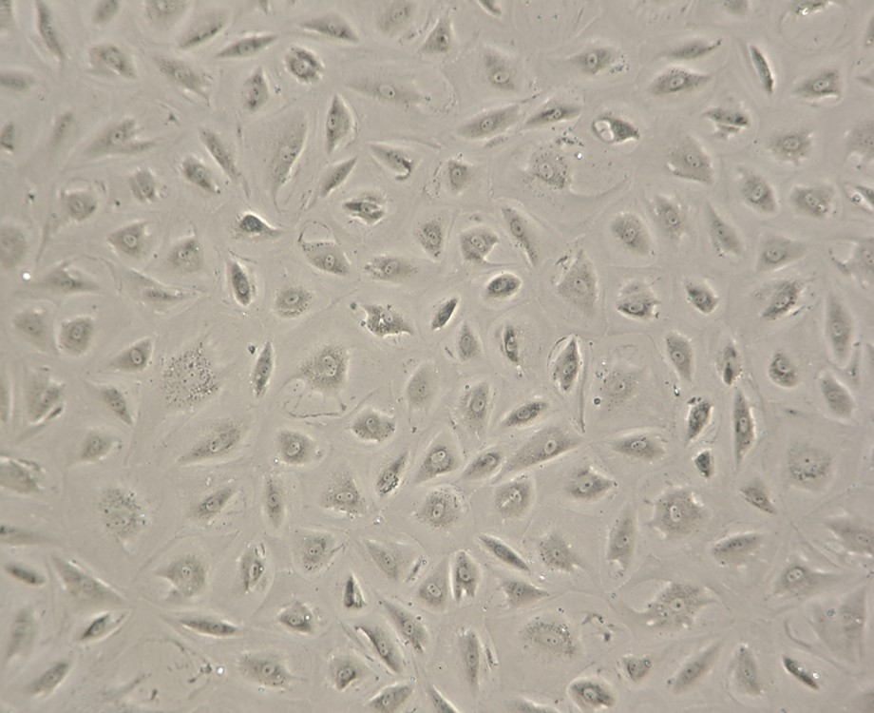
Supplemental Fig. 1

