Slide 1
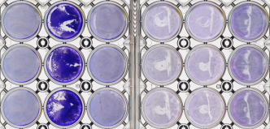
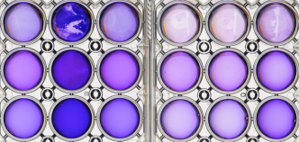
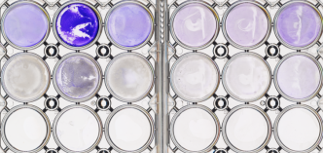
Additional file 1
Additional file 1- Comparisons of biofilm treated with ethanol or SDS.
(Upper panel) Pre-ethanol or SDS treated biofilm; (middle panel) Post-ethanol or SDS
treated biofilm; (lower panel) Removal of the solution.
CV stain
DW
Solubilization
95% EtOH
1% SDS
DW
Remove the
solution
95% EtOH
1% SDS
33277
PGN_0274
mutant
PGN_0319
mutant
PGN_0450
mutant
PGN_0970
mutant
PGN_1740
mutant

