Slide 1
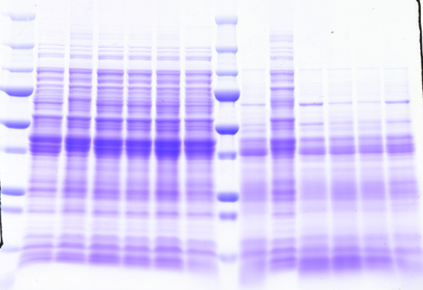
Additional file 4
Additional file 4 - Protein profile on an SDS-PAGE gel.
Ten micrograms of the whole cell protein of wild-type P. gingivalis ATCC 33277 and ECF sigma factor mutants were separated by SDS-PAGE and stained with CBB. Left side: with TLCK, Leupeptin. Right side: without TLCK, Leupeptin.
TLCK (+), Leupeptin (+)
TLCK (-), Leupeptin (-)
kDa
250
150
100
75
50
37
25
20
15
PGN_0274
mutant
PGN_0319
mutant
PGN_0450
mutant
PGN_0970
mutant
PGN_1740
mutant
PGN_0274
mutant
PGN_0319
mutant
PGN_0450
mutant
PGN_0970
mutant
33277
33277
PGN_1740
mutant

