Slide 1
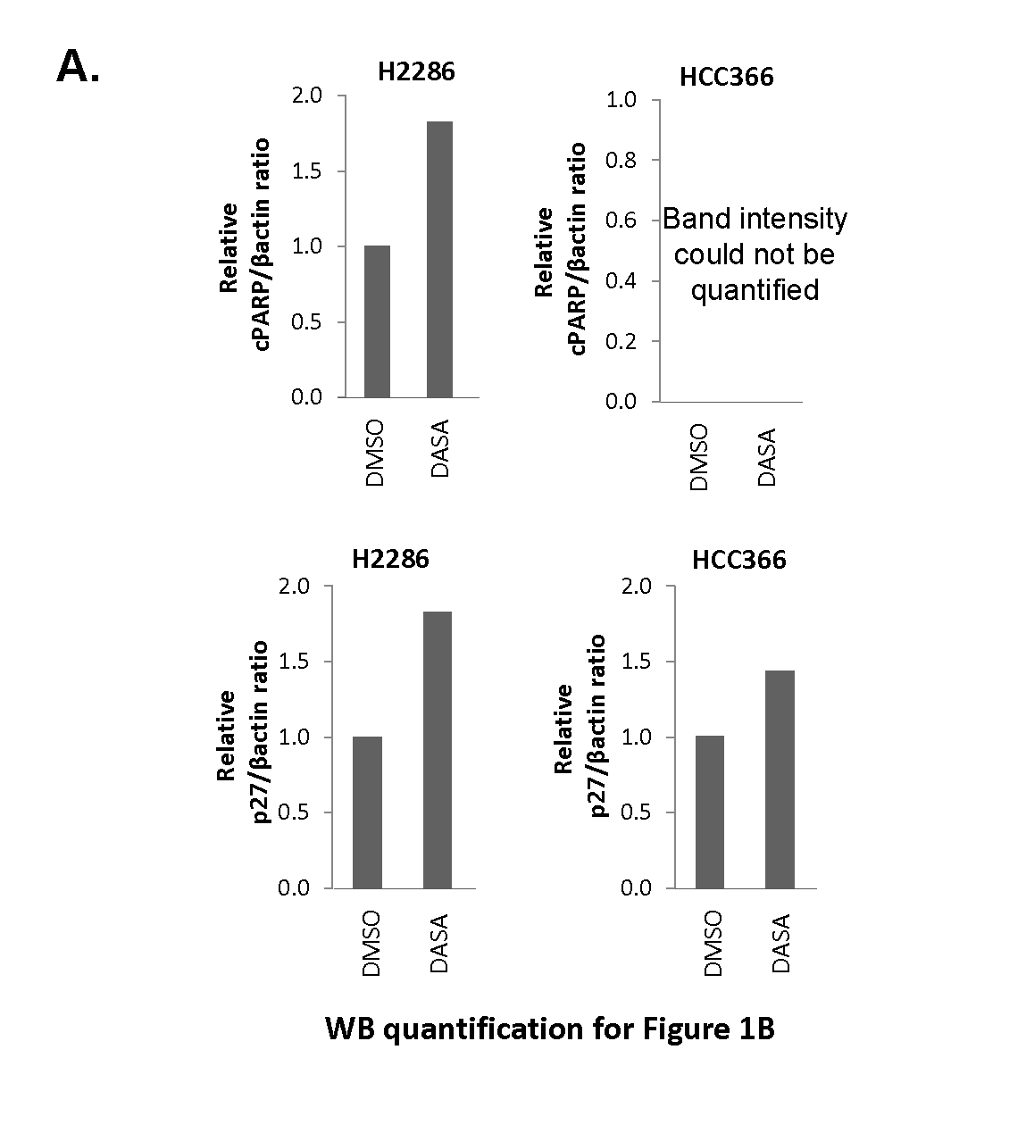
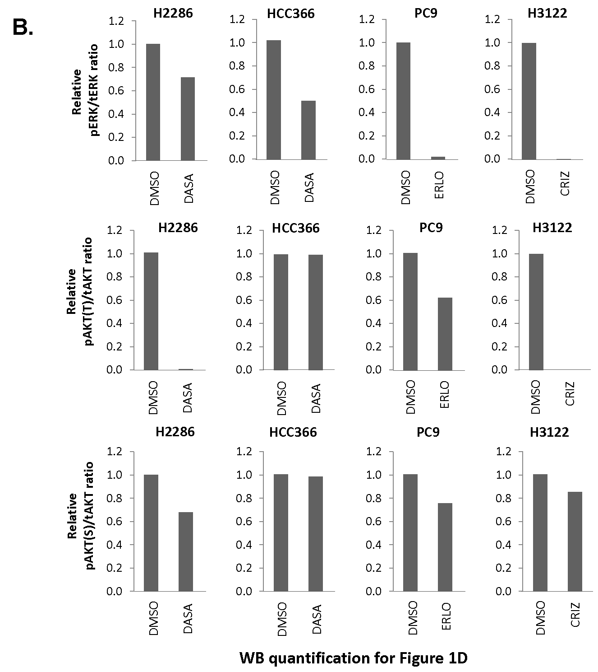
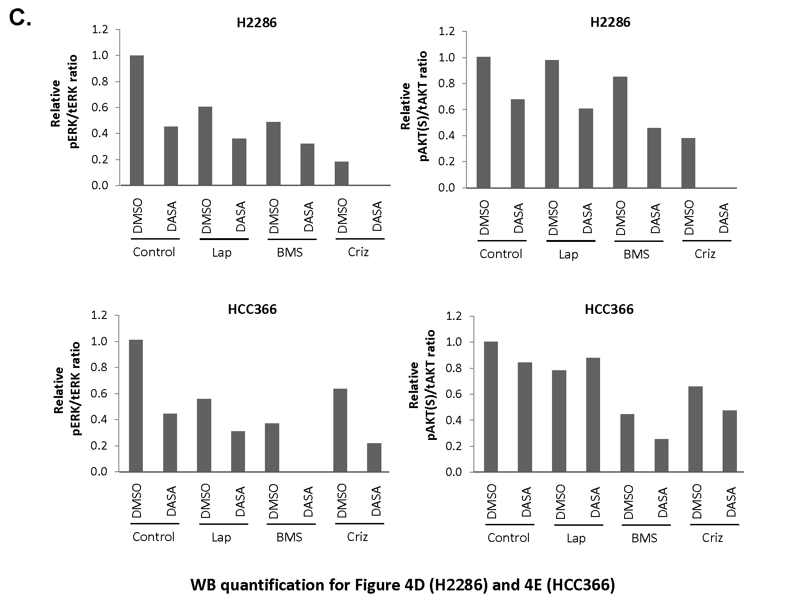
Figure S1

Slide 2
Figure S2
H2286
HCC366
DIpYETDpYYR (IGF-1R pY1161/1165)
GSTAENAEpYLR (EGFR pY1197)
Intensity
Intensity
DMSO
DASA
DMSO
DASA
DIGLYNLR (IGF-1R)
QPQDGYLYR (IGF-1R)
GLWIPEGEK (EGFR)
ELIIEFSK (EGFR)
Intensity
Intensity
Intensity
Intensity
DMSO
DASA
DMSO
DASA
DMSO
DASA
DMSO
DASA

Slide 3




Figure S3
H2286 HCC366
H2286 HCC366
DMSO Lap DMSO Lap
DMSO Criz DMSO Criz
pEGFR
(Y1068)
pMET
(Y1234/5)
EGFR
MET
β-actin
β-actin

Slide 4
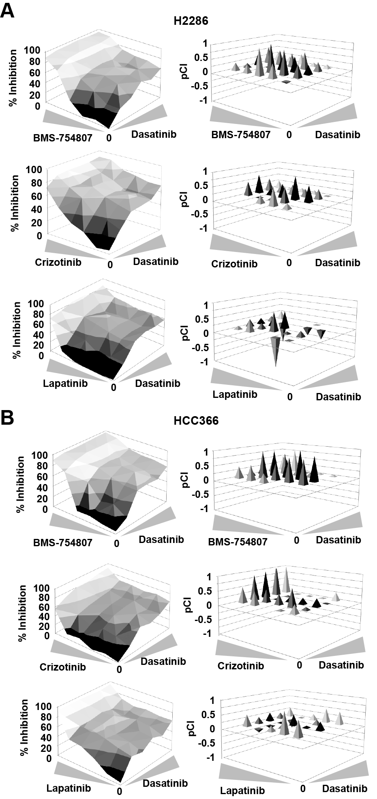
Figure S4

Slide 5












Figure S5
H2286 HCC366
H2286 HCC366
H2286 HCC366
H2286 HCC366
- + - +
- + - +
HGF
- + - +
Gas6
- + - +
EGF
IGF1
pEGFR
(Y1068)
pIGF1Rβ/IR
(Y1131/1146)
pMET
(Y1234/1235)
pAXL
(Y702)
EGFR
IGF1R
MET
AXL
β-actin
β-actin
β-actin
β-actin

