Slide 1
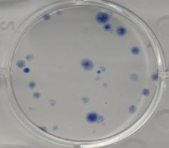
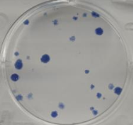
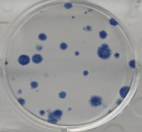
Additional file 3: Figure S3.
2 weeks incubation
***
20
***
15
10
Colony forming unit (CFU)
5
0
Vec
WT
W4P
Figure S3. Induction of cell transformation by LHBs. Huh7 cell lines expressing WT and W4P LHBs were subjected to a colony formation assay. Data represent means ± SD from three independent experiments. *** P < 0.001 vs vector cell line, 1-way t-test.

