Slide 1
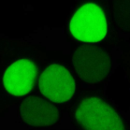
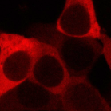
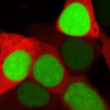
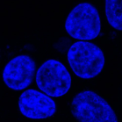
Additional Figure 3
A
B
USP1
NLSs
S313
USP1
UAF1-mRFP
Merge
DNA
1-
Importins
?
-785
UAF1
235-408
235
S
408
USP1(235-408)
S313wt
235
S/D
408
USP1(235-408)
NLSm+NLS
SV40NLS
235-408 NLSm+NLS
S313D
Additional Figure 3.
A. Schematic representation of USP1 protein illustrating the hypothesis that UAF1 and importins might compete for binding to USP1(235-408). The UAF1-binding motif reported by Villamil et al., (orange) including the S313 phosphorylation site, overlaps with USP1 NLSs (red). In order to test this hypothesis, the variant USP1(235-408NLSm+NLS) (represented below) was generated. In this variant, USP1 NLSs are inactivated, and its nuclear localization is mediated by an SV40 NLS fused to its amino terminus. S313 wild type and S313D phosphomimetic mutants of USP1(235-408NLSm+NLS) were used.
B. Mutation of USP1 NLSs does not result in UAF1 binding to the 235-408 segment. Confocal images showing representative examples of the results using the in vivo nuclear relocation assay. 293T cells were co-transfected with UAF1-mRFP and YFP-USP1(235-408), GFP-USP1(235-408NLSm+NLS), and GFP-USP1(235-408NLSm+NLS)^{S313D}. Cells were counterstained with Hoechst to show the nuclei (DNA panels).

