Slide 1
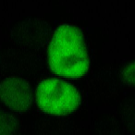
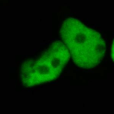
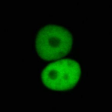
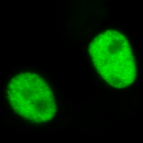
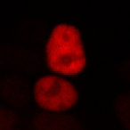
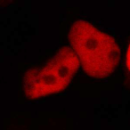
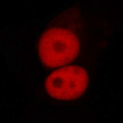
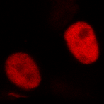
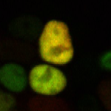
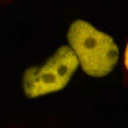
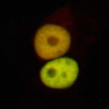
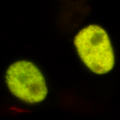
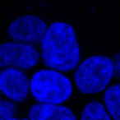
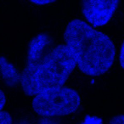
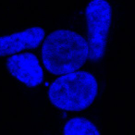
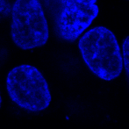
Additional Figure 5
A
B
GFP-USP1
YFP vector
G667A
L669P
K673T
A676T
Xpress-UAF1+ GFP-USP1 (+HU)
YFP/GFP
WT
C90S
GG/AA
ubPCNA
MW (KDa)
(long exposure)
37
UAF1-mRFP
PCNA
37
(short exposure)
USP1
115
Merge
UAF1
82
β-actin
49
DNA
37
C
Xpress-UAF1+GFP-USP1
G667A
G667A(S90)
A676T
L669P
A676T(S90)
L669P(S90)
K673T
GG/AA
K673T(S90)
WT
C90S
MW(KDa)
USP1
-115
UAF1
-82
α-tubulin
-64
-49
Additional Figure 5.
(A) The USP1GG/AA autocleavage site mutant deubiquitinates PCNA. Immunoblot analysis of 293T cells co-transfected with Xpress-UAF1 and GFP-USP1 wild type (WT), the catalytically inactive GFP-USP^{C90S} or the autocleavage site mutant GFP-USP1^{GG/AA}. Cells were treated with 4 mM hydroxyurea (HU) for 24 h. Using an anti-PCNA antibody, monoubiquitinated PCNA (ubPCNA) is detected as a band migrating slightly above the non-ubiquitinated form. The image in the ubPCNA panel was obtained using a longer exposure time. The dotted line indicates that the panel is a composite of two images from a single exposure of the same gel. Expression of wild type GFP-USP1 or GFP-USP1^{GG/AA} decreased PCNA monoubiquitination, whereas expression of GFP-USP1^{C90S} did not. Expression of β-actin was used as a loading control.
(B) Cancer-associated USP1 mutants relocate UAF1 to the nucleus. Confocal images showing representative examples of nuclear relocation assay results with four cancer-associated USP1 mutants. 293T cells were co-transfected with UAF1-mRFP and YFP vector (negative control), GFP-USP1^{G667A}, GFP-USP1^{L669P}, GFP-USP1^{K673T}, and GFP-USP1^{A676T}. Cells were counterstained with Hoechst to show the nuclei (DNA panels). The four mutants were able to induce the nuclear relocation of UAF1-mRFP, suggesting that the ability to interact with UAF1 is not disrupted by these mutations.
(C) Mutation of the catalytic C90 residue abrogates autocleavage of USP1 cancer-related mutants. Immunoblot analysis of 293T cells co-transfected with different USP1 constructs and Xpress-UAF1. By introducing a C90S point mutation (S90), the autocleavage of USP1 cancer-related mutants was completely abrogated (note disappearance of the lower band). Note that the cleavage of L669P is per se very inefficient, and totally abrogated by the C90S mutation.

