Slide 1
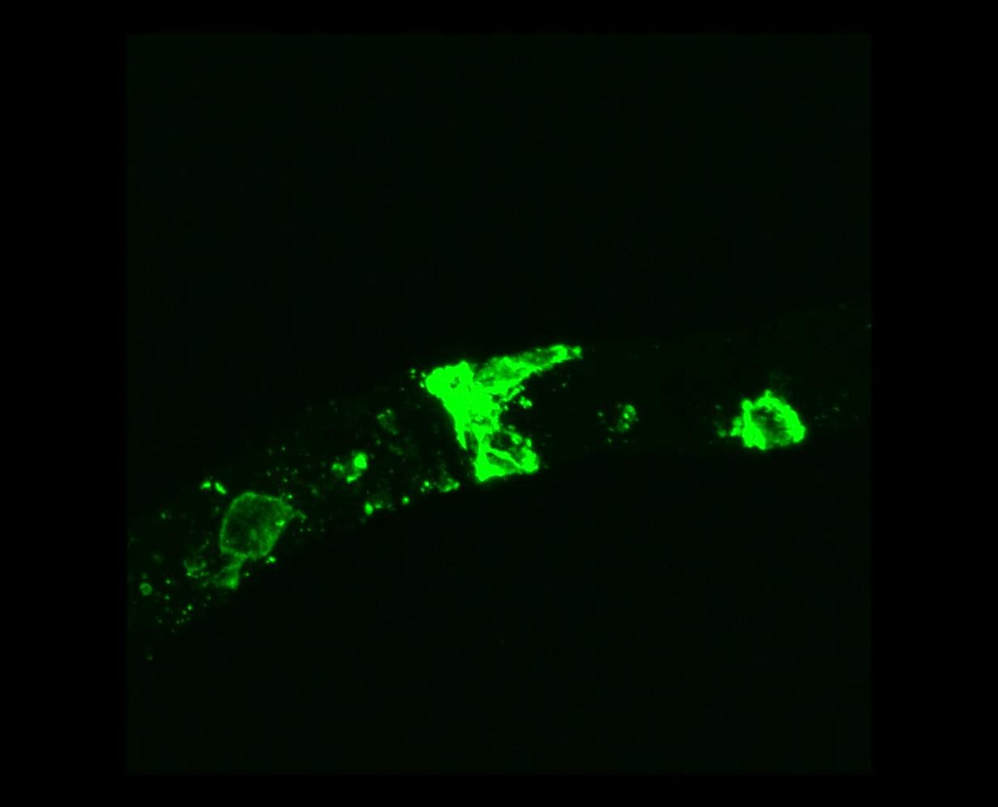
Supplementary Figure S1
NT

Slide 2
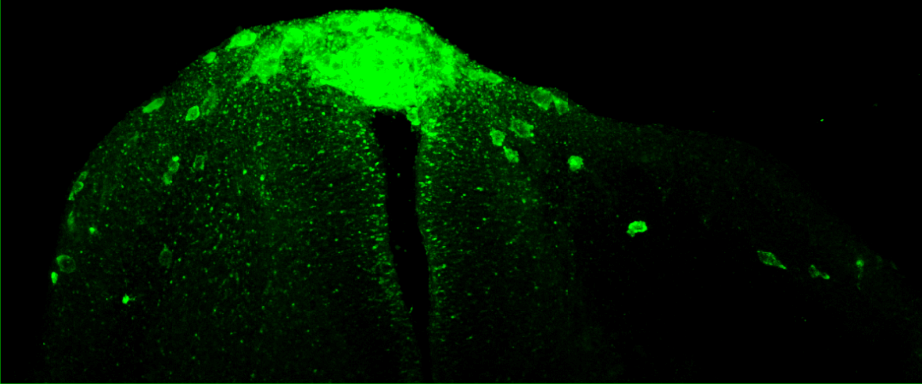
Supplementary Figure S2
*
NT

Slide 3
Supplementary Figure S3

