Slide 1
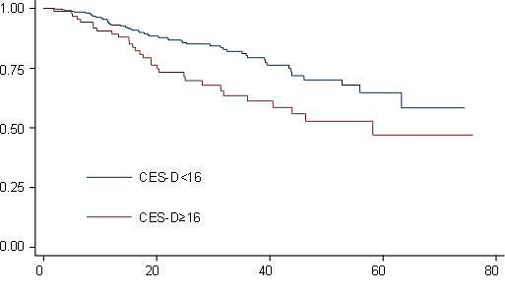
Supplemental Figure 1. Kaplan-Meier survival curves for patients with CES-D ≥16 (with current depressive symptoms) vs. patients with CES-D <16 (without current depressive symptoms). Differences between curves were tested by Log-Rank test with P value shown. Note: MST=median survival time; CES-D= Center for Epidemiologic Studies Depression Scale.
MST>199.8 months
MST=58.26 months
P=0.004
Months
Notes:
Figure 1A∙ Kaplan-Meier survival curves for patients with CES-D ≥16 (with current depressive symptoms) vs. patients with CES-D <16 (without current depressive symptoms). Differences between curves were tested by Log-Rank test with P value shown. MST=median survival time; CES-D= Center for Epidemiologic Studies Depression Scale.

Slide 2
1.00
MST>199.8 months
MST>199.8 months
0.75
MST>199.8 months
0.50
MST=58.257 months
0.25
P=0.025
0.00
0
20
40
60
80
Months
Long Telomere and MDD negative
Short Telomere and MDD Negative
Long telomere and MDD positive
Short telomere and MDD positive
Supplemental Figure 2. Kaplan-Meier survival curves by cross-classification of lifetime MDD (positive vs. negative) and telomere length (long vs. short). Telomere length was categorized (long vs. short) by median split. Differences between curves were tested by Log-Rank test with P value shown. Note: MST=median survival time; MDD=Major Depression Disorder.
Notes:
Figure 3A. Kaplan-Meier survival curves by cross-classification of CES-D (≥16 vs. <16) and telomere length (long vs. short). Telomere length was categorized (long vs. short) by median split. Differences between curves were tested by Log-Rank test with P value shown. MST=median survival time; CES-D= Center for Epidemiologic Studies Depression Scale.

