Slide 1
Supplementary Figure 1. DNA-PK expression and tumour specific PRKDC locus amplification
17727 non-tumour
17727 HCC
05178 non-tumour
05178 HCC
06275 non-tumour
06275 HCC
Reference probe | 03797-L25270 | 04483-L03872 | 07022-L23200 | 06708-L25279 | 10681-L11263 | 16538-L21570 | 14909-L17529 | 09870-L19465
chromosome | 21q22.13 | 1p34.2 | 14q11.2 | 10p11.1 | 6p12.2 | 15q21.1 | 18p11.21 | 2p16.1
nucleotides | 150 | 266 | 305 | 361 | 409 | 439 | 490 | 502
17727 N | 0.27±.01 | 0.64±.02 | 0.40±.01 | 1.43±.01 | 1.00+0.0 | 3.00±0.0 | 1.80±.01 | 1.53±.06
17727 T | 0.33±0.2 | 1.09±.05 | 0.69±0.04 | 1.9±0.10 | 1.60±0.0 | 3.8±0.30 | 2.5±0.17 | 2.56±.06
05178 N | 0.48±.03 | 2.19±.05 | 0.99±0.01 | 1.00±0.0 | 3.93±.56 | 2.43±.21 | fail | 1.28±.06
05178 T | 0.88±.03 | 0.53±.02 | 0.70±0.0 | 0.70±0.0 | 0.70±0.0 | 1.23±.15 | 1.0±.17 | 0.76±.05
06275 N | 0.74±.01 | 1.11±.01 | 0.80±.01 | 1.33±.06 | 1.0±0.0 | 2.75±0.35 | 1.9±0.26 | 1.17±.06
06275 T | 0.47±0.4 | 0.72±.63 | 0.76±0.4 | 2.33±.06 | 1.73±.06 | 5.0±.26 | 2.83±0.1 | 2.30±0.1

Slide 2
Supplementary Figure 2. DDR gene expression in HCC cells
A NHEJ
B MMR
C HRR
D NER

Slide 3
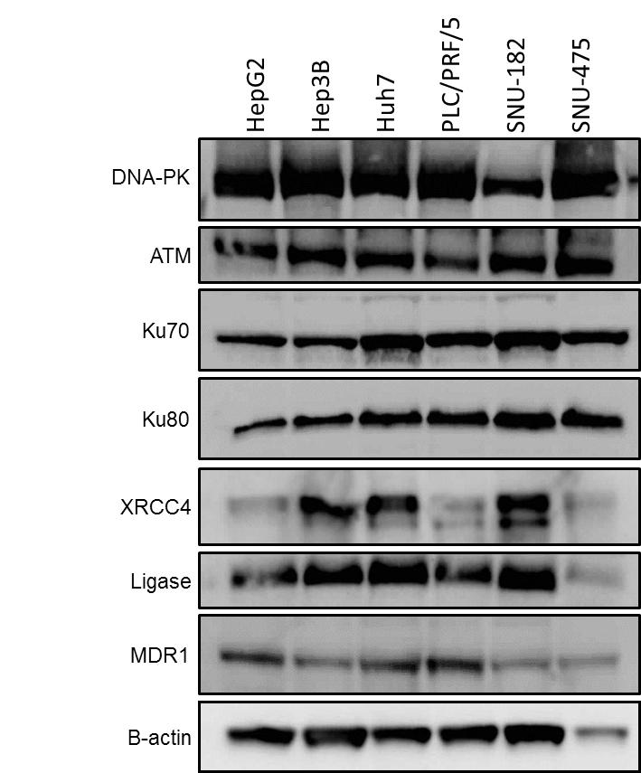
Supplementary Figure 3: DDR protein expression and activity in HCC cells
A
B

Slide 4
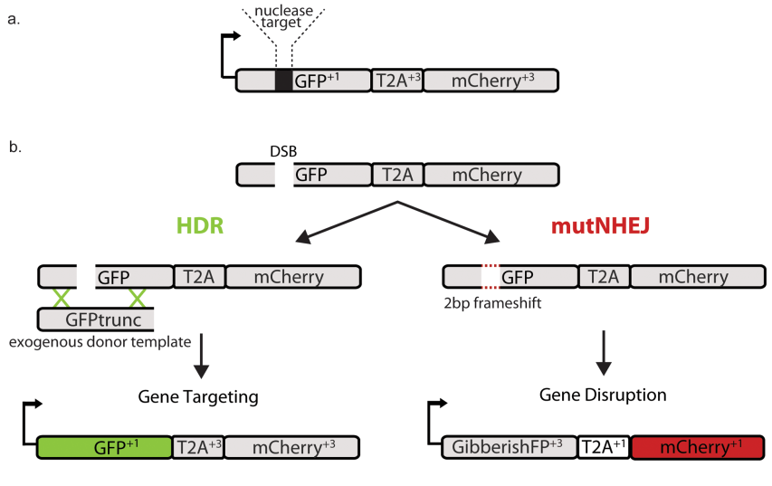
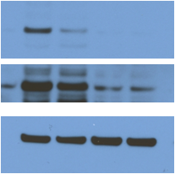
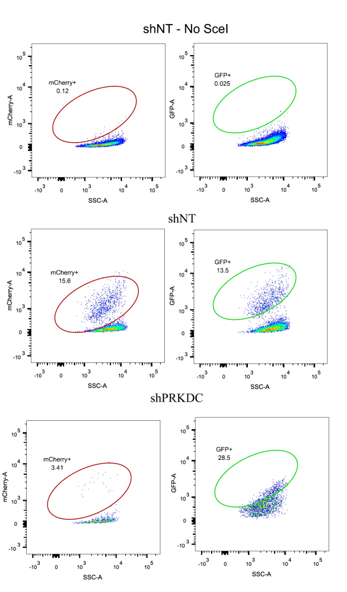
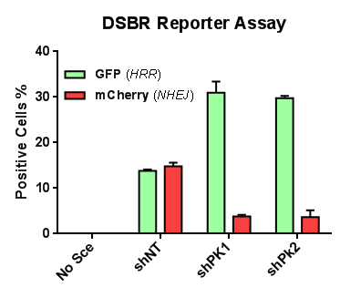
Supplementary Figure 4: Effects of DNA-PKcs knockdown on NHEJ activity
A
HRR
Parental
shPK2
C
shNT
B
shPK1
Anti-DNA-PKcs
(Dark)
Anti-βActin
D

Slide 5
Supplementary Figure 5: Clonogenic survival of HCC cells exposed to IR- and doxorubicin-induced cytotoxicity in HCC cells
A
B

Slide 6
Supplementary Figure 6: DNA-PK inhibition potentiated IR- and doxorubicin-induced cytotoxicity in HCC cells
A
B

Slide 7
Supplementary Figure 7: ATM inhibition potentiated IR- and doxorubicin-induced cytotoxicity in the majority of HCC cells
A
B

Slide 8
Supplementary Figure 8: Combination DNA-PK and ATM inhibition suppressed clonogenic survival in the absence of cyctotoxic injury in HCC cells

Slide 9
Supplementary Figure 9: Combined ATM and DNA-PK inhibition further potentiated IR and doxorubicin cytotoxicity in HCC cells
A
B

Slide 10
Supplementary Figure 10: Neither NU7441 nor KU55933 effect nuclear doxorubicin accumulation
A
B

Slide 11
Supplementary Figure 11: In vivo effects of NU7441 and doxorubicin treatment
A
B

