Slide 1
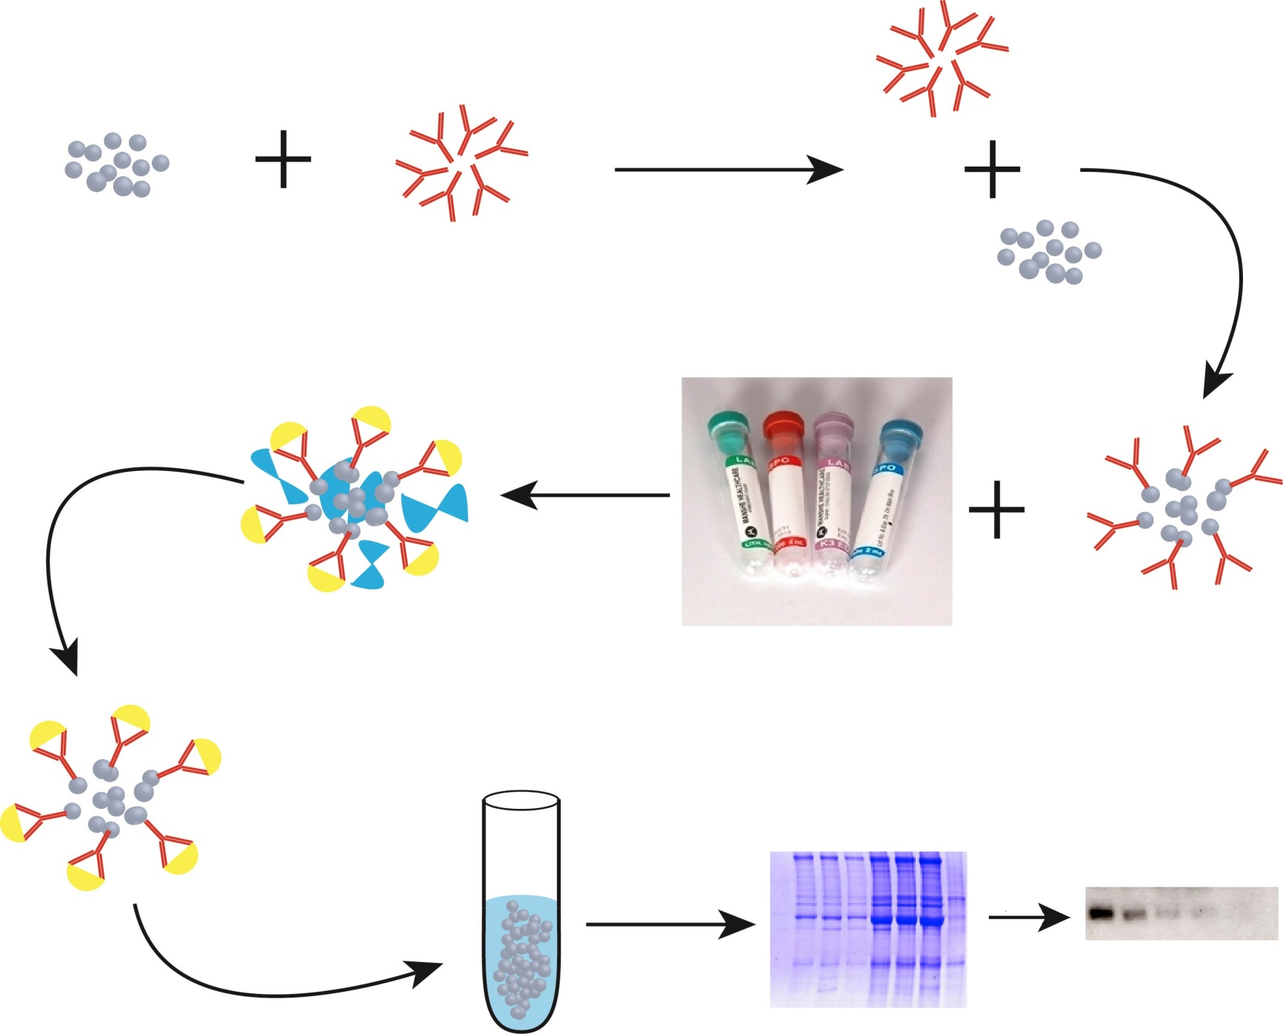
Supplimentary Figures
Supplimentary Figure 1
Ab coupled with
Sepherose at 4°C
CNBr sepherose
MAB 526-4 Ab
Ab coupled Sepherose
Un specific bound proteins are washed
Incubated at
4°C for 4 hrs
Human serum samples
Detection with XPA 210 IgY Ab
bound proteins were eluted with Sample buffer
Analysed by
SDS-PAGE gel
25 kDa

Slide 2
Supplimentary Figure 2
A)
12 13 14 15 16 17 18 19 20
21 22 23 24 25 26 27 28 29 30
25kDa
25kDa
B)
11 12 13 14 15 16 17 18 19 20 21 22
25kDa

Slide 3

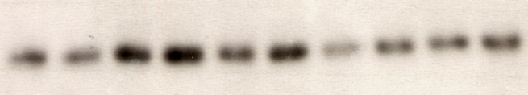
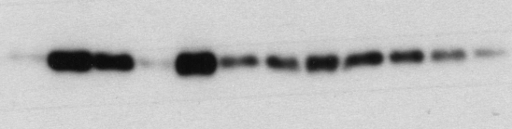
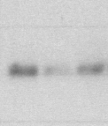

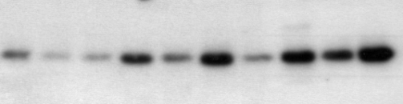
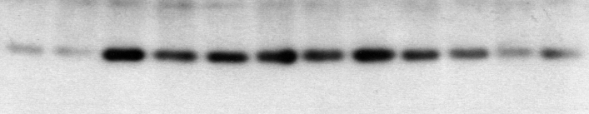
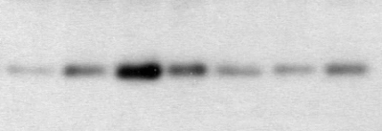
Supplimentary Figure 3
A)
9 10 11 12 13 14 15 16 17
18 19 20 21 22 23 24 25 26 27
25kDa
25kDa
28 29 30 31 32 33 34 35 36 37 38 39
40 41 42
25kDa
25kDa
B)
10 11 12 13 14 15 16 17 18
19 20 21 22 23 24 25 26 27 28
25kDa
25kDa
29 30 31 32 33 34 35 36 37 38 39 40
41 42 43 44 45 46 47
25kDa
25kDa

Slide 4
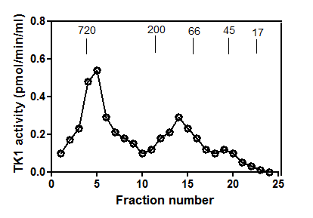
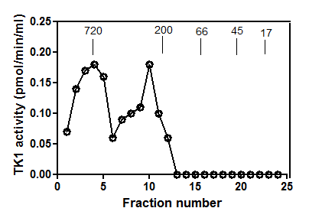
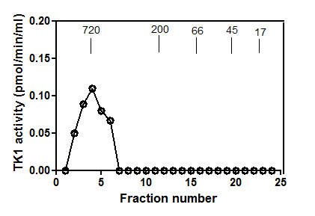
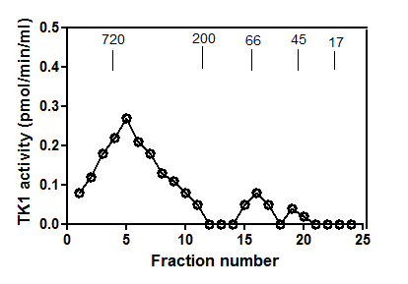
Supplimentary Figure 4
E)
A)
B)
F)
2 4 6 8 10 12 14 16 18 20 22
2 4 6 8 10 12 14 16 18 20 22
25kDa
25kDa
G)
C)
D)
2 4 6 8 10 12 14 16 18 20 22
25kDa

Slide 5
Supplimentary Figure 5
B)
A)
C)

