Slide 1
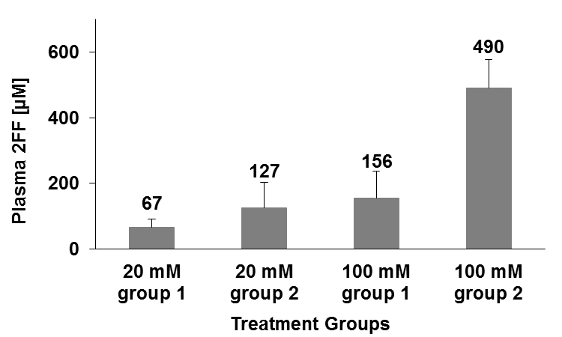
Plasma Levels of 2FF
Figure S2
Plasma samples were collected from NY1DD mice (n=4/group) given 2FF in drinking water for 7 days.
Samples were evaluated for 2FF using an HPLC assay.

