Slide 1
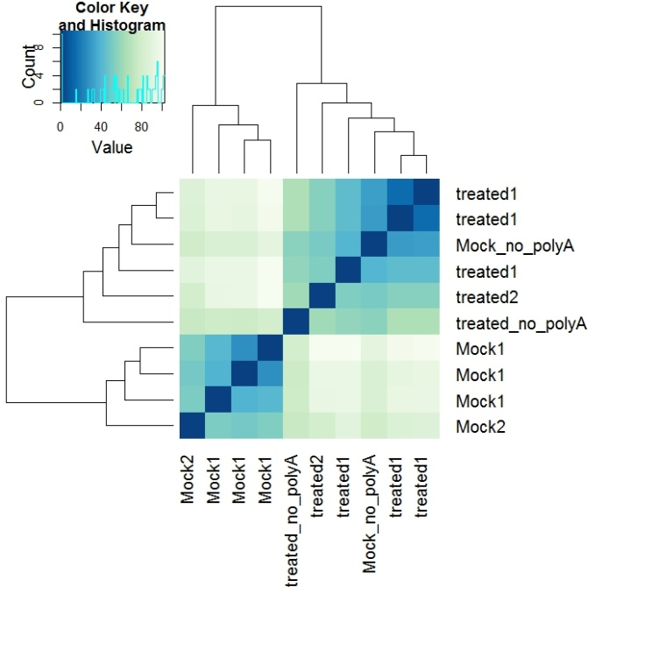
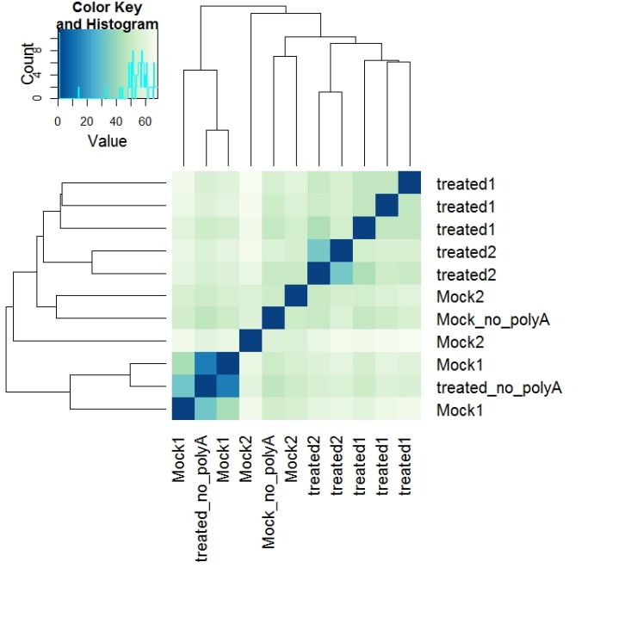
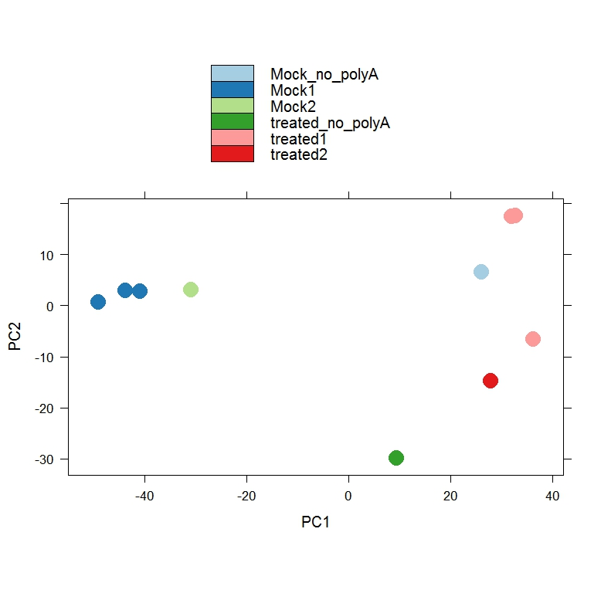
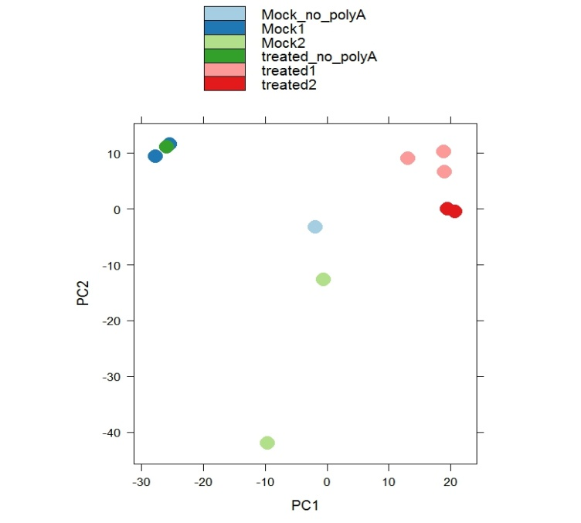
A
B
C
D
Supplementary Figure S2. Clusters (A, B) and Principal Component Analyses (C, D) of polyA selection and rRNA depletion cDNA library preparation methods using DESeq2 package. Cv. Lahontan (A, C); cv. Moapa 69 (B, D).

Slide 2
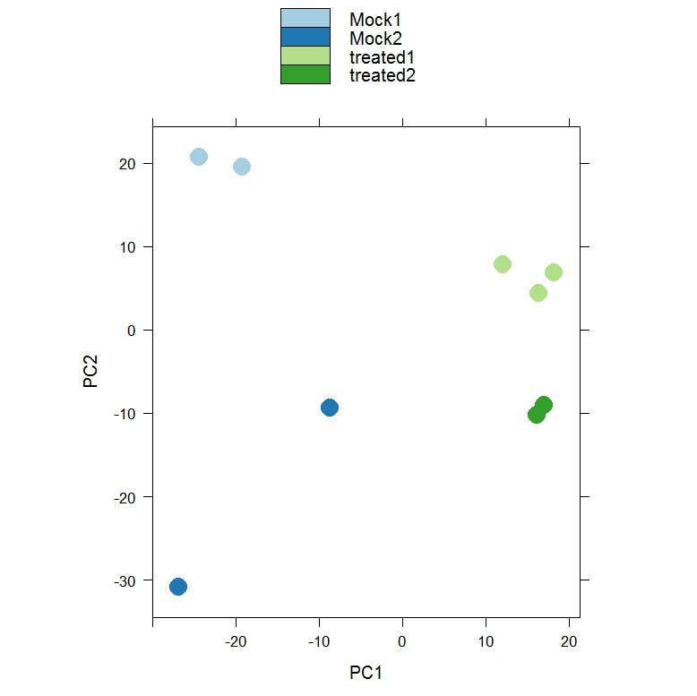
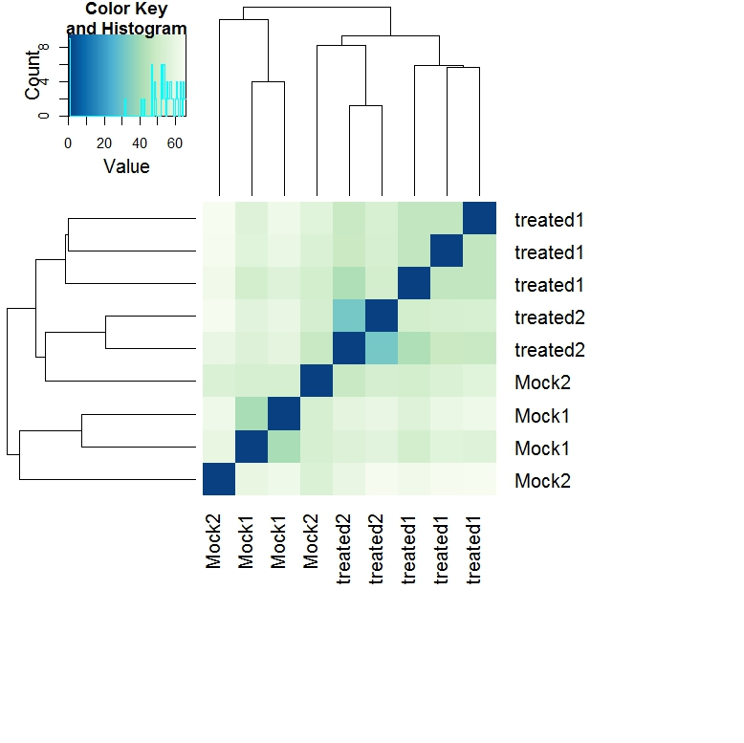
Moapa 69, only samples with poly A selection
A
B
Cluster (A) and PCA (B) analysis of Moapa 69
samples with poly A selection type of library preparation using DESeq2 package.

