Slide 1
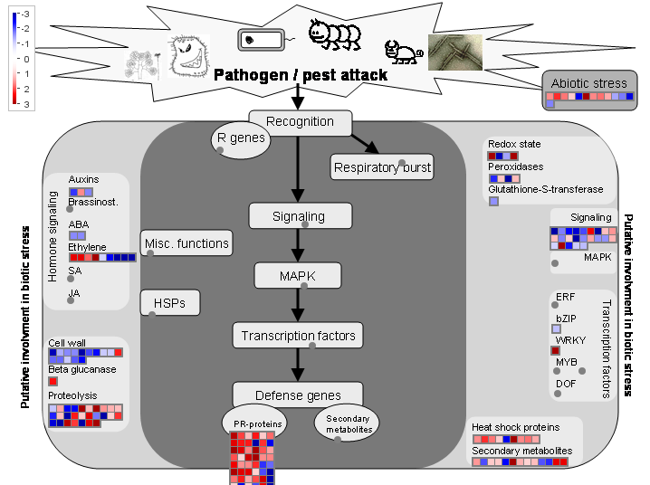
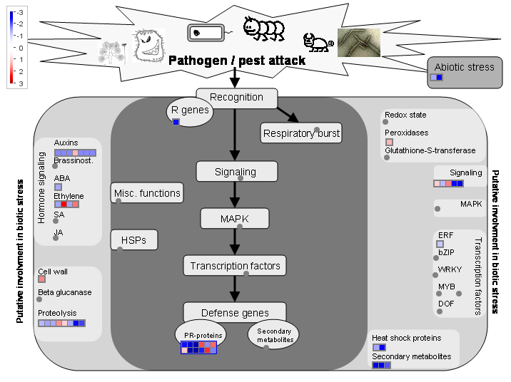
cv. Lahontan
cv. Moapa 69
Supplementary Figure S2. MapMan representation of the genes related to biotic stress.

