Slide 1
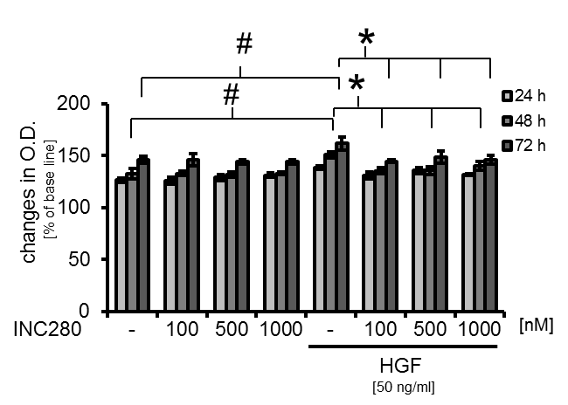
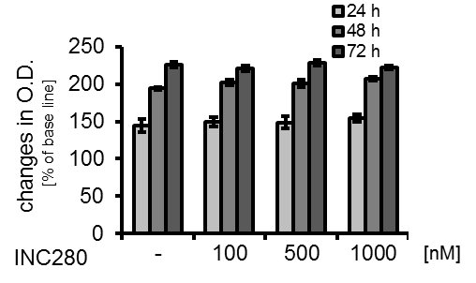
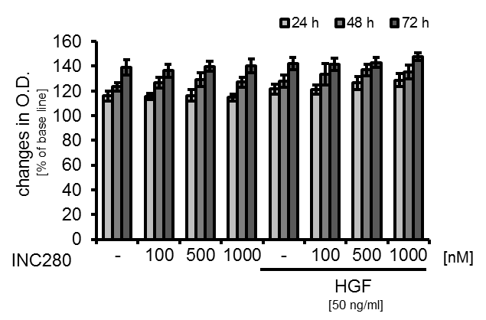
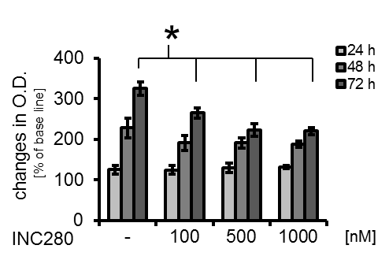
Supplementary Figure 3
Effects of cMET inhibition on human ECs and VSMCs
A
B
C
D
Supplementary Figure 3: Effects of targeting cMET on ECs and VSMCs.
A) No effect of targeting cMET with INC280 on ECs was detected upon constitutive conditions. B) HGF induces growth of ECs after 48 and 72 hours of incubation (#P<0.05). Incubation with INC280 impairs this (*P<0.05). C) In VSMCs, INC280 led to inhibition of constitutive growth upon constitutive conditions (*P<0.05). D) Upon serum-starved conditions, no effect on constitutive growth was detectable. Similar, stimulation of VSMCs with HGF did not affect in vitro growth. Bars = SE.

