Slide 1
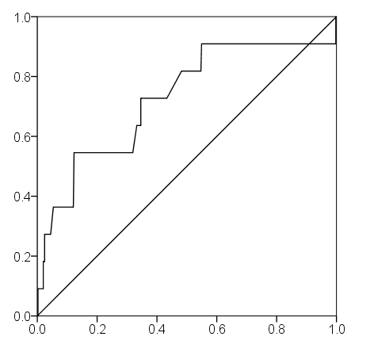
Additional file 2: ROC curve of the incidence of SAEs for LAC⊿
sensitivity
1-specificity

