Slide 1
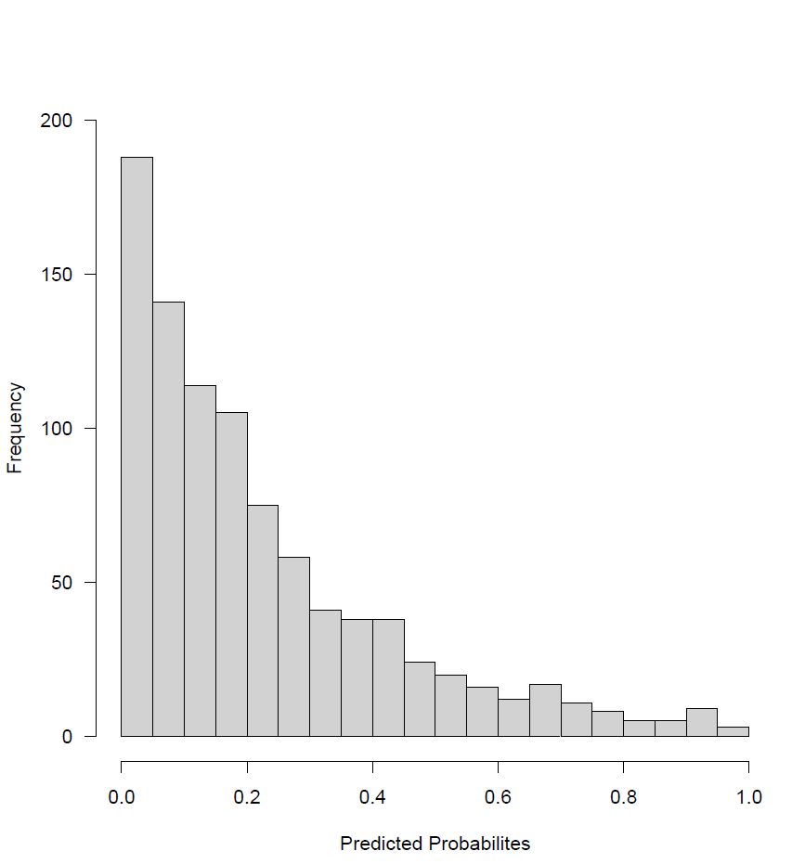
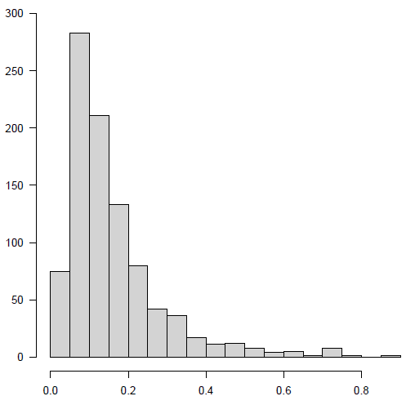
Frequency
Need for Hospitalization
Decision of the clinical team for hospitalization
Frequency
Predicted probability
Predicted probability

