Slide 1
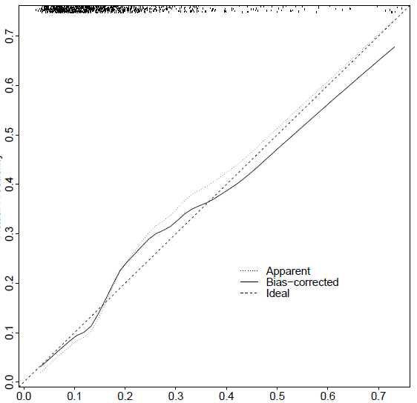
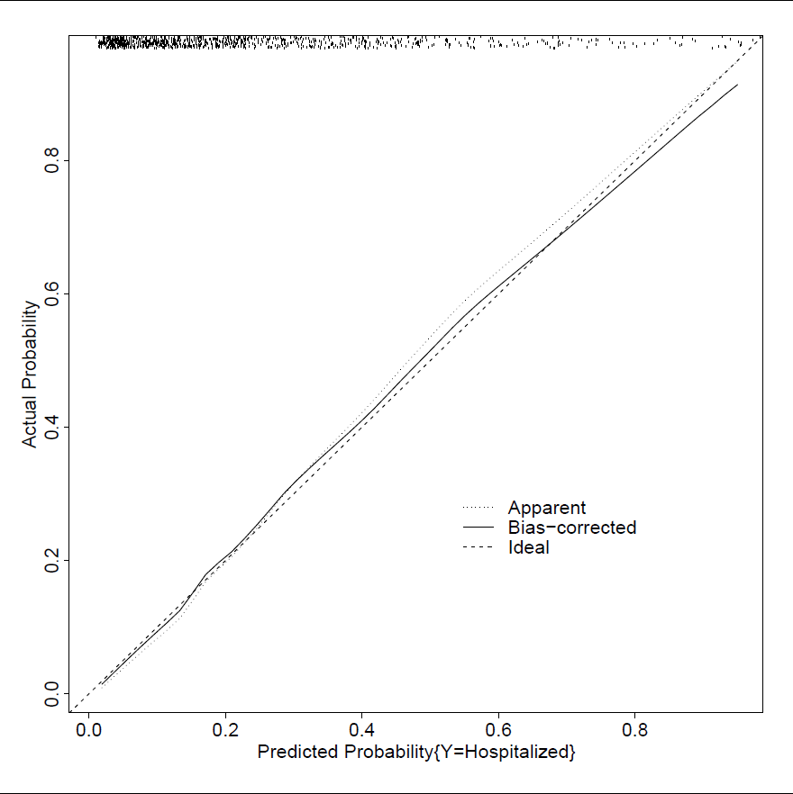
Decision of clinical team for hospitalization
c-index = 0.83
Need for hospitalization
c-index = 0.74
Actual probability
Actual probability
Actual probability
Predicted probability
Predicted probability
Predicted probability

