Slide 1
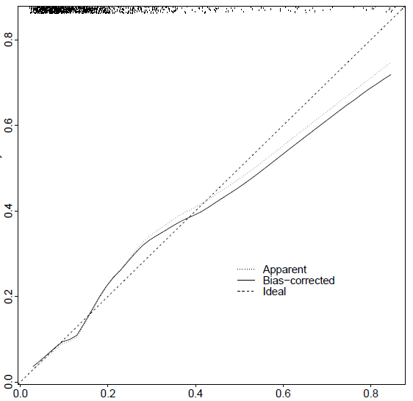
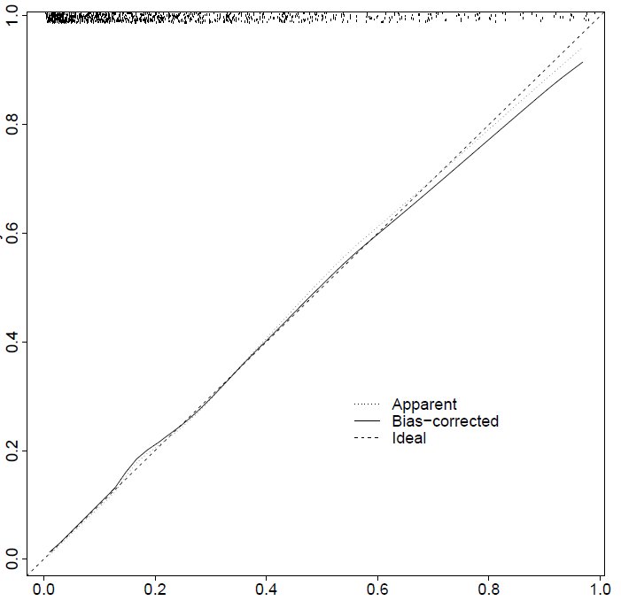
Need for hospitalization
c-index = 0.73
Decision of clinical team for hospitalization
c-index = 0.81
Actual probability
Actual probability
Predicted probability
Predicted probability

