Slide 1
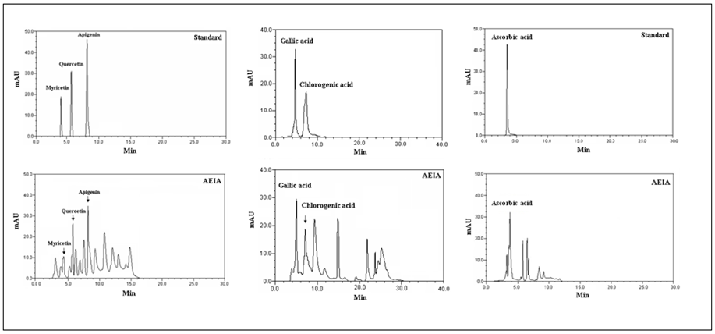
A
B
C
Supple fig. 1

