Slide 1
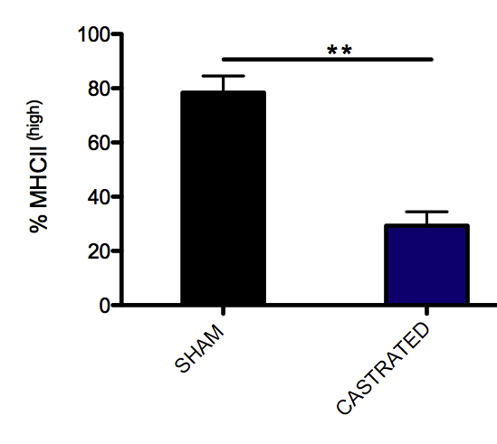
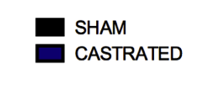
Supplemental Figure 2
Sham
Castrated
Overlay
# of cells
% of Max
MHCII
MHCII

