Slide 1
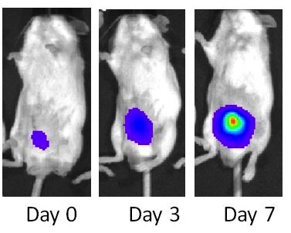

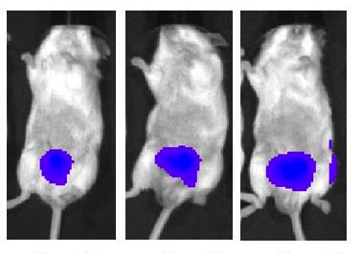
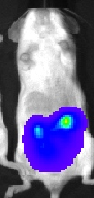
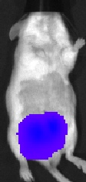
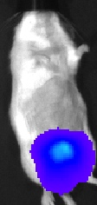
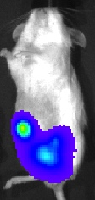
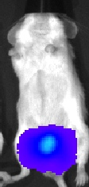
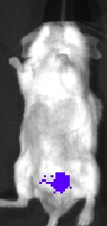
Supplemental Figure 5
A
Sham
B
Control
Luminescence
1.2x10⁸
CWR22Rv1
Day 0 Day 3 Day 7
0.8x10⁸
Castrated
0.4x10⁸
Day 0 Day 3 Day 7
Radiance
(p/sec/cm²/sr)
Castration
C
Cast
Cast + PLX3397
Luminescence
Luminescence
1.5x10⁸
1.5x10⁷
Day 0
1.0x10⁸
1.0x10⁷
0.5x10⁸
0.5x10⁷
Day 7
Radiance
(p/sec/cm²/sr)
Radiance
(p/sec/cm²/sr)

