Slide 1
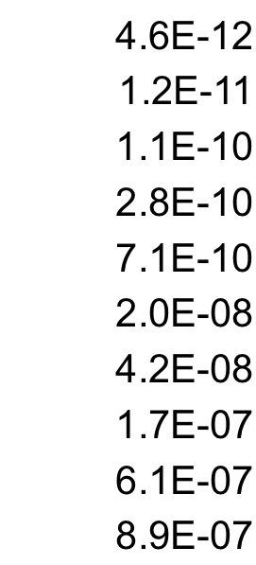
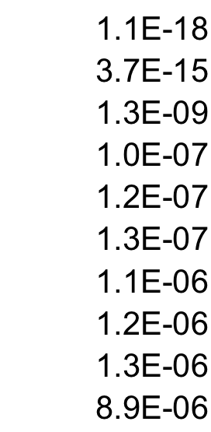
Figure S1
A
B
C
1.1E-32
3.3E-29
3.9E-18
9.0E-16
1.2E-15
8.7E-14
1.2E-13
1.7E-12
6.1E-11
2.8E-10
2.1E-05
1.0E-04
4.8E-04
6.1E-04
1.4E-03
7.7E-03
1.1E-02
2.2E-02
2.4E-02
2.7E-02
9.7E-05
4.6E-04
2.0E-03
1.0E-02
1.1E-02
1.1E-02
1.2E-02
1.3E-02
1.5E-02
1.6E-02
D
E
2 WT / 0 WT - LUAD
2 WT / 0 WT - LAML
Notes:
Supplementary Figure 1

Slide 2
Figure S2
A
11 58 7
19 53 2
9 35 9
16 94 5
%
Mutant
Reads
per
Tumor
WT TP53 RNA Reads
MUT TP53 RNA Reads
CRC
OVCA
UCEC
BRCA
B
Mean
RNAseq
reads
per
tumor
WT TP53 RNA Reads
MUT TP53 RNA Reads
CRC
OVCA
UCEC
BRCA
Notes:
Supplementary Figure 2

Slide 3
Figure S3
A
B
Fold Change: 0 WT / 2 WT
P Value
P53
**
E2F1 Target Genes
**
**
4.0E-30
**
**
3.3E-26
1.0E-25
**
**
#
Target
Genes
Per Bin
5.9E-25
Fraction with E2F1 site
*
**
3.3E-24
**
2.4E-23
REP
3.1E-23
REP
1.0E-22
2.5E-22
1.2E-21
10⁻¹²
10⁻⁶
Bin #
Significance
C
D
Fold Change: 0 WT / 2 WT
Fold Change: 0 WT / 2 WT
P Value
P53
P Value
P53
3.1E-23
REP
7.2E-24
1.0E-22
REP
3.1E-23
REP
4.4E-22
1.0E-22
REP
1.2E-21
REP
5.6E-22
REP
1.3E-21
REP
1.2E-21
REP
1.8E-21
1.3E-21
REP
1.3E-20
REP
2.8E-21
1.5E-19
4.1E-24
1.1E-16
REP
1.3E-20
REP
2.3E-16
1.0E-19
MYBL2 Putative Target Genes
FOXM1 Target Genes
#
Target
Genes
Per Bin
#
Target
Genes
Per Bin
10⁻¹²
10⁻⁶
Bin #
10⁻¹²
10⁻⁶
Bin #
Significance
Significance
Notes:
Supplementary Figure 3

