Slide 1
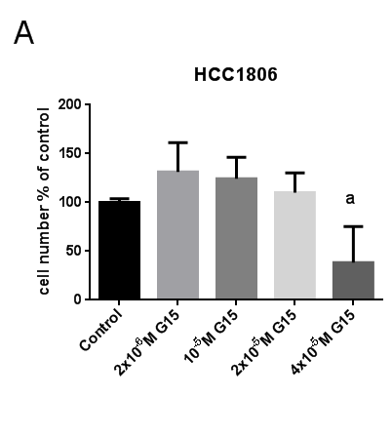
Girgert et al.
Figure S2

