Slide 1
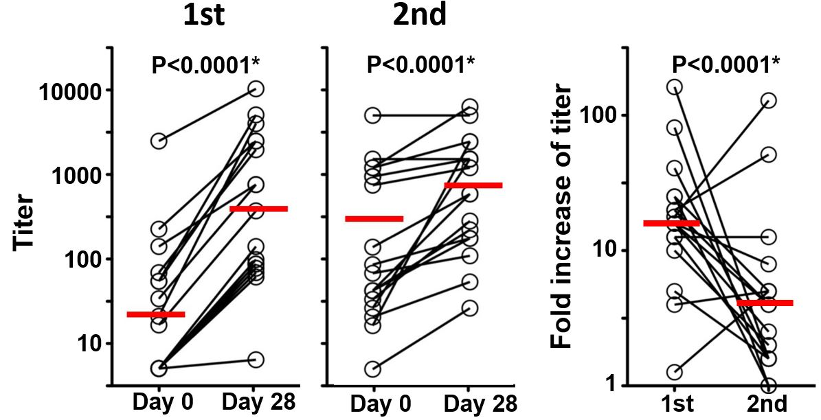
ONLINE SUPPLEMENT 1
Serum neutralizing antibody response to repeated IIV immunization.
Serum samples collected on days 0 and 28±4 after each vaccination in the study subjects (n=18) were serially diluted, starting at 1:10, to measure titers of neutralizing antibodies against pH1N1 in triplicate. A. Titer of pH1N1-specific serum antibodies before and after the first and second immunization. B. Fold increase of titer after the first and second immunization. Horizontal bars indicate geometric mean of titer (A) or fold increase of titer (B). A separate accelerated-failure (lognormal) regression model was fit to the interval-censored titer data for each combination of immunization and day. Hypothesis testing employed perturbation resampling (Jin et al. 2001) with first-order bias correction (Davison and Hinkley 1997). Triplicate titers for each combination of person, immunization and day were union combined (e.g., {[a, b), [a, b), [b, c)} → {[a, c)}) prior to regression analysis. Reported are p-values adjusted by sequential Bonferonni correction for multiple comparisons. * indicates statistically significant difference after the adjustment.
References
Jin, Z., Ying, Z., & Wei, L. J. (2001). A simple resampling method by perturbing the minimand. Biometrika, 88:381-390.
Davison, A.C. & Hinkley, D.V. (1997). Bootstrap methods and their application. New York: Cambridge University Press. p. 104.
A
B

