Slide 1
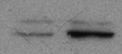
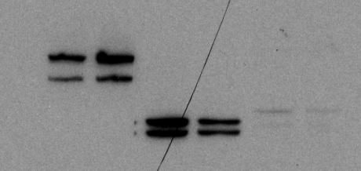
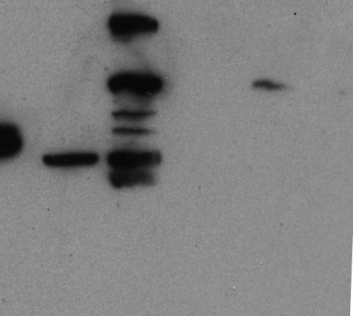
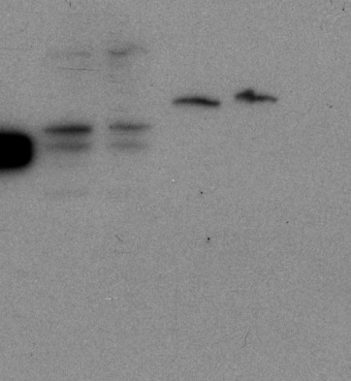
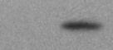
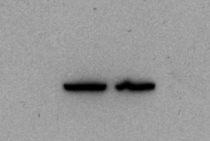
Supplementary Figure S2
NIH 3T3
NIH 3T3
v-Src
p-ERK (T202/Y204)
ERK
p-JNK (T183/Y185)
JNK
p-Akt (S473)
Akt
p-STAT3 (Y705)
STAT3
- 102
p100/p52
- 76
- 52
Tubulin

