Slide 1
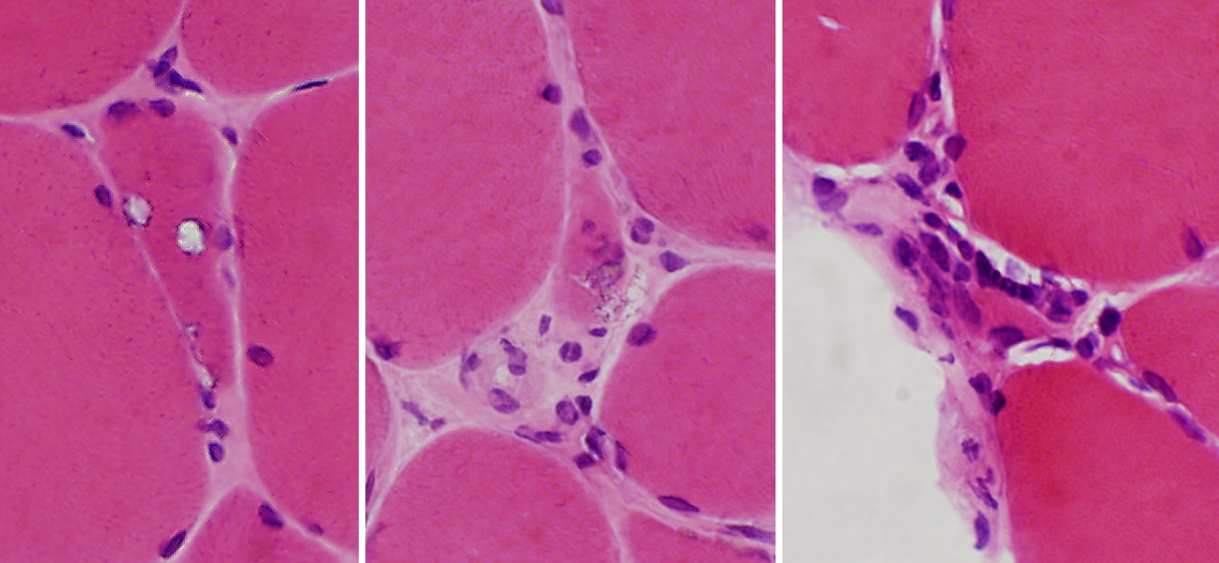
A.
B.
C.
Supplemental Figure 1: Hematoxylin and Eosin staining from a left deltoid muscle biopsy from a patient carrying a p.R95C variant in VCP. A) demonstrates an atrophic fiber with rimmed vacuoles; B-C) atrophic fibers and endomysial cellularity. Scale bar is 25 uM.

