Slide 1
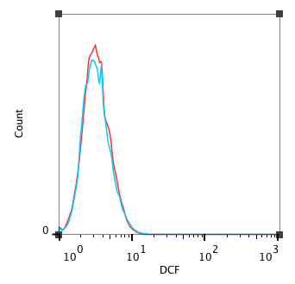
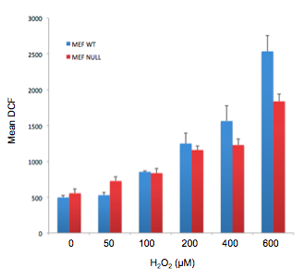
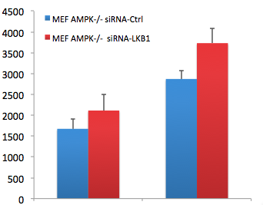




a
b
WT MEF
WT MEF
AMPK-null MEF
AMPK-null MEF
c
d
*
MEF WT
MEF AMPK^{-/-}
Mock Ctrl LKB1 Mock Ctrl LKB1 siRNA
Mean fluorescence intensity
AMPKα
LKB1
p38α
GAPDH
H₂O₂ - +
Figure S1

