Slide 1
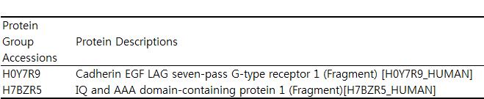
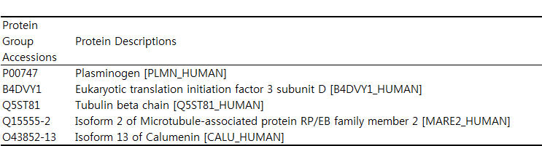
S1 Figure. Human proteins identified from HuDB and HFDB searches of Calu-1 secretome.
A
Venn diagram showing the number of common proteins and the proteins identified exclusively from HuDB search (detailed in B) or HFDB search (detailed in C)
HuDB
5
396
2
HFDB

Slide 2
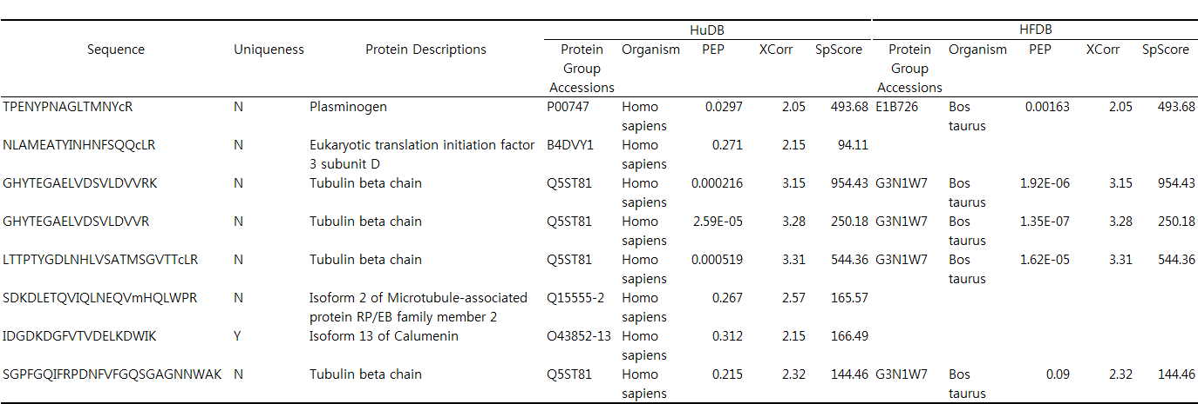
S1 Figure
B
The list is solely identified human protein groups in HuDB. But, almost all PSMs were matched to bovine protein groups in HFDB

Slide 3
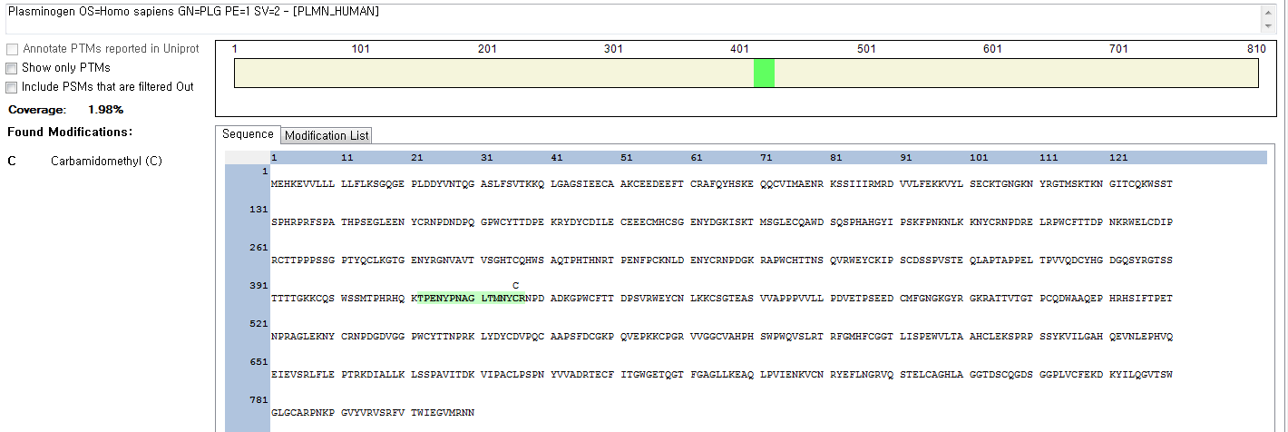
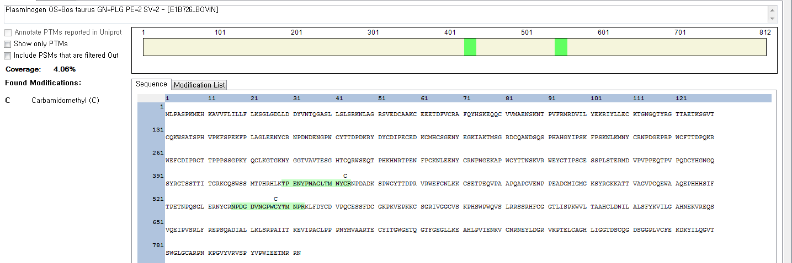
S1 Figure
B
Plasminogen (Human) in HuDB → Plasminogen (Bovine) in HFDB
in HuDB
in HFDB

Slide 4
S1 Figure
B
TPENYPNAGLTMNYcR

Slide 5
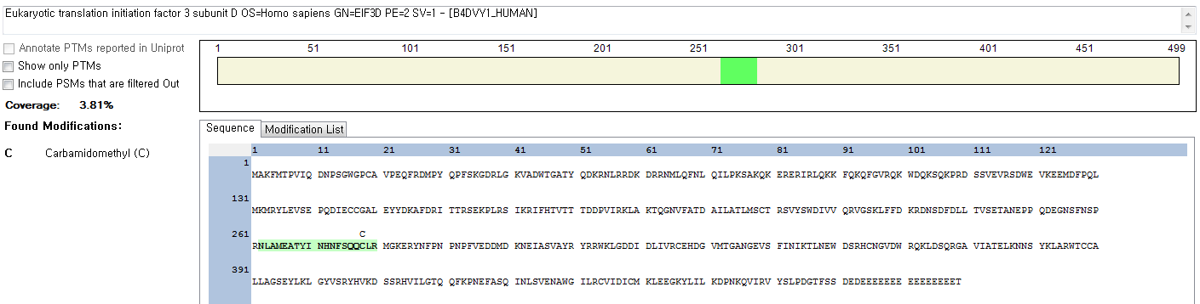
S1 Figure
B
Eukaryotic translation initiation factor 3 subunit D (Human) in HuDB → none in HFDB
NLAMEATYINHNFSQQcLR

Slide 6
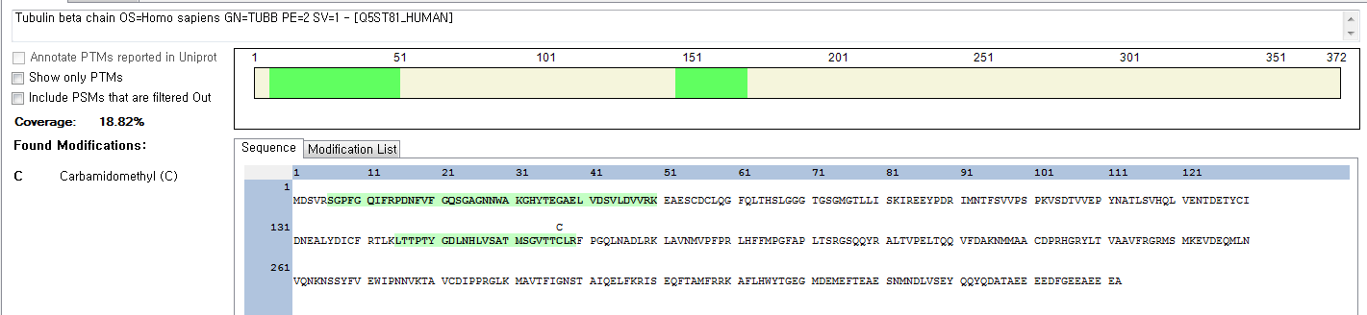
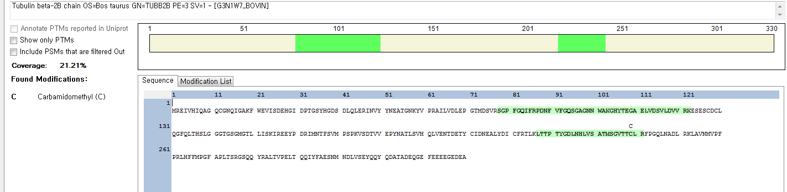
S1 Figure
B
Tubulin beta chain (Human) in HuDB → Tubulin beta chain (Bovine) in HFDB
in HuDB
in HFDB

Slide 7
S1 Figure
B
GHYTEGAELVDSVLDVVRK
GHYTEGAELVDSVLDVVR

Slide 8
S1 Figure
B
LTTPTYGDLNHLVSATMSGVTTcLR
LTTPTYGDLNHLVSATMSGVTTcLR

Slide 9
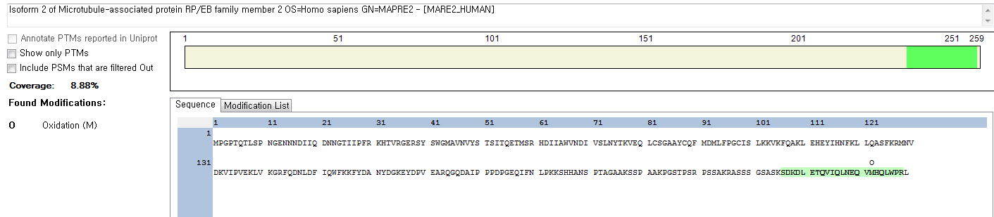
S1 Figure
B
Isoform 2 of Microtubule-associated protein RP/EB family member 2 (Human) in HuDB → none in HFDB
SDKDLETQVIQLNEQVmHQLWPR

Slide 10
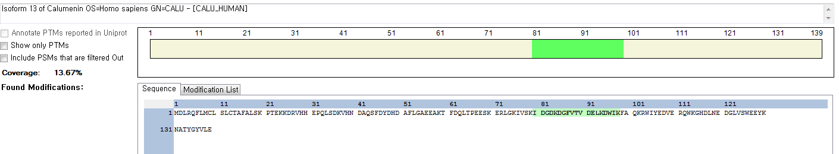
S1 Figure
B
Isoform 13 of Calumenin (Human) in HuDB → none in HFDB
IDGDKDGFVTVDELKDWIK

Slide 11
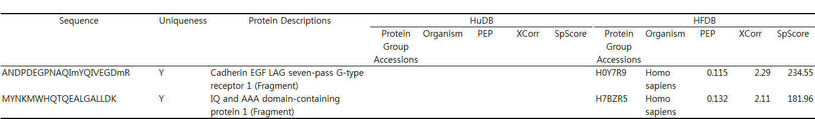
S1 Figure
C
The list is solely identified human protein groups in HFDB. None of PSMs were matched to bovine protein groups in HuDB

Slide 12
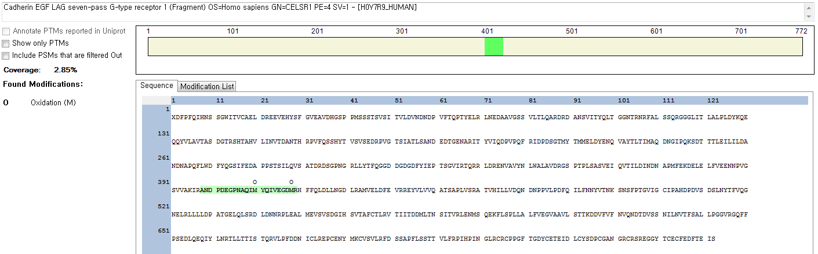
S1 Figure
C
Cadherin EGF LAG seven-pass G-type receptor 1 (Fragment) (Human) in HFDB → none in HuDB
ANDPDEGPNAQImYQIVEGDmR

Slide 13
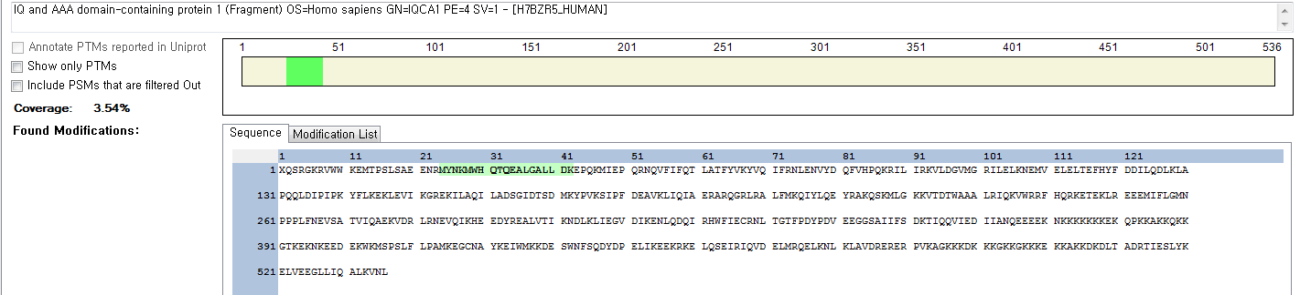
S1 Figure
C
IQ and AAA domain-containing protein 1 (Fragment) (Human) in HFDB → none in HuDB
MYNKMWHQTQEALGALLDK

