Slide 1
Table S1 – Protein Constructs
Tag Abbreviation | Vector | Parent Vector | Sequence
MHTSHP | pMHTSHP | pMAL-c2x | MKIEE…[same as parent]…IEGRISGHHHHHHHHDYDIPSSENLYFQGSASWSHPQFEKSGHHHHHHHHDYDIPSSLEVLFQ / GP
HMT | pT7HMT | pET28 | MGSSHHHHHHSSGLVPRGSQHMGMEQKLISEEDLNGENLYFQ / G
SbpPHMT | pSbpPHMT | pFastBac1 | MDEKTTGWRGGHVVEGLAGELEQLRARLEHHPQGQREPGGGSGGGSGGGSLEVLFQGPHHHHHHEQKLISEEDLNENLYFQG
HbmHSbpMT | pHbmHSbpMT | pFastBac1 | MKFLVNVALVFMVVYISYIYAAPHHHHHHHHMDEKTTGWRGGHVVEGLAGELEQLRARLEHHPQGQREPHMEQKLISEEDLNENLYFQ / G
 |  |  | (Protease cut site used in purification shown with “/” between amino acids)
Protein Expressed | Vector | Amino Acids | Sequence
HMT–IhogFn12 | pT7HMT | 466–679 | [HMT Tags]–ST–YPPTPP…TQRPKTS
HMT–IhogFn12ΔH | pT7HMT | 466–679 | IhogFn12 with R503E, K507E, K509E, R547E
HMT–IhogFn1 | pT7HMT | 466–577 | [HMT Tags]–ST–YPPTPP…PGAALD
HMT–IhogFn2 | pT7HMT | 578–679 | [HMT Tags]–ST–PMPVPE…TQRPKTS
HMT–BocFn3 | pT7HMT | 710–817 | [HMT Tags]–ST–ERPVAG…RKSSGQ
HMT–BocFn23 | pT7HMT | 607–817 | [HMT Tags]–ST–EAPDRP…RKSSGQ
HMT–BocFn13 | pT7HMT | 472–810 | [HMT Tags]–ST–AEAPII…MICETK
HbmHSbpMT–MmHhip | pHbmHSbpMT | 193–667 | [HbmHSbpMT Tags]–S–SNYLGQM…YLGPQCE
HMT–IL6 | pT7HMT | 25–211 | [HMT Tags]–ST–FPTSQVR…LRSTRQT
MHTSHP–ShhN | pMHTSHP | 26–189 | [MHTSHP Tags]–GS–GPGRGFG…HCSVKAE
MHTSHP–ShhN-SC | pMHTSHP | 26–189 | ShhN with P42A, K46A, R154A, S157A, S178A, K179A
MHTSHP–HhN | pMHTSHP | 86–248 | [MHTSHP Tags]–GS–GPGRG…CSVKSD
MmPtcT1 | pSbpPHMT | 2–1174 | [SbpPHMT Tags]–GS–ASAGNA…EVSPAN
DmPtcT1 | pSbpPHMT (or pFastBac Dual with IhogFn12TM) | 1–1114 | [SbpPHMT Tags]–GS–MDRDSL…EAELVP
AcrB | pET21a | 1–1049 | MPNFFI…HTVDHH–AAA–[SbpPHMT Tags]
HhFL | pFastBac Dual | 1–471 | MDNHSS…QSWRHD
ShhFL | pFastBac Dual | 1–437 | MLLLLA…MAVKSS
IhogFn12TM | pFastBac Dual | 1–20, 466–742 | MTLLTS…TSRLEA–YPPTPP…SRGNNP
Hhat | pFastBac Dual | 1–499 | MLPGWE…QTYTVL
Ski | pFastBac Dual | 1–500 | MSRLPD…SKTKTF
 |  |  | (Native sequences shown in bold, tag and vector-derived shown as plain text)

Slide 2
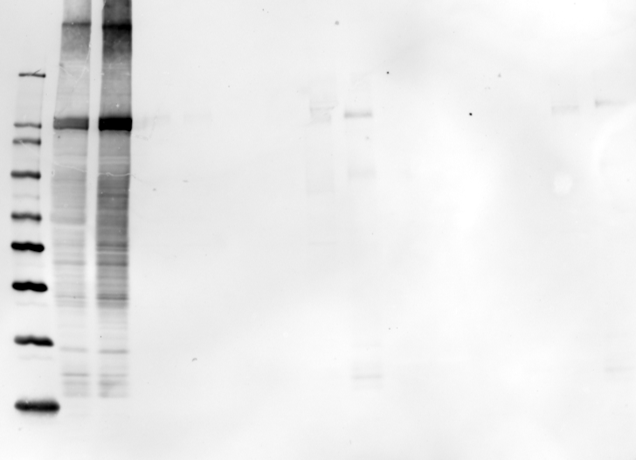
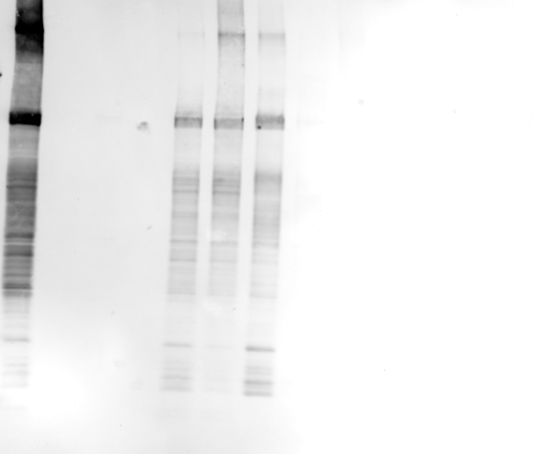
Figure S1 – Detergent solubilization of DmPtcT1
kDa
220
120
DmPtcT1
100
80
60
50
40
30
20
M.W. marker |  | Membranes | S | FT | E | S | FT | E | S | FT | E | S | FT | E
Membranes | S | FT | E | S | FT | E | S | FT | E | S | FT | E
OM
DDM
OG
Cymal-6
CHAPS
FC16
TDAO
TX-100
S – Solubilized protein
FT – Flowthrough from batch incubation with Ni²⁺ resin
E – Elution from Ni²⁺ resin

Slide 3
Figure S2 – SEC of Ptc proteins after exchanging into different detergents
void
Ptc oligomer
void
670
158
44
1.35
kDa
LDAO
DDM
Cymal 7
DM
UV
time

Slide 4
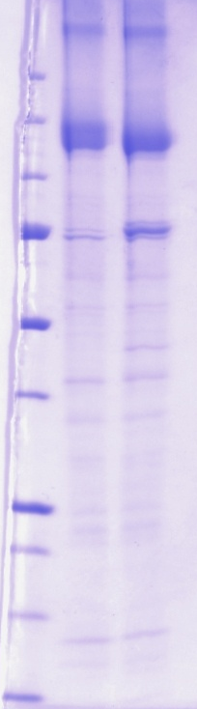
Figure S3 – Ptc proteins can be deglycosylated

Slide 5
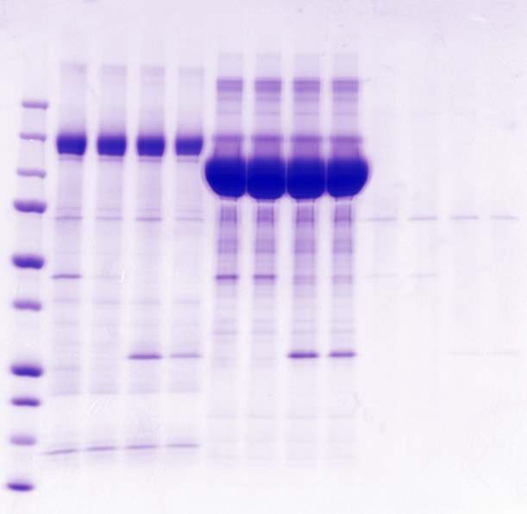
Figure S4 – His-tagged membrane proteins pull down his-tagged proteins
kDa
250
150
MmPtcT1
100
AcrB
75
50
BocFn13
37
25
IL-6
20
15
10
MmPtcCT1 Beads
AcrB Beads
Blank Beads
BocFn13
IL-6
Ca²⁺
EGTA

Slide 6
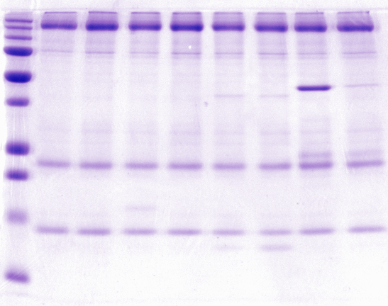
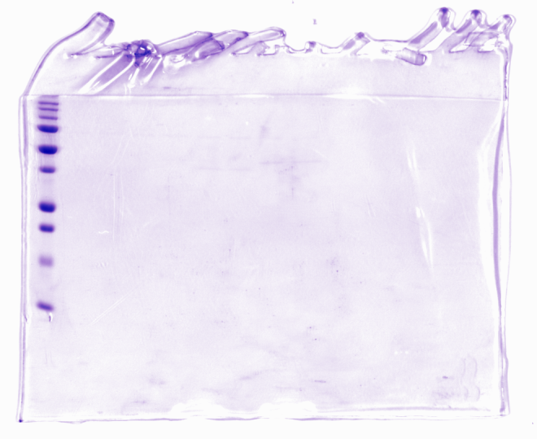
Figure S5 – Dimerization of his-tags in the presence of calcium
B
Pulldown of Boc by MmPtcT1 is Dependent on His-Tag
A
MmPtcT1
His₆-Mediated Dimers
Superdex75 10/300 Gel Filtration
BocFn13
mAU
Untagged BocFn13
70
60
50
BocFn3
40
HMT-BocFn3
Untagged BocFn3
30
– Ca²⁺
+/– Ca²⁺
MmPtcCT1 Beads
Blank Beads
Untagged BocFn3
BocFn3
Untagged BocFn13
BocFn13
Ca²⁺
EGTA
20
+ Ca²⁺
10
0
0
5
10
15
20
25
ml

Slide 7
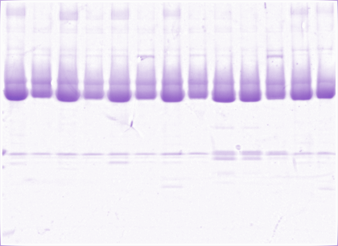
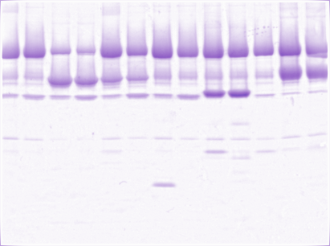
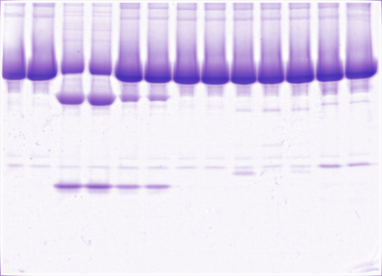
Figure S6 – Pulldown of MmPtcT1 by ShhN
Ptc
MBP-ShhN
MBP-ShhN-SC
Hhip
MBP
BocFn13
BocFn3
MHTSHP Beads
ShhN Beads
ShhN-SC Beads
MmPtcCT1
ShhN
ShhN-SC
BocFn3
BocFn13
Hhip
Heparin
Ca²⁺
EGTA

Slide 8
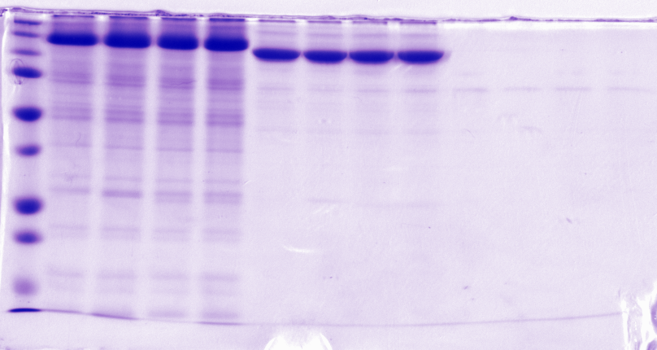
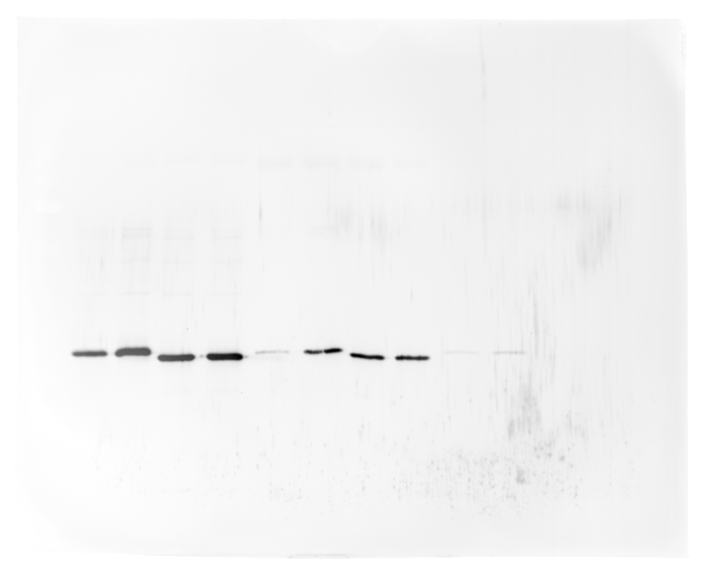

Figure S7 – Pulldown of IhogFn12 by DmPtcT1 beads vs. AcrB and blank control beads
kDa
DmPtcT1
75
AcrB
50
37
25
IhogFn12
IhogFn12ΔH
20
15
< 10
50
37
25
α-Ihog
20
15
< 10
DmPtcT1 Beads
AcrB Beads
Blank Beads
IhogFn12
IhogFn12ΔH
LMWH

Slide 9
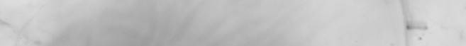
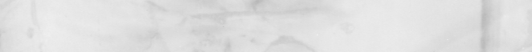
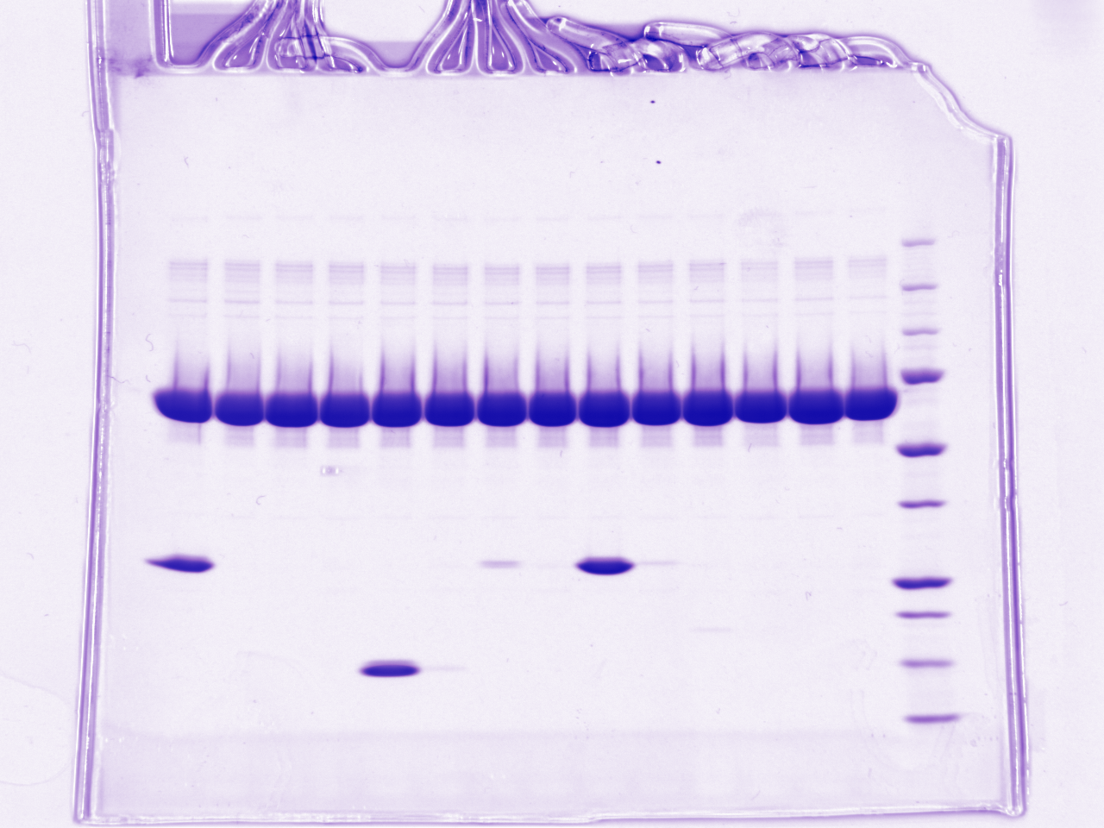
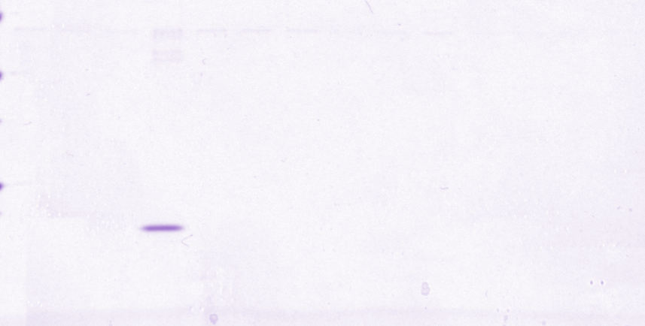
Figure S8 – Pulldown of DmPtcT1 by HhN
4°C
25°C
4°C
25°C
α-Myc (Ptc)
MBP-HhN
IhogFn12 or ΔH
HhN
IhogFn1 or 2
MBP-HhN Beads
Amylose Beads
DmPtcT1
HhN
IhogFn12
IhogFn12ΔH
IhogFn1
IhogFn2
LMWH

