Slide 1
Figure S1
β1
β2
β3
β4
αA
*2
h_ALDH1B1_wt RYSSAAALPSPILNPDIPYNQLFINNEWQDAVSKKTFPTVNPTTGEVIGHVAEGDRADVDRAVKAAREAFRLGSPWRRMD
h_ALDH2_wt SAAATQAVPAPNQQPEVFCNQIFINNEWHDAVSRKTFPTVNPSTGEVICQVAEGDKEDVDKAVKAARAAFQLGSPWRRMD
::: *:*:* :*:: **:******:****:********:***** :*****: ***:****** **:*********
h_ALDH1B1_wt ASERGRLLNLLADLVERDRVYLASLETLDNGKPFQESYALDLDEVIKVYRYFAGWADKWHGKTIPMDGQHFCFTRHEPVG
h_ALDH2_wt ASHRGRLLNRLADLIERDRTYLAALETLDNGKPYVISYLVDLDMVLKCLRYYAGWADKYHGKTIPIDGDFFSYTRHEPVG
**.****** ****:****.***:*********: ** :*** *:* **:******:******:**:.*.:*******
h_ALDH1B1_wt VCGQIIPWNFPLVMQGWKLAPALATGNTVVMKVAEQTPLSALYLASLIKEAGFPPGVVNIITGYGPTAGAAIAQHMDVDK
h_ALDH2_wt VCGQIIPWNFPLLMQAWKLGPALATGNVVVMKVAEQTPLTALYVANLIKEAGFPPGVVNIVPGFGPTAGAAIASHEDVDK
************:**.***.*******.***********:***:*.**************:.*:*********.* ****
h_ALDH1B1_wt VAFTGSTEVGHLIQKAAGDSNLKRVTLELGGKSPSIVLADADMEHAVEQCHEALFFNMGQCCCAGSRTFVEESIYNEFLE
h_ALDH2_wt VAFTGSTEIGRVIQVAAGSSNLKRVTLELGGKSPNIIMSDADMDWAVEQAHFALFFNQGQCCCAGSRTFVQEDIYDEFVE
********:*::** ***.***************.*:::****: ****.* ***** ************:*.**:**:*
h_ALDH1B1_wt RTVEKAKQRKVGNPFELDTQQGPQVDKEQFERVLGYIQLGQKEGAKLLCGGERFGERGFFIKPTVFGGVQDDMRIAKEEI
h_ALDH2_wt RSVARAKSRVVGNPFDSKTEQGPQVDETQFKKILGYINTGKQEGAKLLCGGGIAADRGYFIQPTVFGDVQDGMTIAKEEI
*:* :**.* *****: .*:******: **:::****: *::********* .:**:**:*****.***.* ******
h_ALDH1B1_wt FGPVQPLFKFKKIEEVVERANNTRYGLAAAVFTRDLDKAMYFTQALQAGTVWVNTYNIVTCHTPFGGFKESGNGRELGED
h_ALDH2_wt FGPVMQILKFKTIEEVVGRANNSTYGLAAAVFTKDLDKANYLSQALQAGTVWVNCYDVFGAQSPFGGYKMSGSGRELGEY
**** ::***.***** ****: *********:***** *::*********** *::. .::****:* **.******
h_ALDH1B1_wt GLKAYTEVKTVTIKVPQKNS
h_ALDH2_wt GLQAYTEVKTVTVKVPQKNS
**:*********:*******
*3
αB
αC
β5
β6
β7
αD
β8
αE
β9
αF
*5
β10 …
… β10
αG
β11
β12
αH
β13
αI …
… αI
αJ
β14
β15
αK
β16
αL
β17
αM
β18
αN …
… αN
β17
Notes:
S1

Slide 2
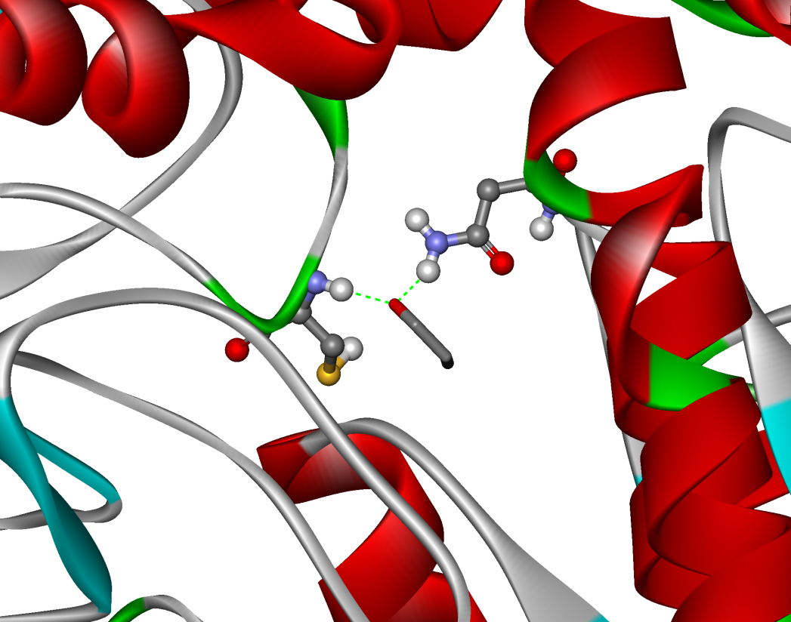
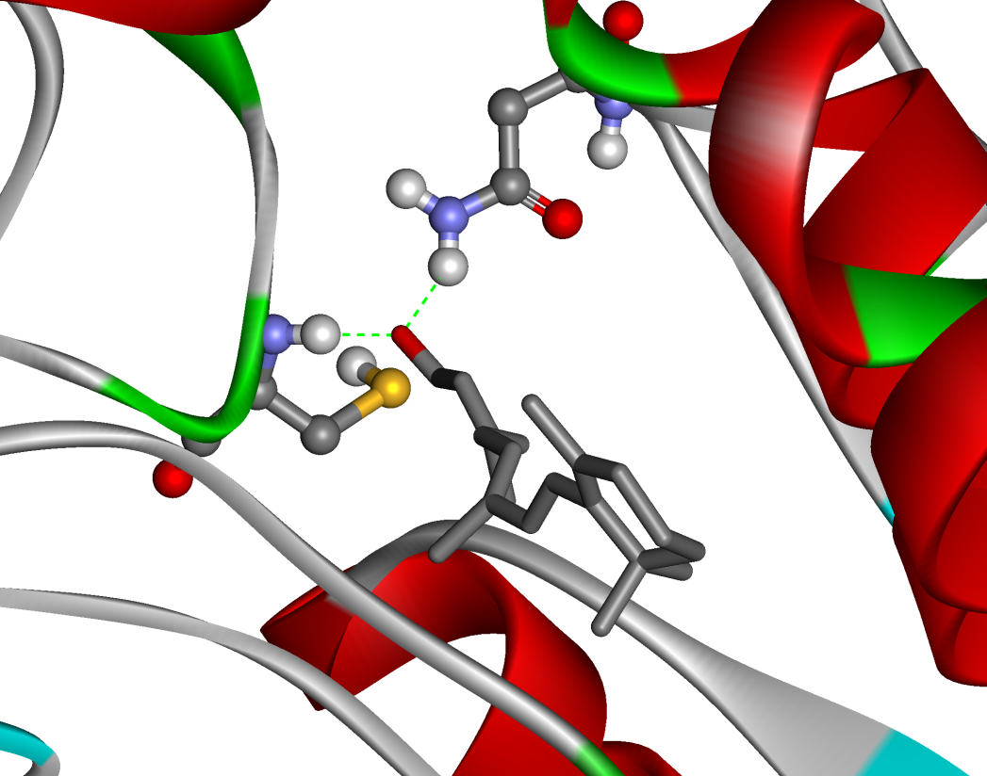
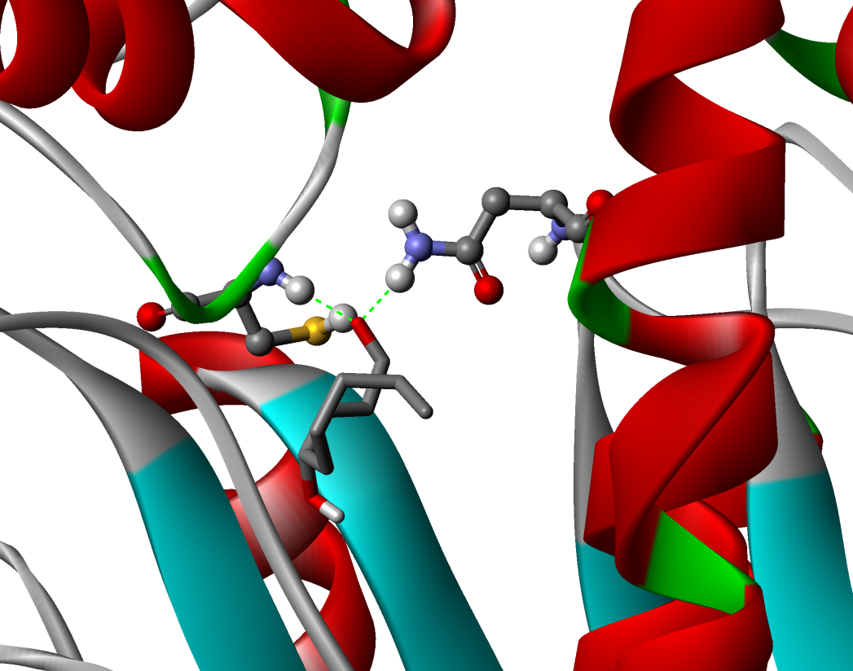
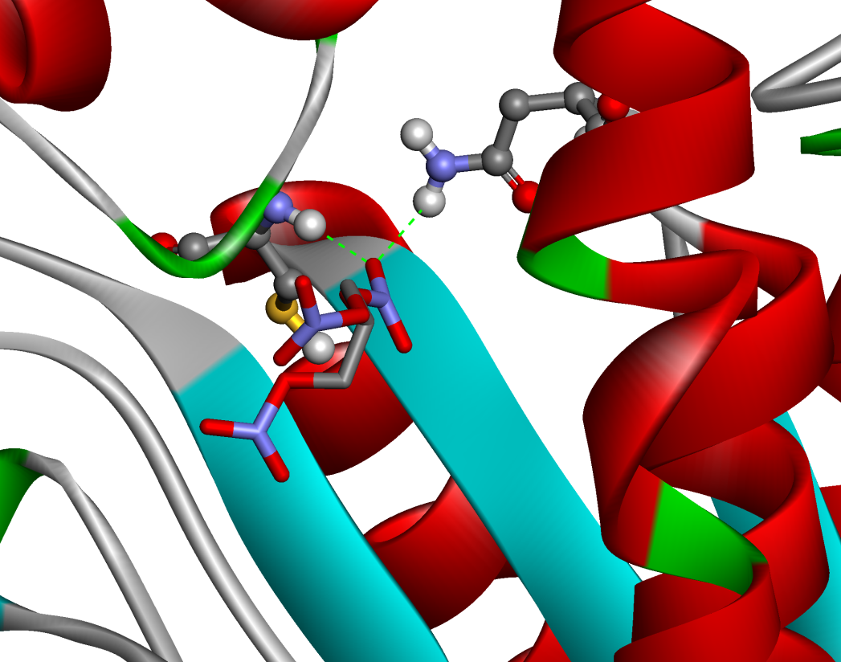
ASN186
Figure S2
ASN186
CYS319
CYS319
propionaldehyde
retinaldehyde
ASN186
ASN186
CYS319
CYS319
nitroglycerin
4-HNE
Notes:
S2

Slide 3
Table S3
Notes:
S3

