Slide 1
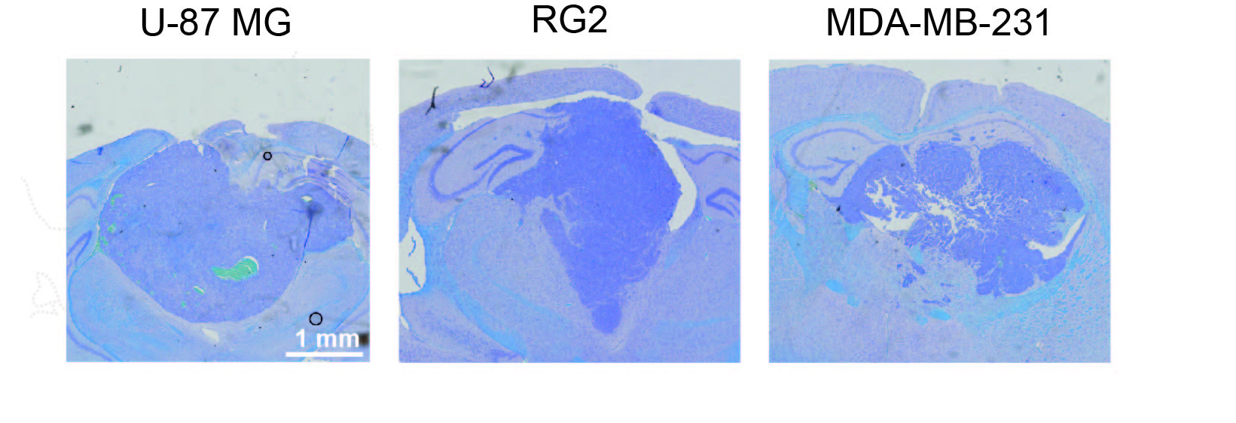
Supplementary Figure S3.

