Slide 1
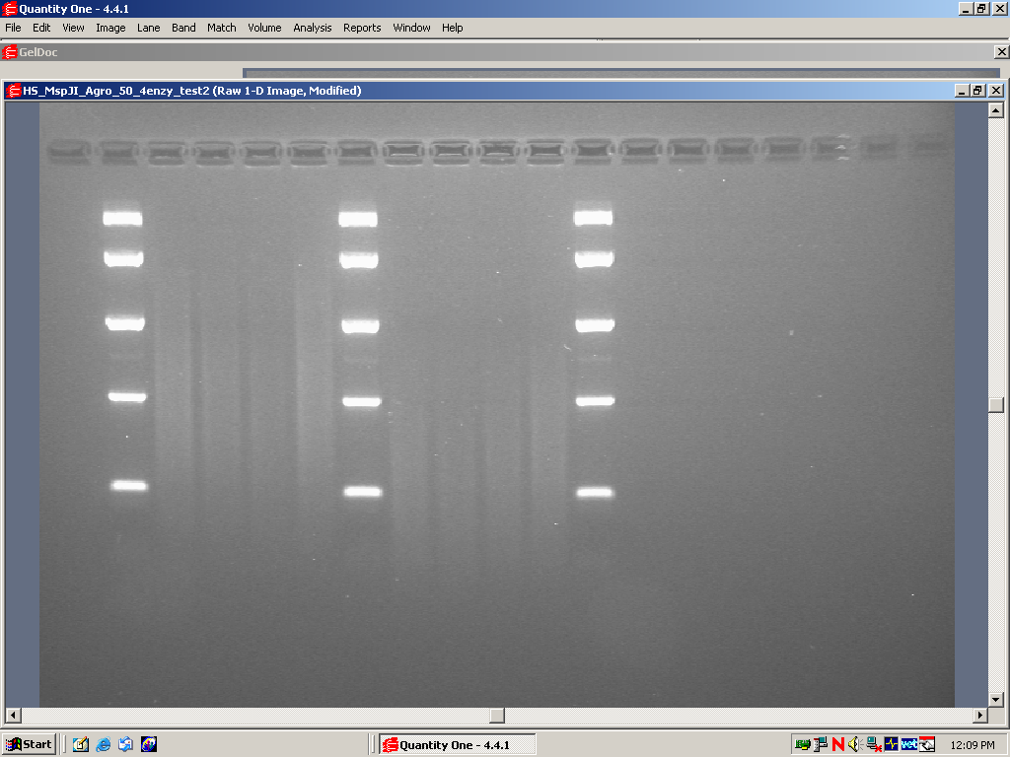
Additional file 2
3 µM
6 µM
MangoTaq
Immolase
Pfu
MangoTaq
Phusion
Immolase
Pfu
Phusion
2 k
1 k
0.5 k
0.25 k
0.1 k

