Slide 1
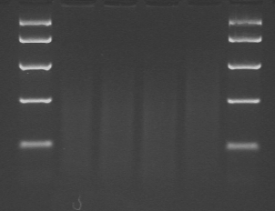
Additional file 3
100 ng
200 ng
500 ng
1000 ng
2 k
1 k
0.5 k
0.25 k
0.1 k

