Slide 1
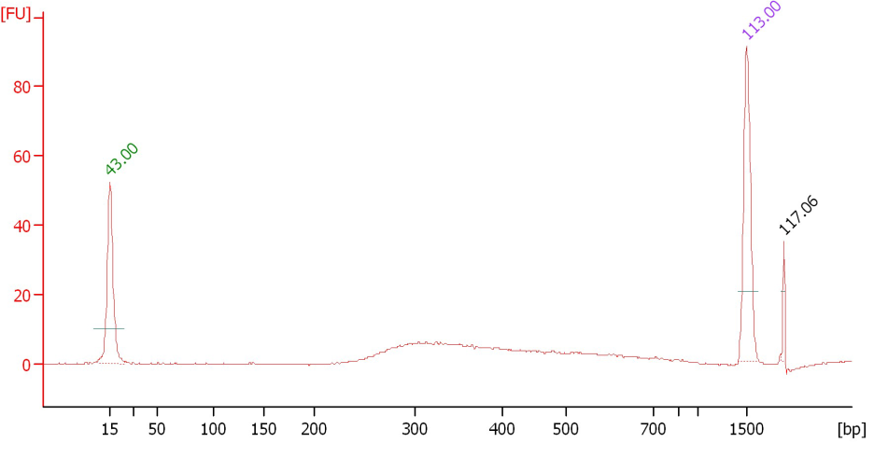
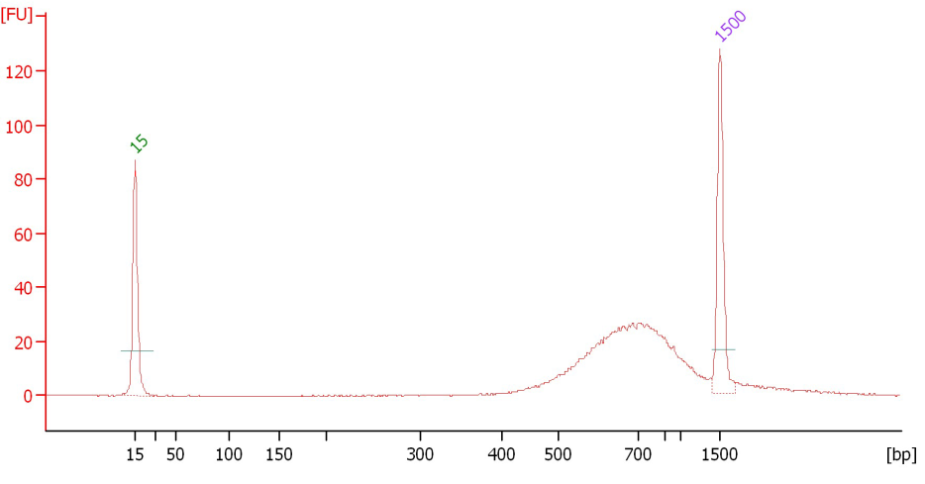
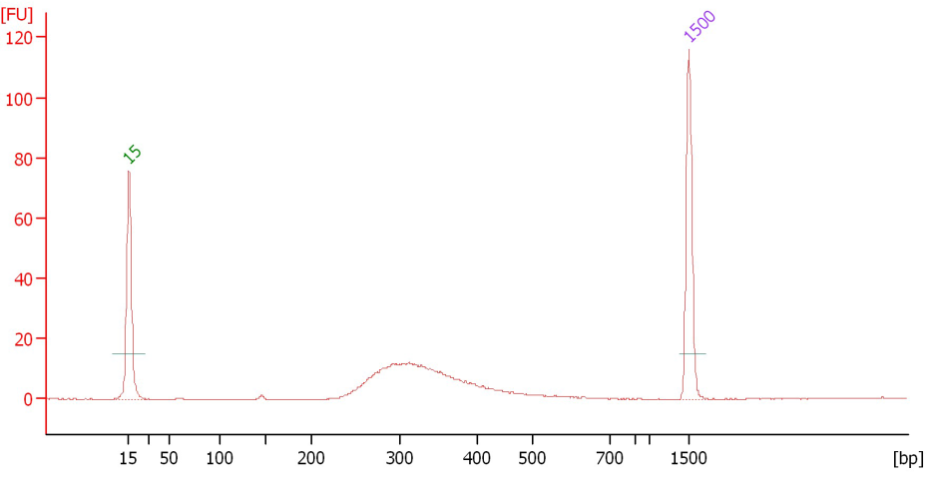
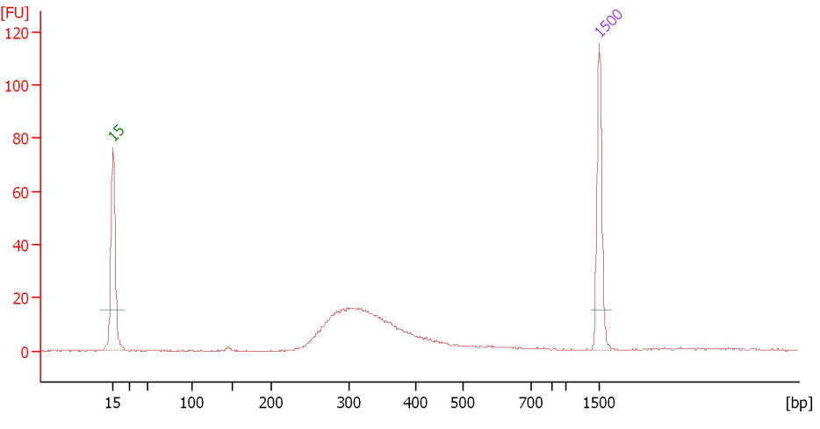
Additional file 4
a) Agro gDNA genome-derived library
b) Arab gDNA genome-derived library
c) BtKIT1-10/MspJI library
d) BtKIT1-10/FspEI library

Slide 2
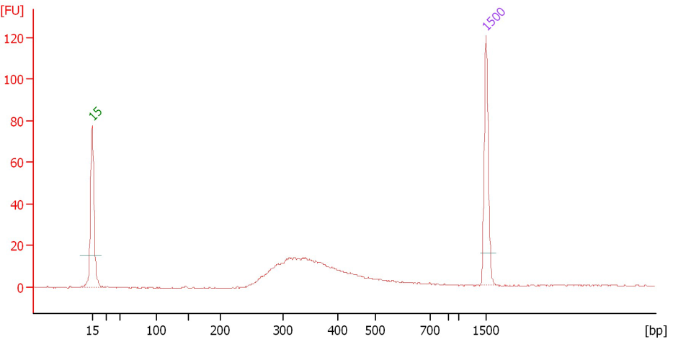
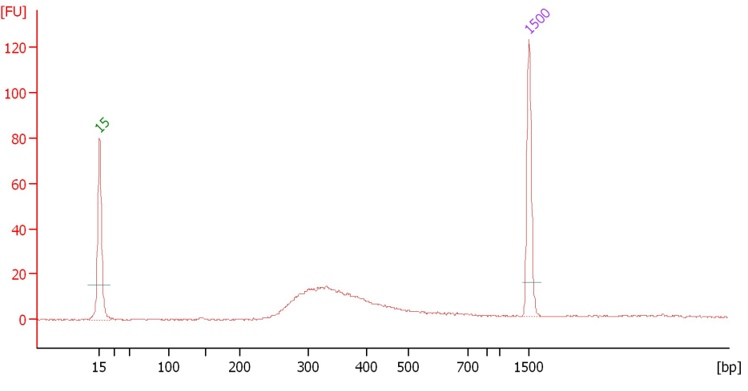
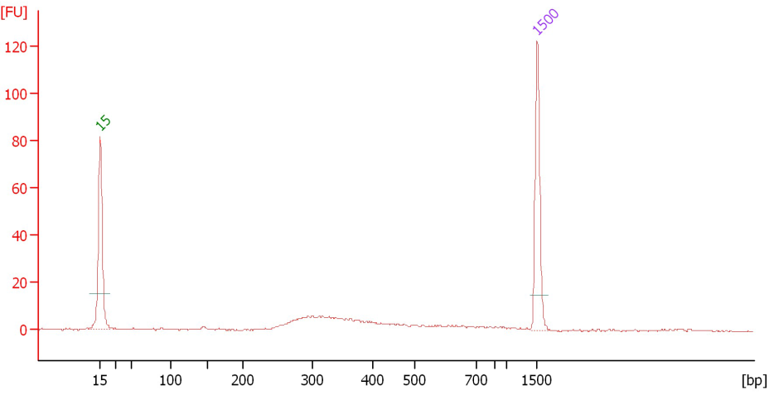
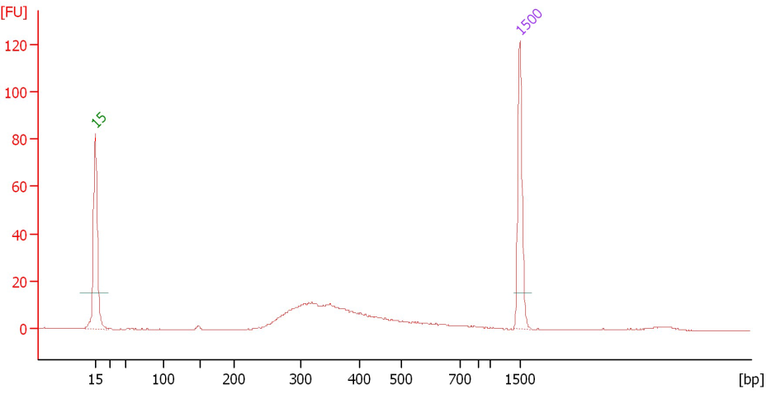
e) BtKIT1-10/LpnPI library
f) BtKIT27-37/MspJI library
g) BtKIT27-37/FspEI library
h) BtKIT27-37/LpnPI library

Slide 3
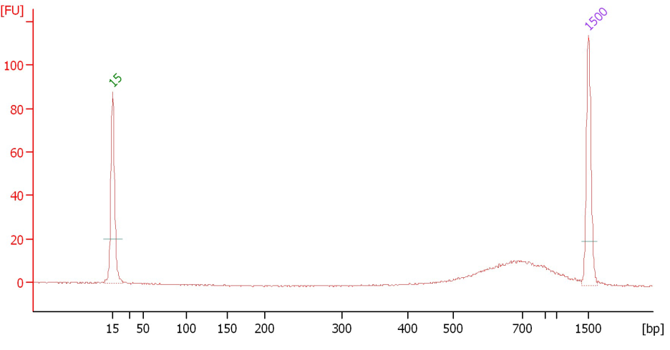
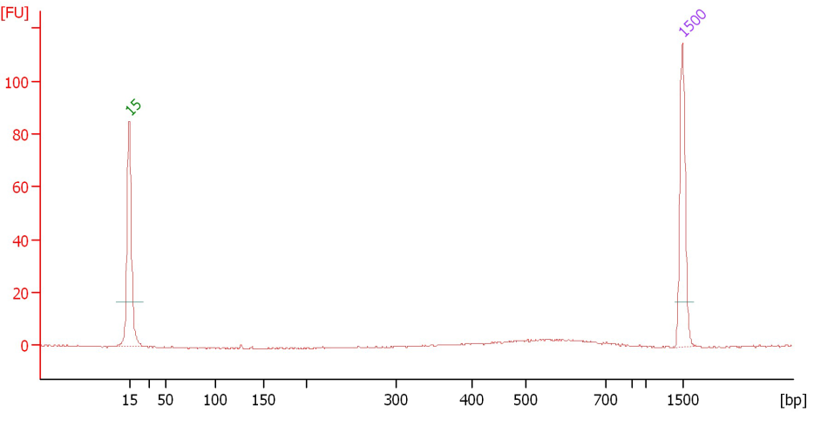
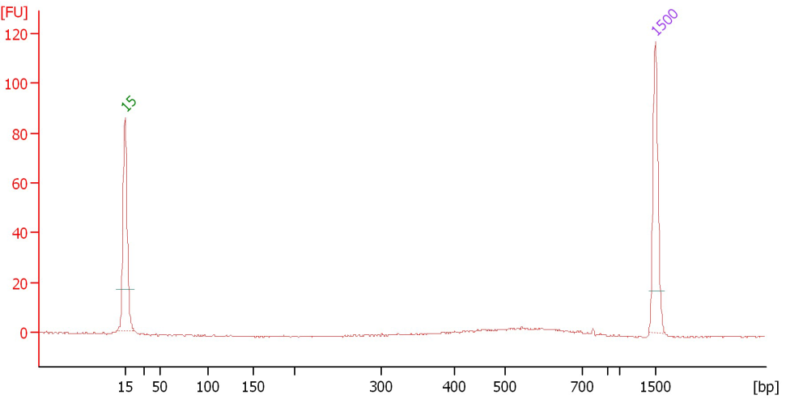
i) Arabidopsis thaliana genome-derived BAC clone library
j) Ryegrass endophyte genome-derived library (rep1)
k) Ryegrass endophyte genome-derived library (rep2)

