Slide 1
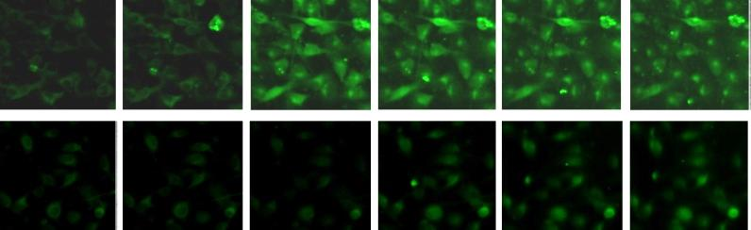
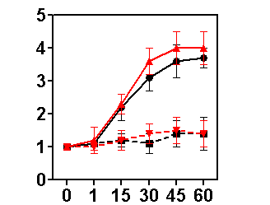
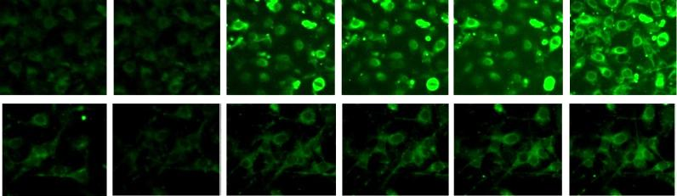
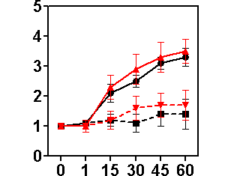
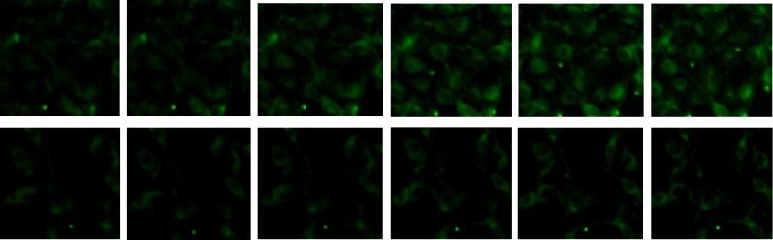
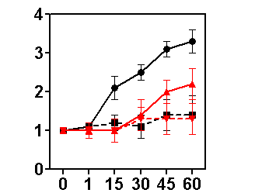
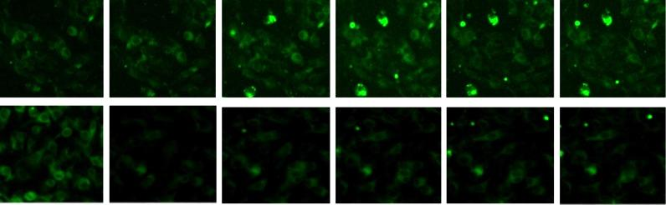
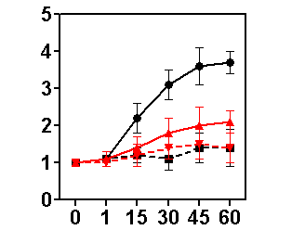
Nifedipine – L-type calcium channel inhibitor
Thomas
Sham
Verapamil – L-type calcium channel inhibitor
Thomas
Sham
Bepridil – T-type calcium channel inhibitor
Relative fluorescence
Thomas
Sham
Mibefradil – T-type calcium channel inhibitor
Thomas
Sham
Background 1 min 15 min 30 min 45 min 60 min

