Slide 1
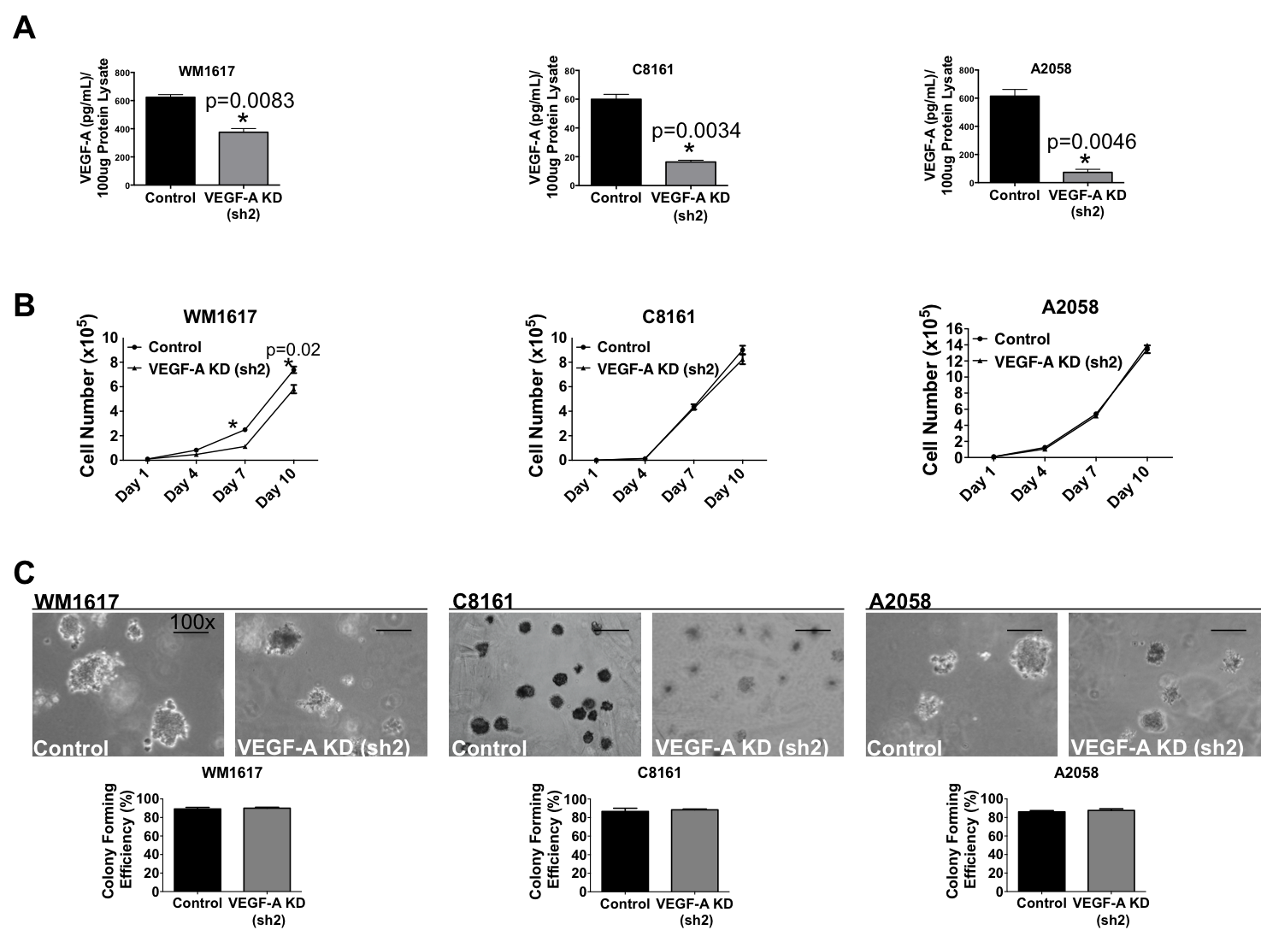
Figure S1. VEGF-A silencing in WM1617, C8161 and A2058 melanoma cells by plasmid-based shRNA (sh2).

