Slide 1
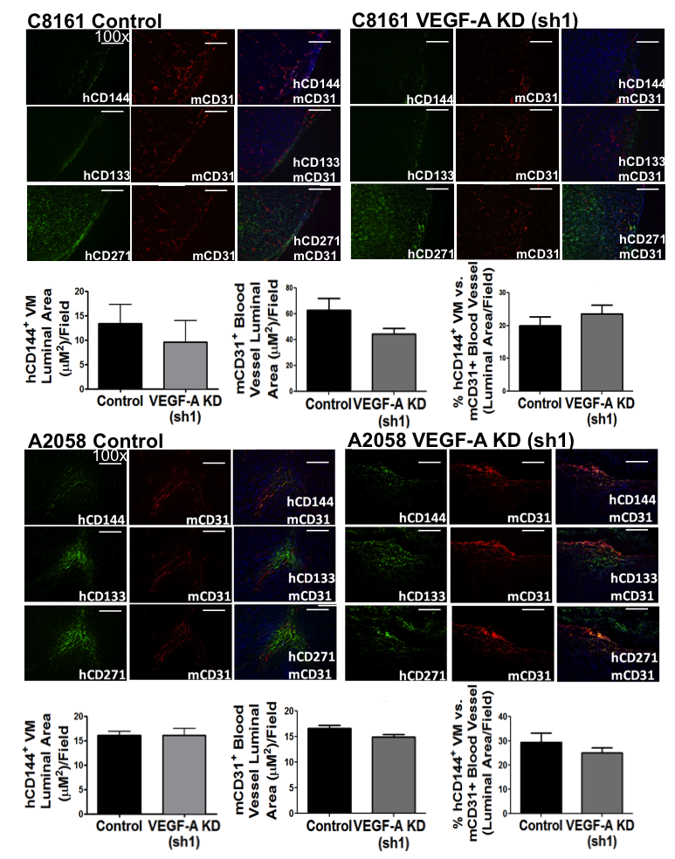
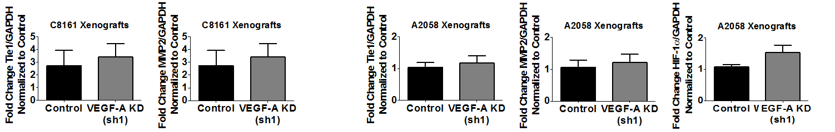
A
B
Figure S3. VEGF-A KD does not modulate VM formation or MSLC subpopulations in C8161 or A2058 melanoma xenografts.

